Slide 1
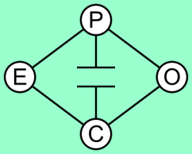
HERBS - Hydro Electric Reservoir Bidding System
Faisal Wahid
Andy Philpott
Anthony Downward
Notes:
Hi Everyone My name is Faisal. I am doing a PhD with Professor Andy Philpott as part of the EPOC research group.
Today I’m here to introduce to you a new model called HERBS that we have been working on for the past few months.

Slide 2
2011 - Graduated in operations research at Engineering Science, University of Auckland
Final year project: Investigating the operational effects of Tekapo A and B asset transfer
2012 - Worked as Trading Analyst for Mighty River Power
Currently pursuing a PhD with Gaspard Monge Program for optimisation and operations research (PGMO) , Meridian Energy and EDF
River Optimisation: short term hydro scheduling under uncertainty
Notes:
I’ve been involved with the New Zealand Electricity Market and in particular river optimisation for the past 3 years.
I graduate from the Engineering Science department in 2011, where my final year project was looking at how the disaggregation of the Waitaki Hydro Scheme would affect it’s management.
I then worked for just over a year with Mighty River Power as a Trading Analyst.
I’m now currently pursing a PhD with PGMO and in partnership with Meridian Energy and EDF.

Slide 3
Acknowledgements
Professor Andy Philpott – EPOC
Dr. Anthony Downward – EPOC
Andrew Kerr – Meridian
Dr. Anes Dallagi – EDF
Professor Frederic Bonnans - INRIA
Notes:
Before I start I would like to give a few recognition to the following people for their support and input in my research thus far.

Slide 4
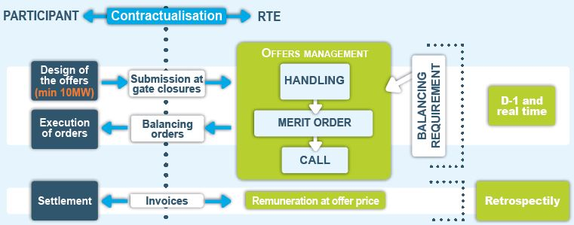
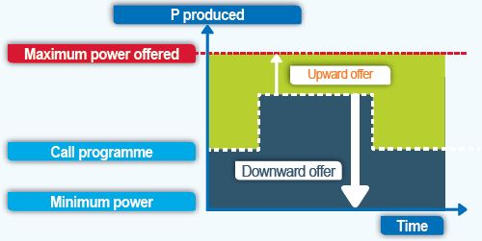
French Balancing Market
Notes:
Source: http://clients.rte-france.com/htm/an/mediatheque/telecharge/balancing_mechanism.pdf
The conception of HERBS has come about working with EDF to provide them with optimisation tools to bid in the French Balancing Market.
The French Balancing market involves:
Producing supply curves around your dispatch quantity and price
Offers are both upward offer, which is the supply curve for extra generation required to meet increasing demand;
And downward offer which is the supply curve for reducing generation required to meet decreasing demand.
The balancing market operates both in a day ahead market or D-1 market and in real time market.
Offers are hourly basis but dispatch set points are half hourly

Slide 5
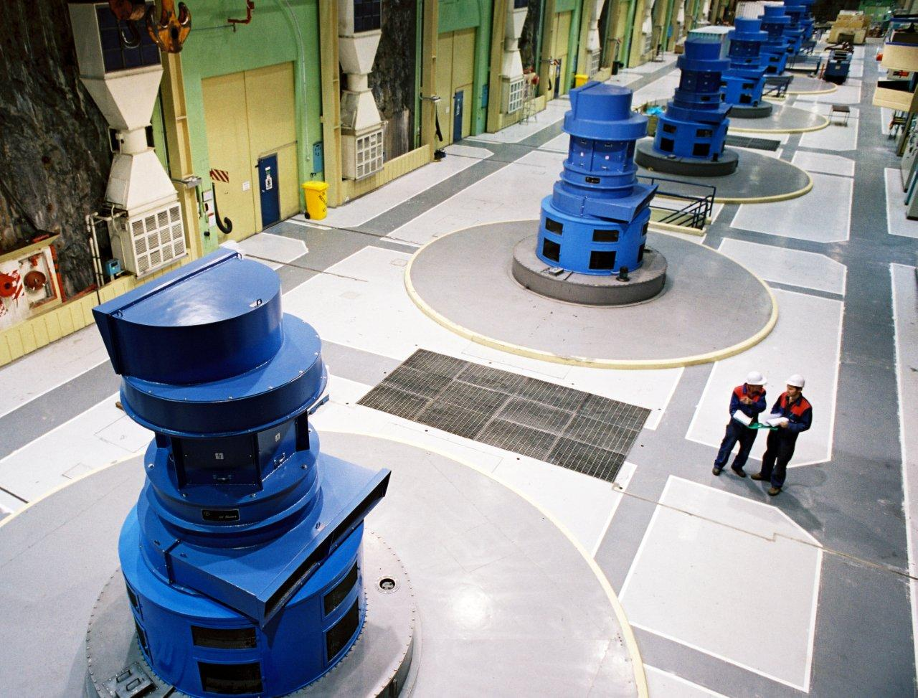
Hydro-bidding
Notes:
Source: http://www.morgo.co.nz/trip-to-manapouri-hosted-by-meridian
Interesting HERBS can also be used in the spot market because much of the mechanics of the balance market are very similar to the NZ spot market.
The reasoning behind that is because it is common practice by energy generation companies to separate out how they participate in electricity market, the trading side, with respect to how they run their stations, the operation side.
For an hydropower producer their operation team are focused on:
Efficient operation of plants to increase their lifespan
Keeping the optimal hydraulic state of the river, while meeting resource consents and dispatch instructions

Slide 6
Notes:
Source: em6live.co.nz
While the trading team focus on:
Keeping the up the competitive edge by producing optimal offer in to the market
Taking into account of future market conditions such as demand, price, and transmission constraints

Slide 7
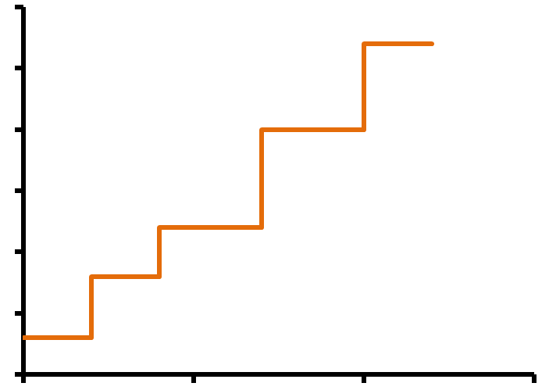
?
Price
Quantity
Notes:
The goals of the traders and operators do vary but it highlights the common pursuit to get the maximum value out of the water they have.
Storage gives the hydroelectric producer great flexibility by:
Allowing them to plan for future hydrological conditions;
and respond to market prices, by timing generation during high prices
This is all carried out by deciding when to hold the water back and when to release
The flexibility makes for optimal supply strategies of hydropower producers extremely important.

Slide 8
Hydro Bidding Problem
Producing optimal supply/offer curves for hydropower producers
Integrates hydropower production and market exchange
Notes:
This leads to the Hydro Bidding Problem, which is about producing optimal supply curves for hydroelectric producers.
It integrates the decision making of hydro power production and market exchange

Slide 9
Presentation Outline
HERBS formulation (single reservoir)
Simple example
Challenges
Opportunities
Discussion
Notes:
The rest of my presentation will follow this format where:
I describe a simple analytical formulation of HERBS for a single reservoir
Use this formulation to solve simple problem and interpret the results
Look at the challenges to HERBS
Look at the opportunities to HEBS
Give you a picture of the future research
And lastly invite you to ask questions and provide your thoughts on HERBS

Slide 10
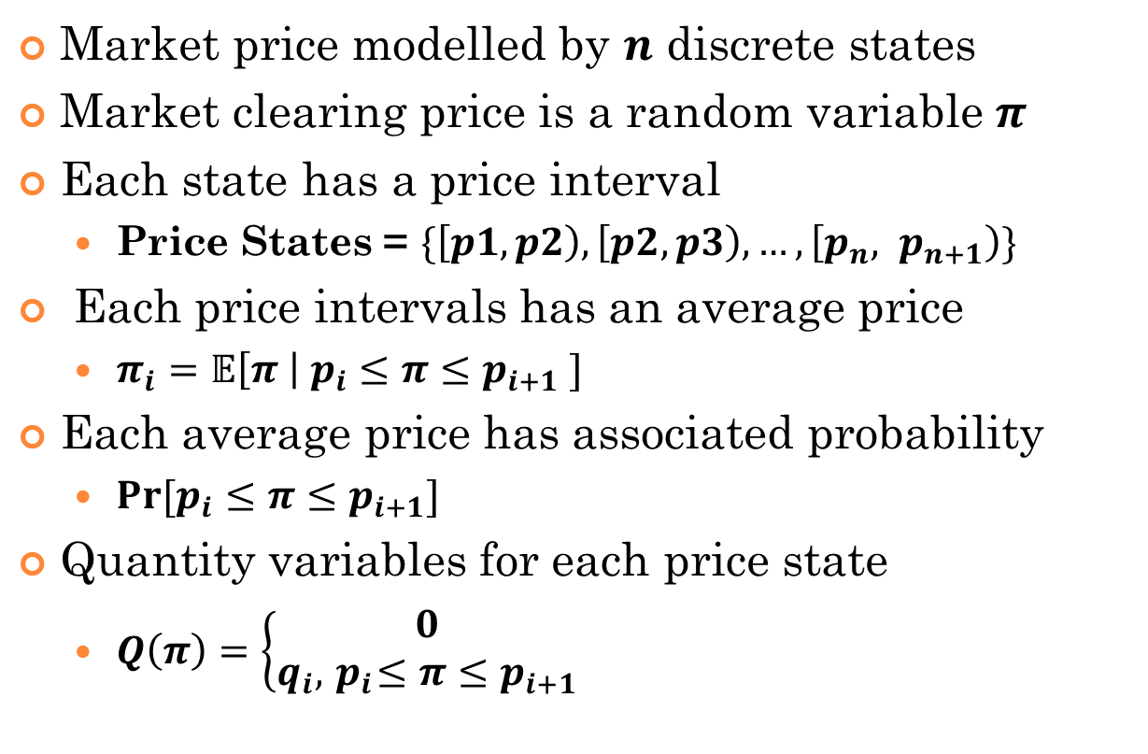
Formulation – Single Stage
Market price modelled by $n$ discrete states
Market clearing price is a random variable $π$
Each state has a price interval
Price States = $\{\left[p1,p2\right), \left[p2,p3\right), …, \left[p_{n}, p_{n+1}\right)\}$
Each price intervals has an average price
$π_{i}=𝔼\left[π \right| p_{i}≤π≤p_{i+1} ]$
Each average price has associated probability
$Pr⁡[p_{i}≤π≤p_{i+1}]$
Quantity variables for each price state
$Q\left(π\right)=\left\{\begin{aligned}0 \\ q_{i}, { p}_{i}≤π≤p_{i+1}\end{aligned}\right.$
Notes:
In HERBS we assume that all the possible market clearing price is modelled by n discrete states
And that one of these prices will be the clearing price pi which is of course a random variable
So for n series of price states, each state is described by a price interval, which indicates that the market clearing price will occur this interval if the market clears at that particular state.
Because Market Clearing Price is a random variable each price intervals will have a conditional distribution.
And so we then take the conditional expectation of the each price interval what would be the market clearing price be on average at between that price interval.
We are also modelling the price as Markov process where the each of the price state has an associated probability
For each price state we have a supply variable which is the quantity offered at that price interval

Slide 11
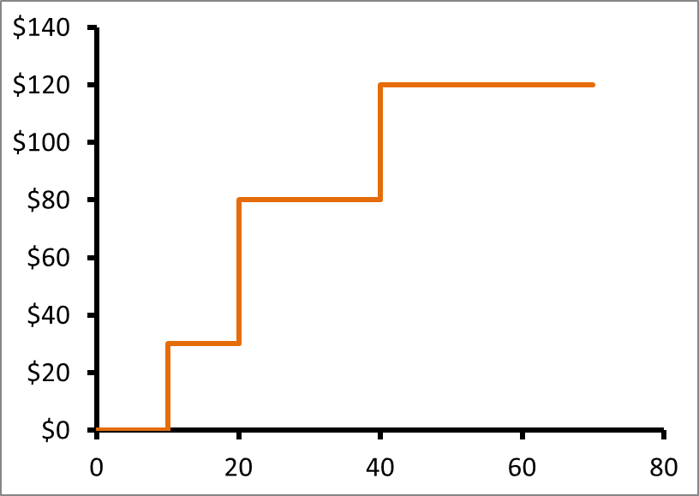
Formulation – Single Stage
Max $𝔼\left[πQ\left(π\right)\right]=\sum_{i=1}^{n}{q_{i}π_{i}Pr⁡[p_{i}≤π≤p_{i+1}]}$
Price
($/MW)
$$π_{3}$$
$$p_{3}$$
$$π_{2}$$
$$p_{2}$$
$$π_{1}$$
$$p_{1}$$
Quantity (MW’s)
$$q_{1}$$
$$≤$$
$$q_{2}$$
$$≤$$
$$q_{3}$$
Notes:
This can be visually represented by a 3 price state supply curve or offer tranches.
Where the pi’s represent average price between each price interval represent and there’s a conditional distribution between these price intervals.
And the q’s are the quantities which at which the energy will be offered.
So you can see that we if we are trying to produce the optimal supply curve which maximises our average of the expected profit;
Which we would simply maximise the sum product of the quantity of energy, average price, and the probability of each price states.

Slide 12
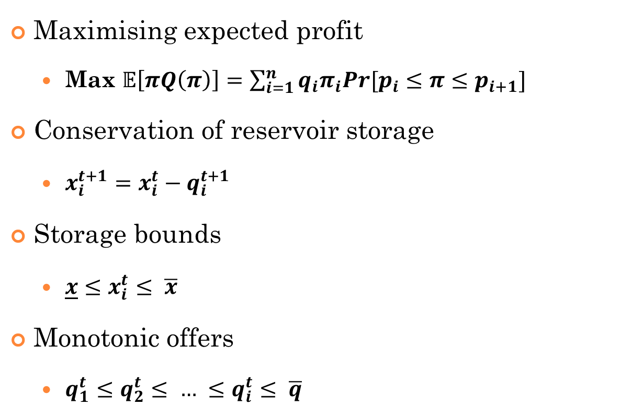
Formulation – Single Stage
Maximising expected profit
Max $𝔼\left[πQ\left(π\right)\right]=\sum_{i=1}^{n}{q_{i}π_{i}Pr[p_{i}≤π≤p_{i+1}]}$
Conservation of reservoir storage
$x_{i}^{t+1}=x_{i}^{t}−q_{i}^{t+1}$
Storage bounds
$\underline{x}≤x_{i}^{t}≤ \overline{x}$
Monotonic offers
$q_{1}^{t}≤q_{2}^{t}≤ … ≤q_{i}^{t}≤ \overline{q}$
Notes:
So that become our objective as you above.
But the supply curves that we produce impacts the state of our river chains;
And so you we need to include the constraints to model the hydrology of the river;
These are constraints such as the conservation of reservoir storage and storage bounds
We also need to add an explicit constraint which produces monotonic offers quantities

Slide 13
Formulation – Two Stage
Stage 0
Stage 1
Stage 2
1
1
$$x_{1}^{2}=x_{1}^{1}−q_{1}^{2}$$
0
$$x_{1}^{1}=x^{0}−q_{1}^{1}$$
$$Q_{2}(π)$$
2
$$x^{0}$$
$$Q_{1}(π)$$
2
$$x_{2}^{2}=x_{2}^{1}−q_{2}^{2}$$
$$x_{2}^{1}=x^{0}−q_{2}^{1}$$
3
3
$$x_{3}^{2}=x_{3}^{1}−q_{3}^{2}$$
$$x_{3}^{1}=x^{0}−q_{3}^{1}$$
Notes:
So we can apply this formulation to a two stage problem and represent the spectrum of price states in the two stages through a scenario tree.
Each of the nodes represent a clearing price state with the zero being pre-determined initial price.
As you travel down the tree the future becomes the reality as one of the price states become the clearing price.
You are dispatched to generate the quantity you offered for that price state.
This in turn affects how much water you will use now and will have in the future for generation.
Solving this model within this scenario tree will give you a policy or strategy for supplying the energy you have.
This model can be extended to river chains by adding the network flow constraints and treating each quantity offered as block dispatch.
So when you are dispatched a particular price state you have to manage the hydraulic state of the river to meet the block dispatch.

Slide 14
Formulation –Balance Market
Stage 0
Stage 1
Stage 2
1
1
$$x_{1}^{2}=x_{1}^{1}−q_{1}^{2}$$
0
$$x_{1}^{1}=x^{0}−q_{1}^{1}$$
$$Q_{2}(π)$$
2
$$x^{0}$$
$$Q_{1}(π)$$
2
$$x_{2}^{2}=x_{2}^{1}−q_{a}^{2}$$
$$x_{2}^{1}=x^{0}−q_{a}^{1}$$
3
3
$$x_{3}^{2}=x_{3}^{1}−q_{3}^{2}$$
$$x_{3}^{1}=x^{0}−q_{3}^{1}$$
Notes:
This model can also be extended to the balancing market by choosing the central node to be the dispatch quantity, which is a parameter at the scheduled market price.
So therefore you optimise your upward and downward offers surrounding your scheduled dispatch and forecasted market price.

Slide 15
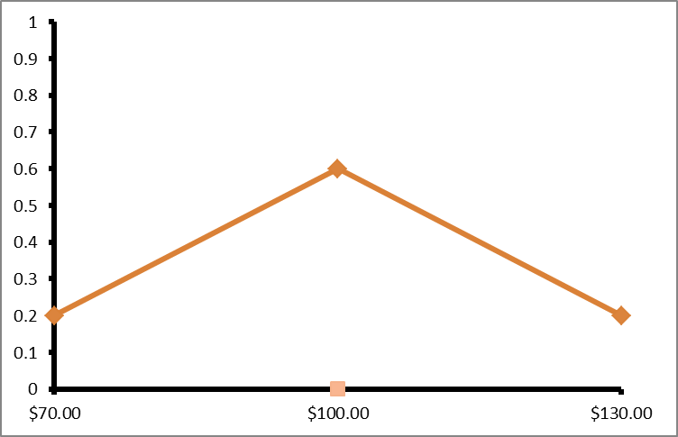
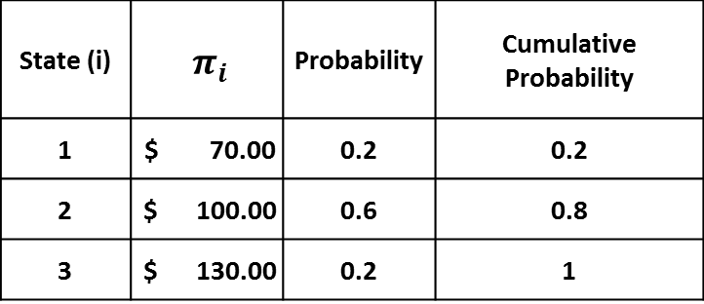
Example #1
State (i) | $π_{i}$ | Probability | Cumulative Probability
1 | $ 70.00 | 0.2 | 0.2
2 | $ 100.00 | 0.6 | 0.8
3 | $ 130.00 | 0.2 | 1
Stage 0 | Stage 1 | Stage 2
0 | 30 | 70
 |  | 70
 |  | 70
 | 70 | 30
 |  | 30
 |  | 30
 | 70 | 30
 |  | 30
 |  | 30
$$\overline{π}=\$100$$
$$x_{0}=100$$
$$\overline{q}=70$$
Notes:
We can run this model with a simple 2 stage 3 prices state scenario tree with stage wise independence
The river chain parameter is that there is 100 MW’s worth of energy storage available and a generation capacity of 70 MW’s at any stage.
The top left table summarised the price states, with the graph below illustrating the pdf of the price states.
We can that the distribution of the prices states is symmetrical.
The top right table is the optimal offer strategy. Not that stage 0 is fixed and with the initial storage to be 100 MW’s worth energy production
At stage 1 the strategy producing one offer curve, but at stage 2 the strategy produces 3 offer curves, where each reflects the 9 price state outcomes.
You can see from the strategy that the offer at stage 1 illustrates the reservoir to offer majority of it’s generation capacity to the mid price state. The strategy is quite simple where you essentially withhold water at stage 1 by offering at the higher price tranches in the hopes of clearing at those high prices. Then at the second stage you simply offer your remaining capacity at the lowest price tranche in order to secure a payout.
[Compare with average price dispatch – (50,50) obj vs HERBS obj]

Slide 16
Comparison with evp
EVP
HERBS
Stage 0 | Stage 1 | Stage 2
0 | 50 | 50
 |  | 50
 |  | 50
 | 50 | 50
 |  | 50
 |  | 50
 | 50 | 50
 |  | 50
 |  | 50
Stage 0 | Stage 1 | Stage 2
0 | 30 | 70
 |  | 70
 |  | 70
 | 70 | 30
 |  | 30
 |  | 30
 | 70 | 30
 |  | 30
 |  | 30
Max $𝔼\left[πQ\left(π\right)\right]=\$10,000$
Max $𝔼\left[πQ\left(π\right)\right]=\$10,240$
Notes:
Getting policies such as previously shown is great but are they adding value?
One way we can compare this by solving the Expected Value Problem
This is simply optimising how much to offer at each stage based on the average across the price states
Because we made the assumption of stage wise independence, there’s a range of solutions for the Expected Value Problem.
All of which will produce the objective of $10,000
But by being smart and with holding water. You can increase you pay off by $240

Slide 17
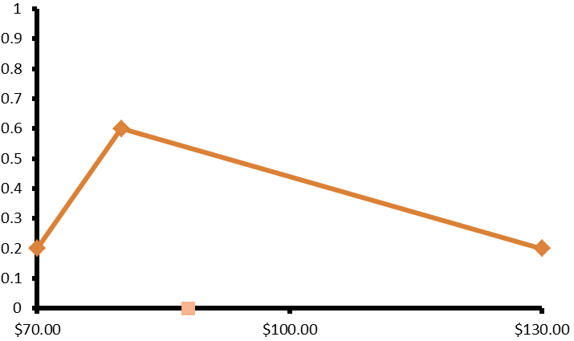
Example #2
State (i) | $π_{i}$ | Probability | Cumulative Probability
1 | $ 70.00 | 0.2 | 0.2
2 | $ 80.00 | 0.6 | 0.8
3 | $ 130.00 | 0.2 | 1
Stage 0 | Stage 1 | Stage 2
0 | 30 | 70
 |  | 70
 |  | 70
 | 30 | 70
 |  | 70
 |  | 70
 | 70 | 30
 |  | 30
 |  | 30
$$\overline{π}=\$88$$
$$x_{0}=100$$
$$\overline{q}=70$$
Notes:
What is more interesting about HERBS is that we can different types of strategies emerging under different parameters
For example if we right skew the probability distribution to the right then we can see that the optimal offer strategy changes for the first stage;
Where now majority of the energy is offered at the maximum price state. This is because there is now greater marginal benefit to be gained from offering at the high price state.
The second stage strategy remains the same as the remaining energy is offered at the lowest price state.
[Compare with average price dispatch – (50,50) obj vs HERBS obj]
[Compare with the previous solution]

Slide 18
Challenges
Curse of dimensionality
Simulating stochastic prices
Implementing large river chains
Solution integrity
Notes:
This example of HERBS is simple but scaling this model to reflect a realistic set of price states over say 48 trading periods, you can immediately see immediately see the scenario tree blowing up. Therefore we need to apply to better techniques to solve HERBS.
Producing the price states are going to be very complex. We assumed stage wise independence in the example but obviously that is an unrealistic assumption. So how do we produce scenarios that reflect the intrinsic nature of prices. We also have to take into account how other factors such as wind generation can affect the price.
Adding a full River Chain Network could affect the offer strategies considerably. Especially if you consider the time delays between water travelling from upstream reservoir to a downstream reservoir and the flexibility of spilling
There is a risk that the offers produced are essentially the same as EVP offers. Will we necessarily see similar types of behaviour we saw in the example when you increase the state space? Will HERBS really value offering quantity between adjacent states that much?
For example you could see that HERBS offers majority of the energy at the lowest tranche, where the price might be $50 and at the tranche where the price is likely to be say $1000. HERBS doesn’t really differentiate any value among the middle states.

Slide 19
Opportunities
Effects of gate closures
Unintuitive offer strategies
Outer approximation (i.e. SDDP, DOASA)
Stochastic dynamic programming
Notes:
However the glass isn’t half empty and there are opportunities for the use of models like HERBS to gain a deeper insight into trading strategies for hydro power producers.
This current version of the model can easily be altered to investigate the affects of gate closures and look at how it would affect the offer strategies with different gate closure times.
We can also compare real time offer strategies from HERBS with that of a day ahead market.
There’s also opportunities for us to investigate spilling affects on offers. Are there situations or scenarios under which spilling might be beneficial for hydro power producer. If so what are they and how often would they occur.
The current formulation of the problem naturally lends itself to use of Outer Approximation techniques such as Stochastic Dual Dynamic Programming or Stochastic Dynamic Programming algorithms to solve larger instances of the model.
We are still in the frontiers of HERBS, which is exciting time.

Slide 20
Thank You
Questions?
Notes:
Source: http://www.jasonlove.com/cartoons/00381-daily-cartoons-beaver-dam.gif
Thank you for the listening I hope you have found my talk enjoyable
Are there any questions?

