Slide 1
Using DOASA to investigate recent trends in the NZ electricity market’s management of dry years
Presented to EPOC Winter Workshop
July 2014

Slide 2
Motivation
2009 Ministerial Review
Electricity Industry Act 2010
To examine impact of measures on management of dry years
We studied 2008, 2012 and 2013

Slide 3
Measures undertaken
Sale of Whirinaki
Reserve energy scheme abolished
Customer Compensation Scheme
Scarcity pricing
Stress testing
Physical asset swaps between SOEs
Virtual asset swaps between SOEs
Electricity futures market

Slide 4
DOASA
Variant of the SDDP algorithm
Aims to optimise the scheduling of hydro and thermal generation resources in the face of uncertain future inflows
Developed by Stochastic Optimization Limited
A version is available as part of the Authority's suite of EMI tools

Slide 5
Stagewise dependence of inflows (1)
Physical inflows exhibit stagewise dependence
Inflows in one period partly depend on inflows in earlier periods
Important in order to correctly account for the probability of dry (and wet) sequences

Slide 6
Stagewise dependence of inflows (2)
Some SDDP implementations use linear Periodic Autoregressive (PAR) models to represent stagewise dependence
DOASA approximates this by artificially spreading (increasing variance of) inflows
Dependent Inflow Adjustment (DIA) feature automatically spreads inflows for each catchment consistent with accumulation over a specified number of weeks

Slide 7
Water Values
DOASA yields marginal water values for each hydro storage reservoir
Function of reservoir storage and date
Represent the expected value of holding back a unit of water for release in some future period
And hence the opportunity cost of instead releasing that unit of water now
Balance risk of spill and running out of water

Slide 8
Two approaches used
Compare the water values implied by actual reservoir levels (under various hydro policies) with the prices that actually occurred
Simulate operation with actual inflows (under various hydro policies) and compare simulated reservoir levels with the levels that actually occurred

Slide 9
Implied water values approach
Water values depend on model inputs (thermal prices and shortage prices)
Somewhat subjective
Tuning factors required to match market prices
We chose to scale the demand
Manually spread inflows – 2x
Observed trends are interesting

Slide 10
Simulated reservoir levels approach
Depend more on relativity between water values and thermal/shortage prices
Actual prices less important
Less dependent on market dynamics
More objective
Model risk aversion by adding one or more fictitious dry years when creating policies
DIA accumulation over 4 weeks

Slide 11
Implied water values

Slide 12
Water values vs spot price 2008: Spreading factor 2; 110% Demand

Slide 13
SI water values vs SI storage 2008: Spreading factor 2; 110% Demand

Slide 14
Water values vs spot price 2012: Spreading factor 2; 120% Demand

Slide 15
SI water values vs SI storage 2012: Spreading factor 2; 120% Demand

Slide 16
Water values vs spot price 2013: Spreading factor 2; 120% Demand

Slide 17
SI water values vs SI storage 2013: Spreading factor 2; 120% Demand

Slide 18
Best fit
2008 – 110% demand
2012 & 2013 – 120% demand
Implies market was more risk averse in 2012 and 2013 than in 2008

Slide 19
Other observations
Spot prices move ahead of the movement in model water values
Market is anticipating movements in storage to some extent
Better information than the model?
Partly due to stagewise dependence?

Slide 20
Simulated reservoir levels

Slide 21
Simulation results 2008: One fictitious dry year policy

Slide 22
Simulation results 2008: Three fictitious dry year policy

Slide 23
Simulation results 2012: One fictitious dry year policy

Slide 24
Simulation results 2012: Three fictitious dry year policy

Slide 25
Simulation results 2013: One fictitious dry year policy

Slide 26
Simulation results 2013: Three fictitious dry year policy

Slide 27
Closest match (Total NZ storage)
2008 – One fictitious dry year policy
2012 & 2013 – Three fictitious dry year policy
Again implies market was more risk averse in 2012 and 2013 than in 2008

Slide 28
Other observations
Individual reservoir levels depart from the simulated levels much more than the aggregated level …

Slide 29
Lake Pukaki and Lake Tekapo (1)
Lake Pukaki and Lake Tekapo in 2008
Both lakes controlled by Meridian
Actual levels quite similar
SPECTRA? - lumped island reservoirs
Heuristic to split out reservoir policies
Model runs Lake Tekapo almost empty!
Tekapo directly supplies 185MW of plant
Pukaki directly supplies 1550MW of plant

Slide 30
Lake Pukaki and Lake Tekapo (2)
Similar pattern in 2012
After Tekapo stations sold to Genesis
Not so obvious in 2013
Disrupted by canal outages?

Slide 31
Lake Hawea
2008 - Lake Hawea drawn down rapidly
Almost empty through July – August
Contact under-hedged?
2012 – lower inflows April through August
Yet more gradual draw down
Contact better positioned?
Model holds Hawea high (valuable)
Only 13% of Clutha inflows are controllable
Compare: Waitaki 70%; Waikato 77%

Slide 32
Lakes Manapouri/Te Anau
Model runs lakes lower than in reality
Operating rules allow temporary excursions above main operating range
Model has hard limit at top of main operating range
Hence model overstates risk of spill
Should model a higher limit to better approximate the rules

Slide 33
Some questions
Management of individual reservoirs under the market deviates markedly from DOASA’s supposedly optimal strategy
Does this imply a loss of welfare?
How material is it?
Would a greater range of hedge products better align individual company incentives with total welfare maximisation?
What sort of products?

Slide 34
How much risk aversion is “optimal”?
Theoretically a risk neutral policy has the lowest expected cost
This should be the case over a very large number of Monte Carlo simulations (with inflow spreading)
This approximates the population the policy is optimised for
But …

Slide 35
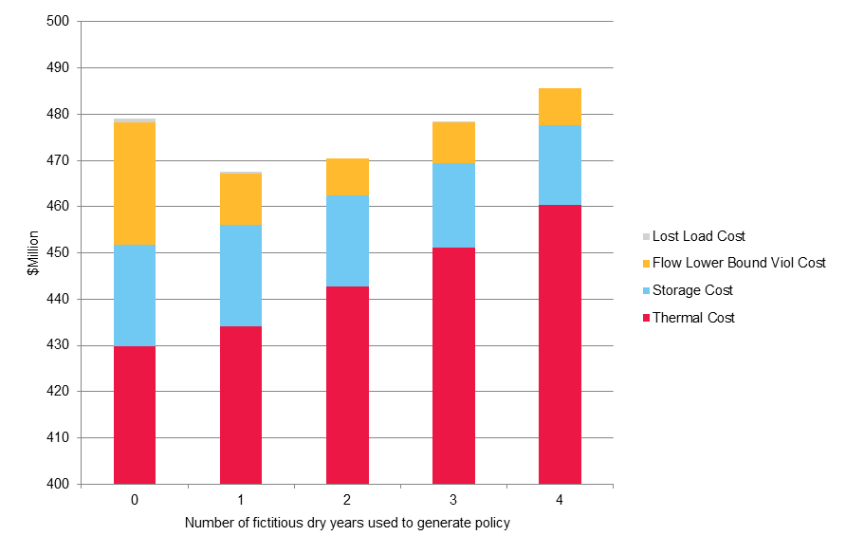
Expected cost of 2008 policies 400 Monte Carlo simulations

Slide 36
Why did risk neutral policy not minimise cost?
Algorithm was terminated after 300 iterations so not completely converged?
400 Monte Carlo simulations - not a large enough statistical sample to approximate the entire population?

Slide 37
What about historical simulations?

Slide 38
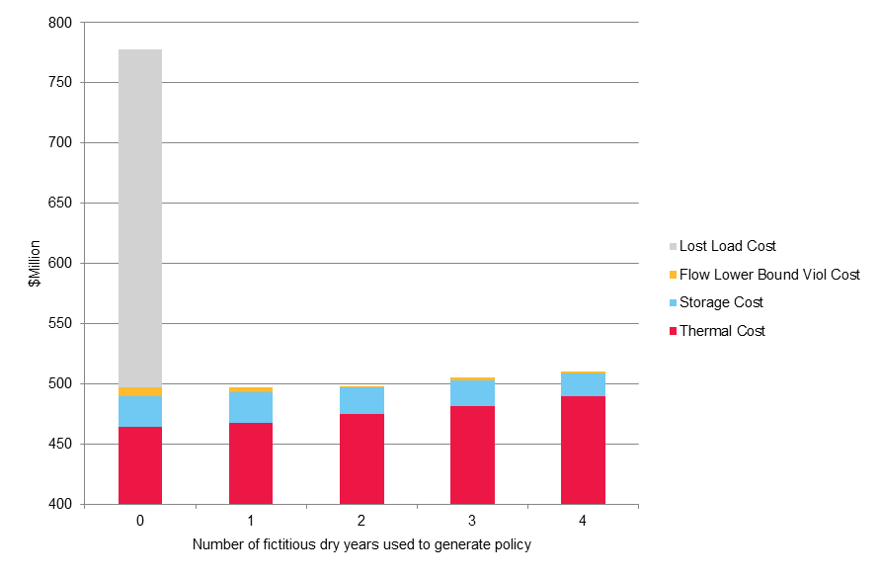
Expected cost of 2008 policies Historical simulations

Slide 39
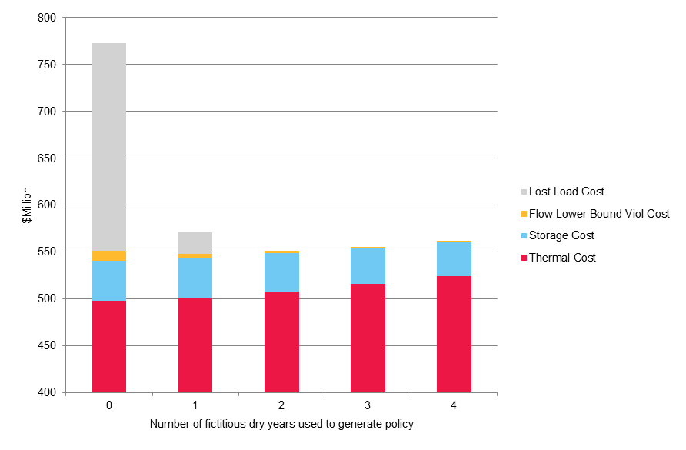
Expected cost of 2012 policies Historical simulations

Slide 40
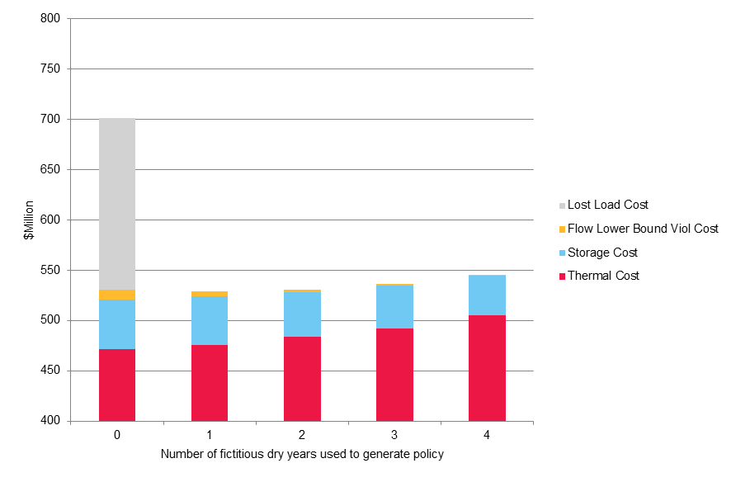
Expected cost of 2013 policies Historical simulations

Slide 41
Observations
Even “worse” than Monte Carlo
Significant load shedding cost for risk neutral policy
Risk neutral policy clearly not optimal

Slide 42
Why?
Inflow spreading technique not adequately accounting for risk of extended dry sequences?
82 historical inflow sequences only a small sample of entire population
Reduced set of 20 historical inflow years used to generate policies did not adequately capture some of the driest historical sequences in full 82 year set?

Slide 43
So how much risk aversion is “optimal”?
2008 & 2013 – load shedding avoided and cost minimised for one fictitious dry year policy
2012 – load shedding avoided and cost minimised for two fictitious dry year policy
But 2012 & 2013 simulations look like a three fictitious dry year policy (best match)
Implication: market might be overly risk averse now?

Slide 44
Conclusions
Market appears significantly more risk averse since Authority’s security of supply measures
Market managed 2012 and 2013 dry year events more effectively than in 2008
Maybe industry as a whole is now treating hydro risk a little too conservatively?
Management of individual hydro reservoirs appears to deviate significantly from welfare maximising strategy
Perhaps new hedge products would help this

Slide 45
Questions … ?

