Slide 1
Day-Ahead Bidding for Hydropower considering Price and Inflow Uncertainty
Ellen Krohn Aasgård
Norwegian University of Science and Technology
EPOC Winter Workshop
September 7, 2016

Slide 2
Outline of talk
Hydropower in the Nordic markets
The specifics of the day-ahead bidding problem
How does inflow uncertainty affect the bids?
Results from a case study
Summary and conclusions

Slide 3

Nordic hydropower
Hydropower accounts for about 50 % of total Nordic generation capacity
About 50 GW installed capacity, of which 30 GW is located in Norway
Large variety of river chain topologies: often smaller reservoirs, but high head
Lots of rain and snow!

Slide 4

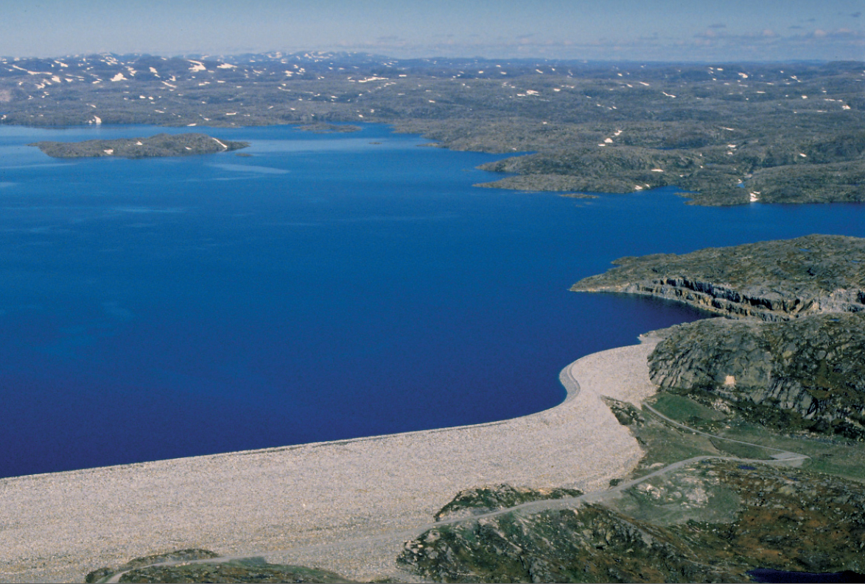
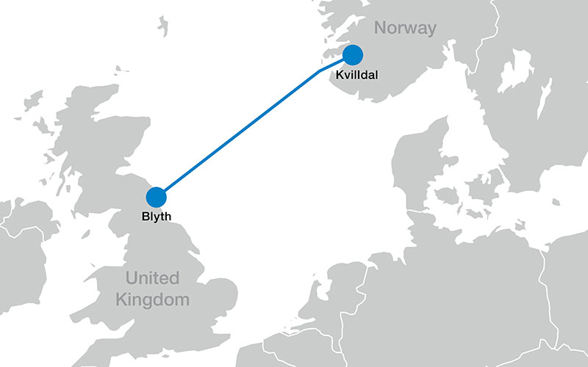
Norwegian hydropower
Norway's "most beautiful power plant", Tyssedal.
Norway's largest reservoir, Blåsjø, with 7.8 TWh storage capacity, 1000 mas
Interconnector between Norway's largest power plant (Kvildal, 1240 MW) and the UK. Scheduled to be online in 2021.
Notes:
North sea link

Slide 5
Trading at Nord Pool
Deregulation during the 1990s
Integration to a common Nordic market operated by Nord Pool – "Power without borders"
Trading of physical power in day-ahead, intra-day and regulating reserves markets

Slide 6
Trading at Nord Pool

Slide 7
Market concentration
NordREG: organization for Nordic energy market regulators
"A well-functioning Nordic wholesale market with competitive prices"
360 participants in the day-ahead market

Slide 8
Market concentration
Survey from 2009: "…find no evidence of systematic exploitation of system level market power on Nord Pool. Local market power arising from transmission constraints seems to be more problematic in some price areas across the Nordic countries. "

Slide 9
Other markets and products
NASDAQ OMX Commodities Europe runs the financial energy market
National markets for ancillary services were the TSO is the single buyer
Three types of reserve
- Frequency Containment Reserves (spinning)
- Frequency Restoration Reserves (spinning)
- Regulation Reserves

Slide 10
Markets for reserves
Spinning reserves
- "Week-ahead" market to cover expected demand. Daily market (after energy day-ahead market) to cover residuals
Regulation Reserves (non-spinning)
-Weekly and seasonal common Nordic market + special Norwegian seasonal market during winter
- Volume traded is about 4 TWh/year

Slide 11
Future challenges
Nord Pool Annual Report 2015:
"The biggest issue facing the power sector is to efficiently manage what is becoming an increasingly complex marketplace"
Interconnections between areas and countries
Variety of products: energy, capacity, different time periods
Uncertainty due to larger shares of renewables

Slide 12
Day-ahead bidding problem for hydropower

Slide 13
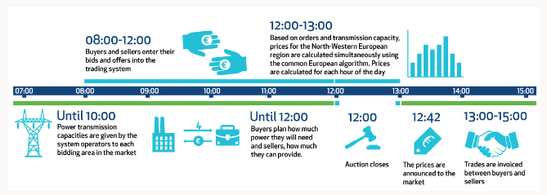
Time line for day-ahead market

Slide 14
The day-ahead bidding problem
12-36 hours before operation: Submit a set of offer curves for each 1-hour trading period of the coming day
Dispatch is dependent on the price realization, so for every bid we need to have a feasible production schedule
Production may be adjusted in the intraday market, but liquidity is much lower which means it might be costly

Slide 15
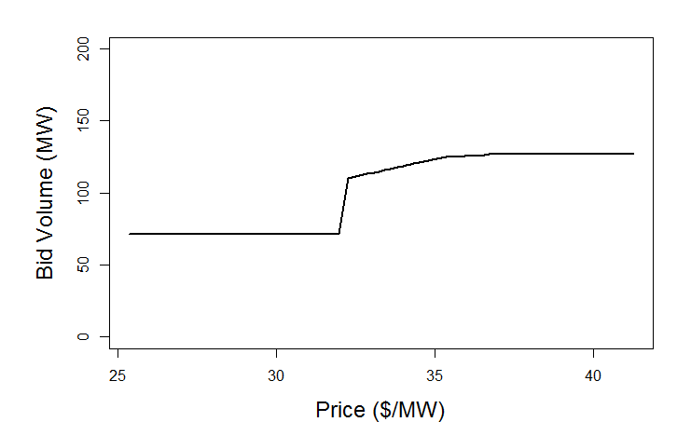
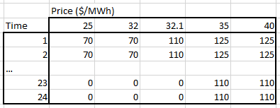
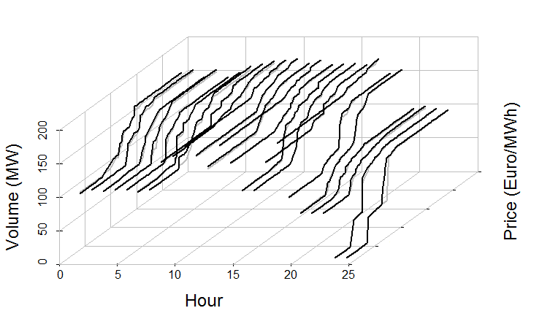
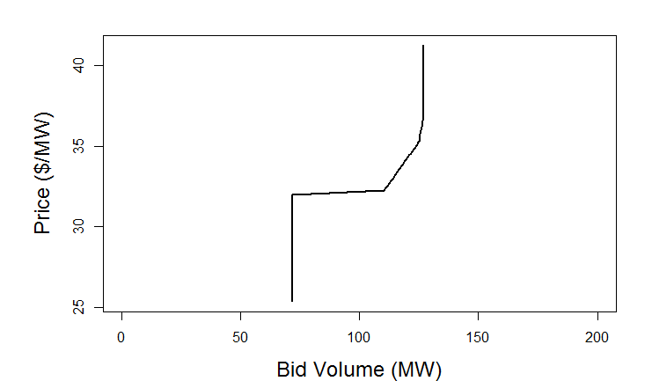
Definitions
Bid Curve for 1 hour
Bid Matrix
This is really the same thing!
Bid Curve for all hours
Marginal Cost Curve for 1 hour

Slide 16
The day-ahead bidding problem
Price-taker: Bid according to marginal cost
Inflow is a "free" resource and only has a cost due to its limited availability → marginal cost = opportunity cost
Investigate how the opportunity cost may be affected by daily uncertainty in inflow

Slide 17
Daily uncertainty in inflow
Local inflow is most often considered deterministic in the short-term, which might be ok
For small, head-dependent reservoirs where variation in inflow is large, daily uncertainty in inflow will affect the marginal costs
We would like to have a robust reservoir management strategy that balances the objectives of having high head and high efficiency vs risk of spillage
For cascaded system, the total strategy will be determined by the strategy for bottlenecks in the system

Slide 18
Short note on modelling
Optimization model is implemented in software delivered by SINTEF Energy Research
MILP and/or LP models solved in iterations to account for nonlinearities -> successive linear programming
Deterministic version (SHOP) in daily use by 30+ companies in the Nordics/Europe + South America
Version based on stochastic programming (SHARM) under development since 2009

Slide 19
How does uncertainty affect the bids?
Price uncertainty is to some degree addressed by the bid/marginal cost curve itself; more production is offered as the price increases. Price uncertainty is a prerequisite for formulating a model that can optimize bids
What about inflow uncertainty? Is it important enough to be included in the model?
Compare the bids curves obtained with and without inflow uncertainty and explain any differences observed

Slide 20
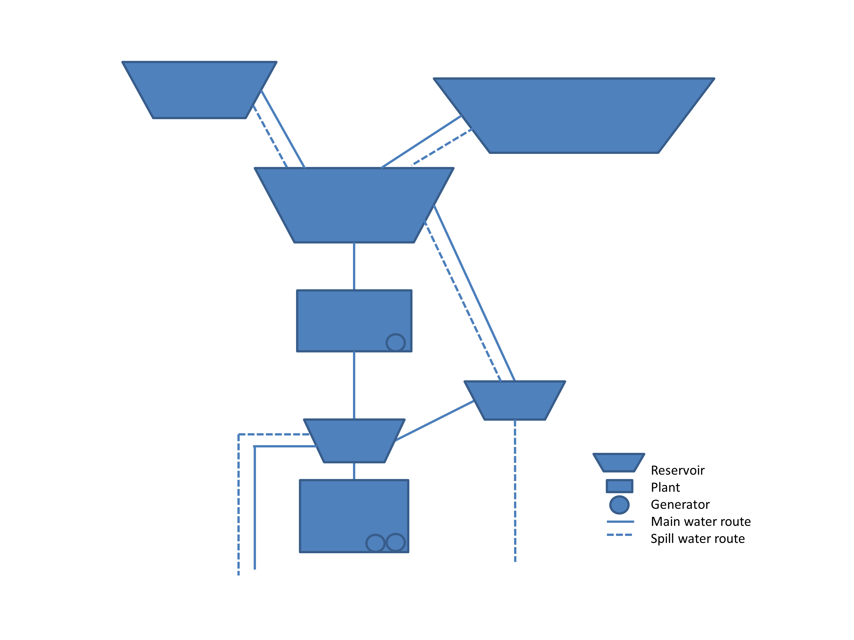
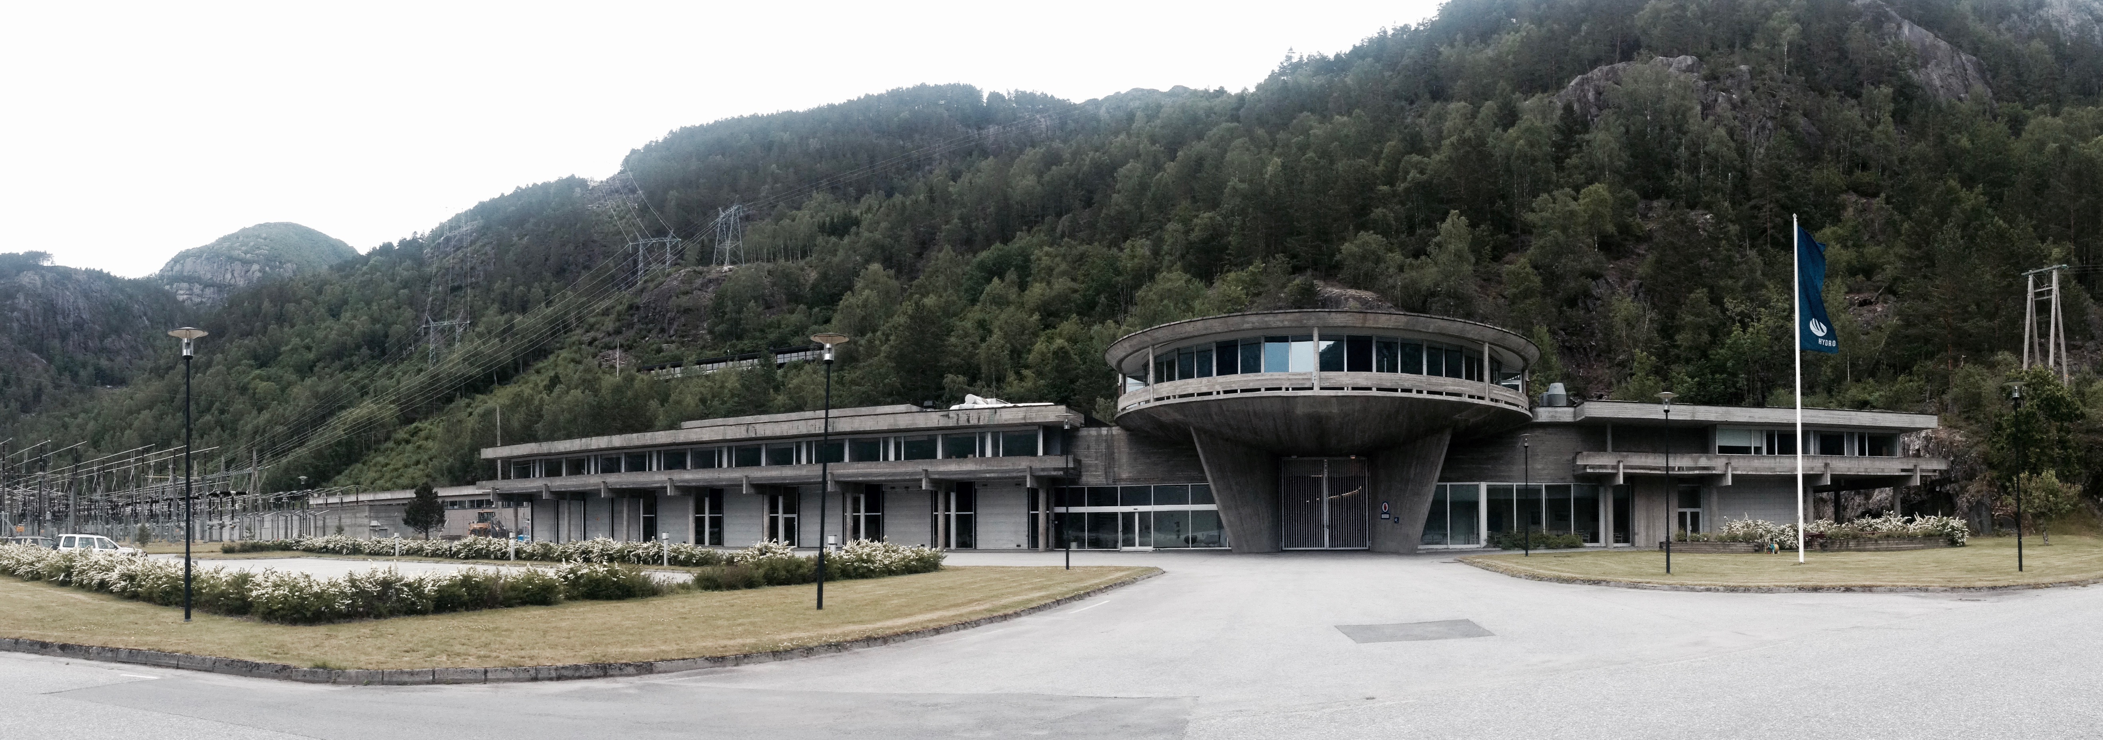
Case study
Total installed capacity 190 MW
Yearly production 2.857 GWh

Slide 21
Case study
Stylized examples: possibly very high inflows to the small downstream reservoir
Realistic input where data is obtained from the company that owns and operates the plant

Slide 22
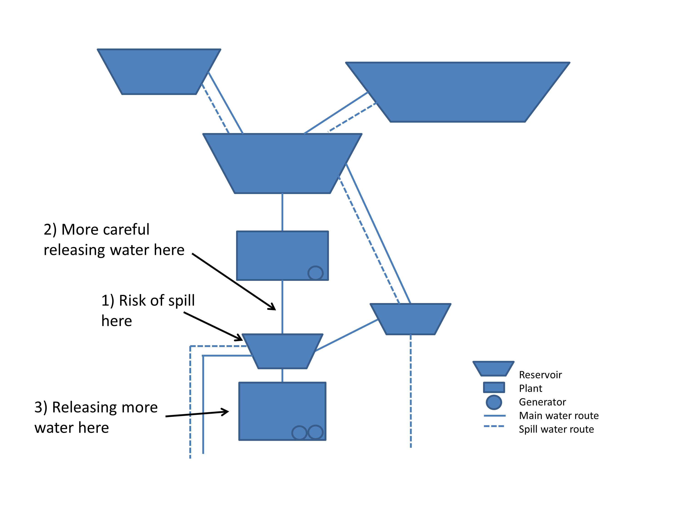
High inflow – how to operate the system?

Slide 23
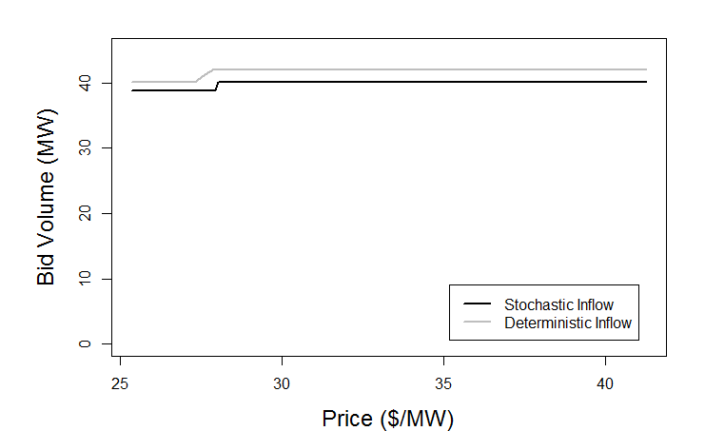
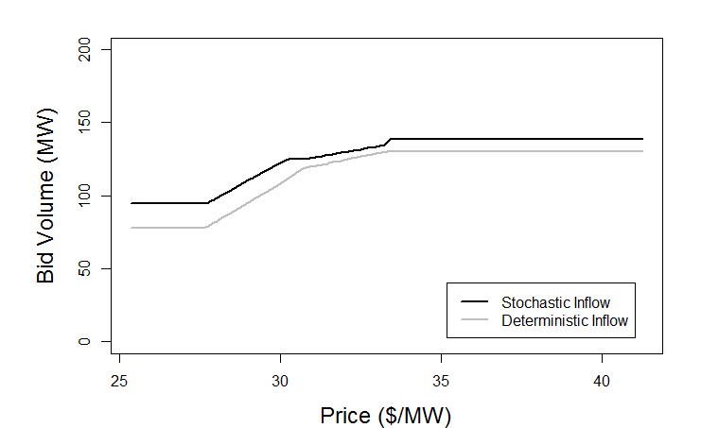
Can we see this from the bid curves?
Upstream plant
Downstream plant
At a given price, less water is released with stochastic inflow vs deterministic inflow (higher marginal costs)
At a given price, more water is released with stochastic inflow vs deterministic inflow (lower marginal costs)

Slide 24
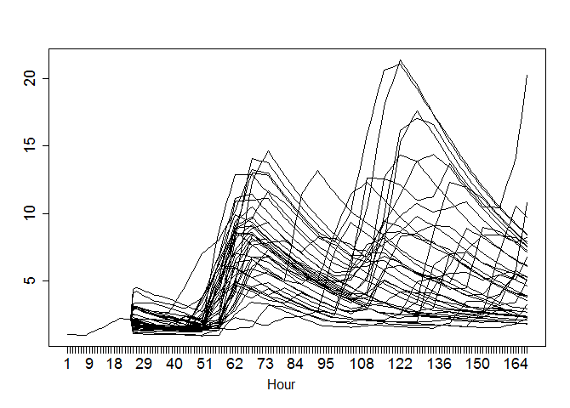
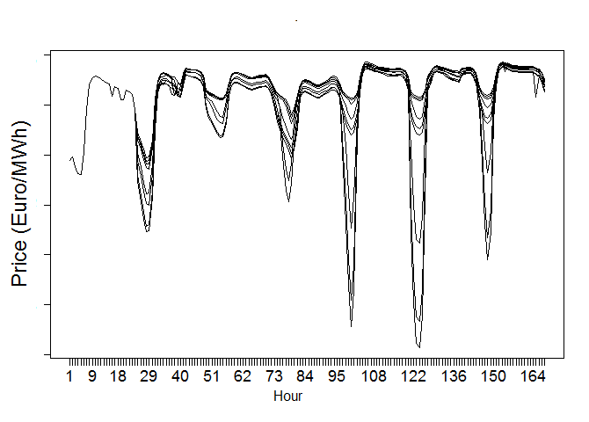
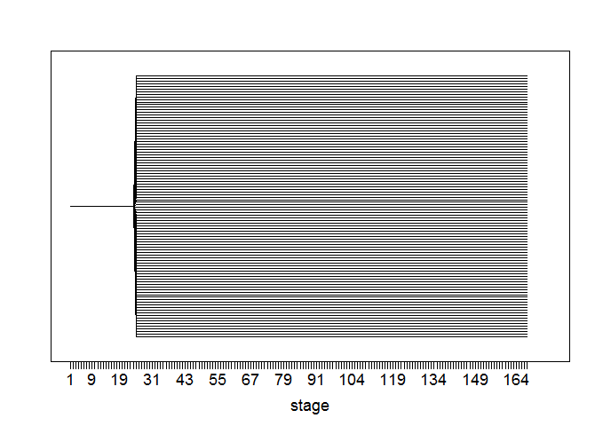
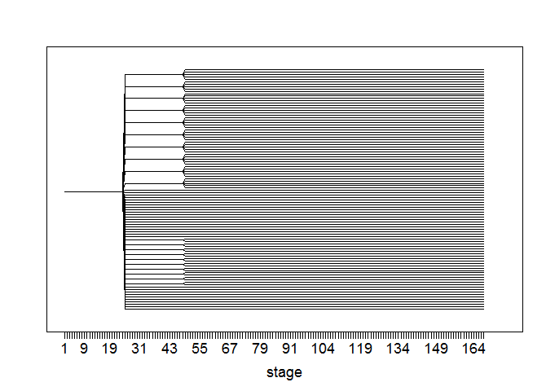
Full case study
Inflow
Hydrological transport model (HBV)
Price
Fundamental model
Assume independence and generate scenario trees

Slide 25
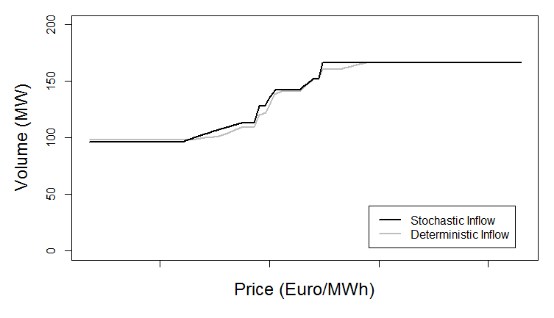
Bid curve
There are (small) differences in the curves with/without considering inflow uncertainty

Slide 26
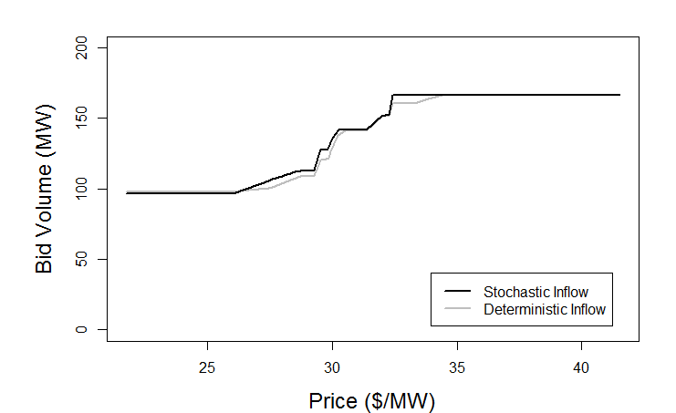
Bid curve explained
The effect of wanting to release more water from the downstream reservoir to avoid spill is most important, that's why the stochastic curve is higher ( → lower marginal costs when inflow is stochastic)
Beneficial to have high head over the downstream plant
Almost always release at best-point from the upstream plant
Almost always a minor risk of spillage from the downstream reservoir

Slide 27
Summary
Price uncertainty is needed if the model should optimize bids, and is addressed by the shape of the bid curve
Inflow uncertainty may affect the marginal costs on a daily basis and should be taken into account for a correct assessment of marginal costs
Further work: Make the model feasible for operational use (calculation time). Include optimization of other markets and products. Quantify the gain from improved decision support in the bidding process.

Slide 28
Extra slides

Slide 29
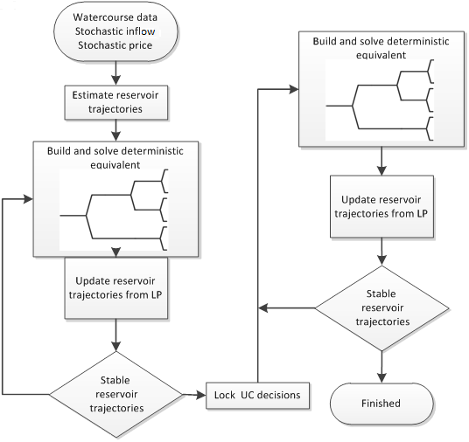
Method

Slide 30
References
SINTEF SHARM, [online], http://www.sintef.no/en/software/the-stochastic-short-term-model-sharm/
O.B. Fosso and M. M Belsnes, "Short-term scheduling in a liberalized power system", 2004 International Conference on Power System Technology, 2, 1321-1326
S.-E. Fleten and T. K. Kristoffersen, "Stochastic programming for optimizing bidding strategies of a Nordic hydropower producer", European Journal of Operational Research, 181(2):916–928, 2007.
M.M. Belsnes, O. Wolfgang, T. Follestad, E.K. Aasgård, "Applying Successive Linear programming for Stochastic Short-term Hydropower Optimization", Electric Power Systems Research, 130, 167-180, 2016
E. K. Aasgård, G. S. Andersen, S.-E. Fleten, D. Haugstvedt. "Evaluating a stochastic-programming-based bidding model for a multireservoir system" IEEE Transactions on Power Systems, 29(4),1748–1757, 2014.
E.K. Aasgård, C.Ø. Naversen, M. Fodstad, H.I. Skjelbred. "Optimizing Day-Ahead Bid Curves in Hydropower
Production" , submitted to Energy Systems

Slide 31
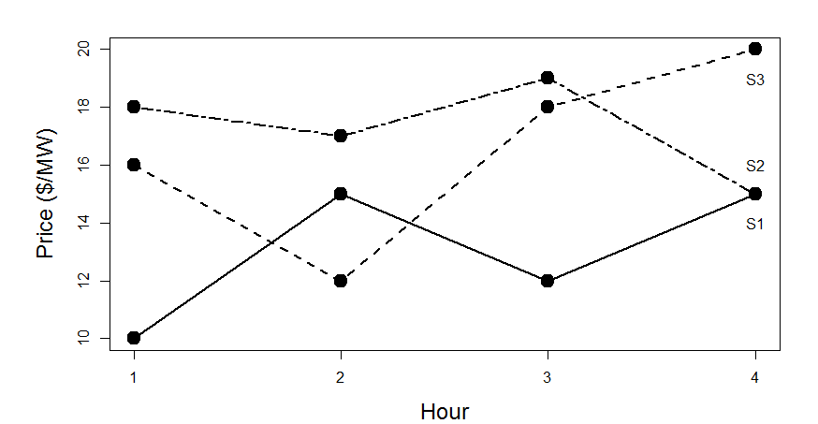
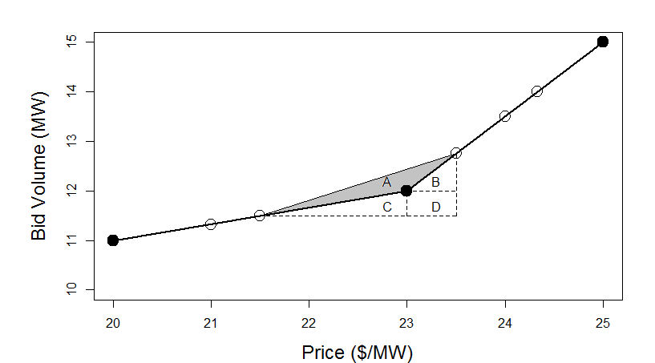
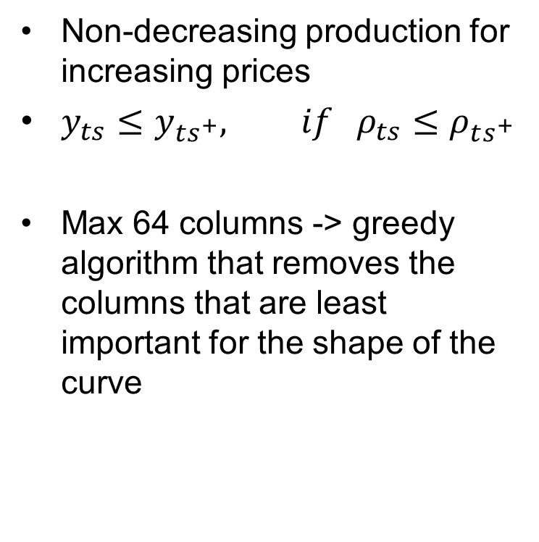
Modelling of Bids
Non-decreasing production for increasing prices
$y_{ts}≤y_{ts^{+}}, if ρ_{ts}≤ρ_{ts^{+}}$
Max 64 columns -> greedy algorithm that removes the columns that are least important for the shape of the curve

