Slide 1
Analysing renewable power system development for a Pacific Nation
Ramu Naidoo (Scientia Consulting)
E Grant Read (EGR Consulting)
in association with Concept Consulting Group

Slide 2
Study: for World Bank
Analysed the economics of a proposed hydro project in the Solomon Islands considering:
system requirements
current diesel generation
solar and battery resources
interplay between energy and reserves
We discuss some challenges of modelling this small system:
And some observations on renewable development
The Global Infrastructure Facility (GIF) is a global collaborative platform that facilitates preparing and structuring complex PPPs in infrastructure and mobilizing capital from the private sector and institutional investors. For more information, please visit www.globalinfrafacility.org

Slide 3
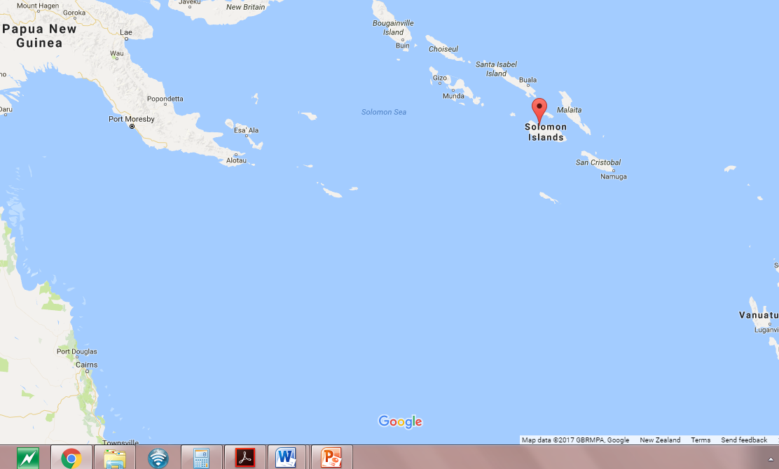
Honiara – Solomon Islands

Slide 4
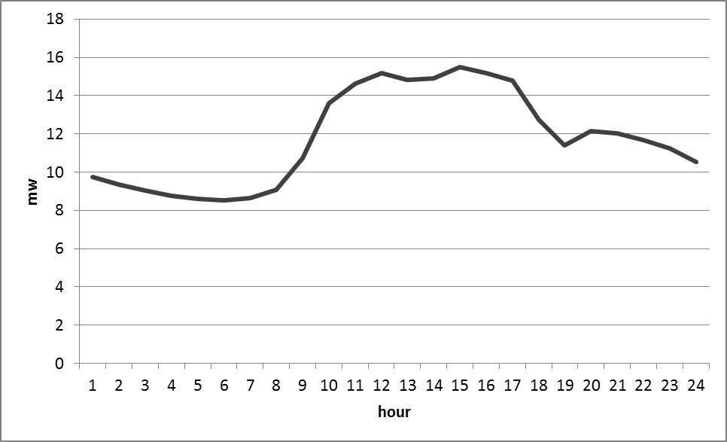
Current Power System
Demand profile consistent through the year
Current peak ~ 16MW
Predominantly diesel supply
Existing solar ~1MW
Ageing diesel generation fleet
Largest diesel unit: 4.5MW
Smallest diesel unit: 1.5MW

Slide 5
Potential resources
Hydro (3 or 4 x 5MW units)
Variable inflows
Limited storage (~ 1 day with average inflows)
Solar
Variable output
Batteries
Energy and reserves
Geothermal (not considered as part of this exercise)
Baseload energy

Slide 6
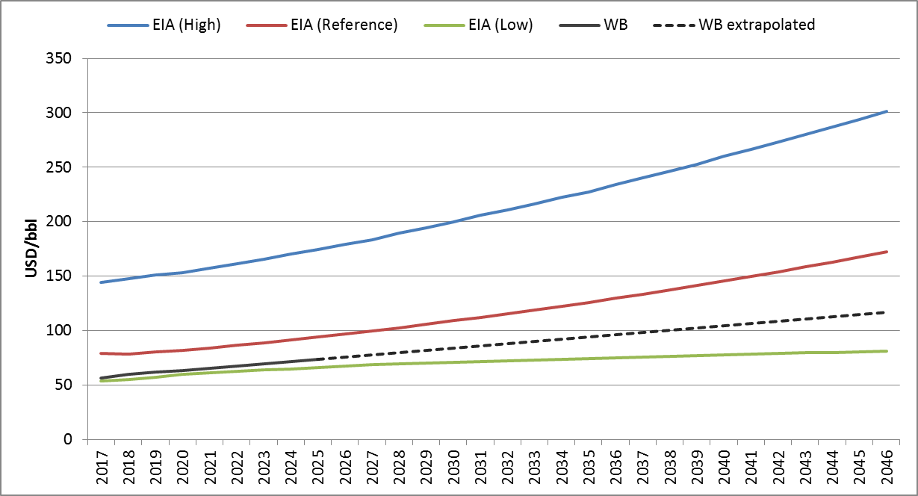
Expected increase in oil prices
Source: EIA and World Bank

Slide 7
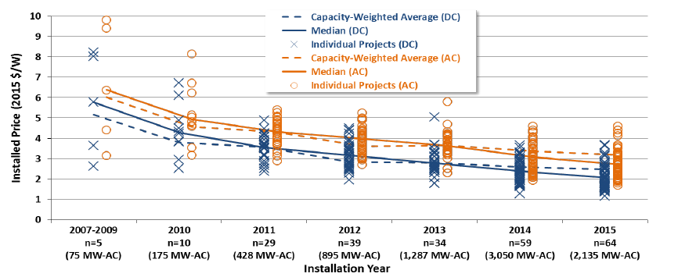
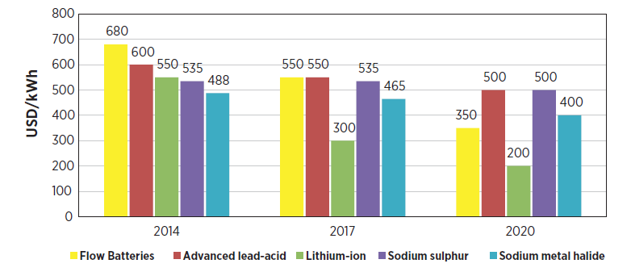
Declining solar/battery technology costs
Source: Utility-Scale Solar, 2015, Lawrence Berkley National Laboratory
Source: IRENA, 2015

Slide 8
Modelling framework
An optimisation modelling framework was developed for this specific system
It optimises at three nested levels with outputs from preceding levels fed forward
Optimal thermal dispatch model
Least-cost hydro-thermal-solar-battery dispatch model
Least-cost development plan model

Slide 9
Some caveats
Hydro option and data as provided by SIEA, World Bank, and other consultants
3% discount rate (with sensitivities at 4%) – based on World Bank requirements
Assessment only on generation (ignoring transmission)
Optimistic assumptions about power system control etc from new technologies (implying conservative valuation of hydro)

Slide 10
Hydro with existing system
Current system predominantly diesel with some solar
Diesel fuel prices linked to global oil prices
Ageing diesel units
~1MW of existing solar
Proposed hydro development would be large proportion of system demand (sometimes exceeding)
Hydro can displace diesel but need to consider the interactions:
High and low inflows
Energy and reserves

Slide 11
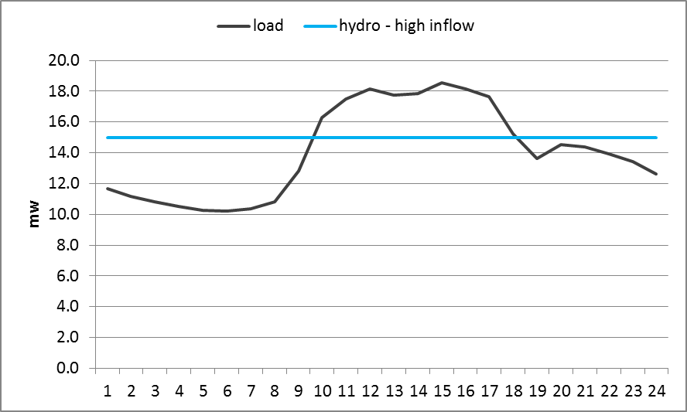
High inflows – hydro energy production limited by load
Spill
Spill
Initially off-peak loads lower than hydro capacity
Limited storage implies spill when load cannot fully absorb hydro generation

Slide 12
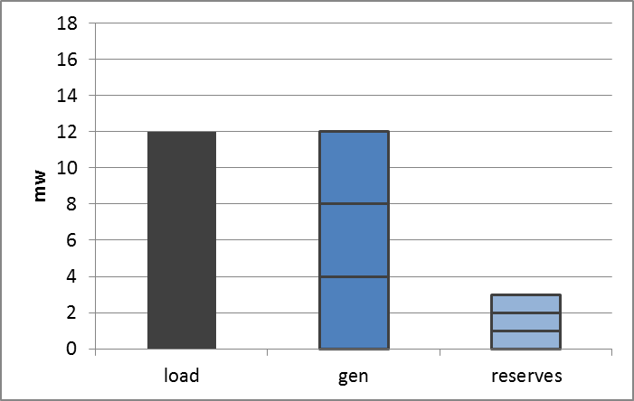
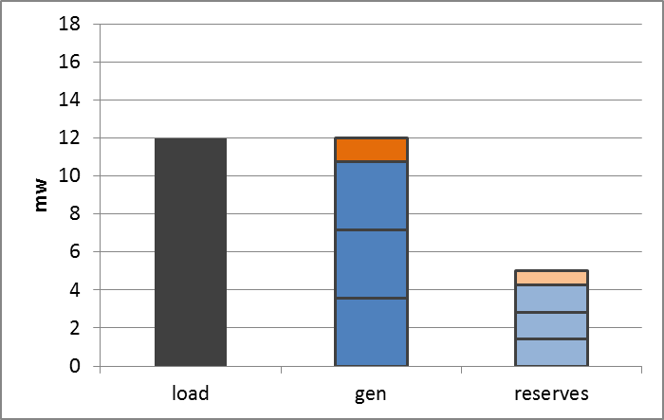
Reserve requirements further restrict hydro generation
Provision of reserves reduces hydro energy
Also need to manage contingencies
Hydro gen reduced to supply load
Reduce hydro gen further
Need more reserves to cover shortfall
Reserves from hydro and diesel
Spare hydro can provide reserves

Slide 13
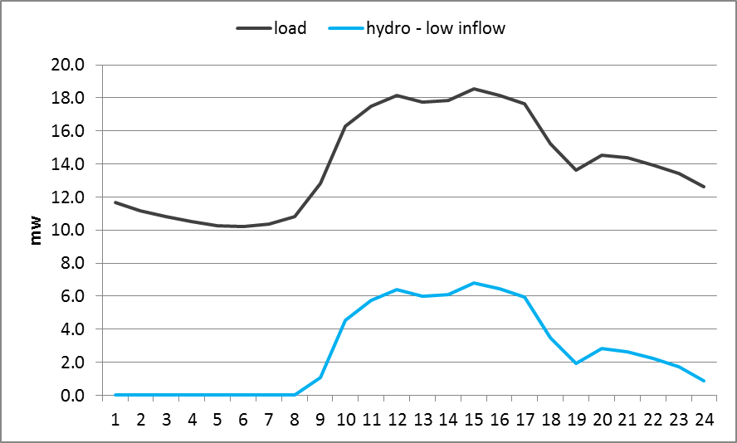
Low inflows – hydro only provides reserve and peak support
Hydro generation limited under low inflows → reduce peak of residual load curve → reserve provider

Slide 14
Surprisingly?
Under these assumptions, optimisation recommends batteries to support hydro generation
During low load periods
By avoiding need to back-off hydro and/or run additional diesel for reserves
Hydro gen reduced to supply load
Battery reserves cover shortfall
Battery reserves
Spare hydro can provide reserves

Slide 15
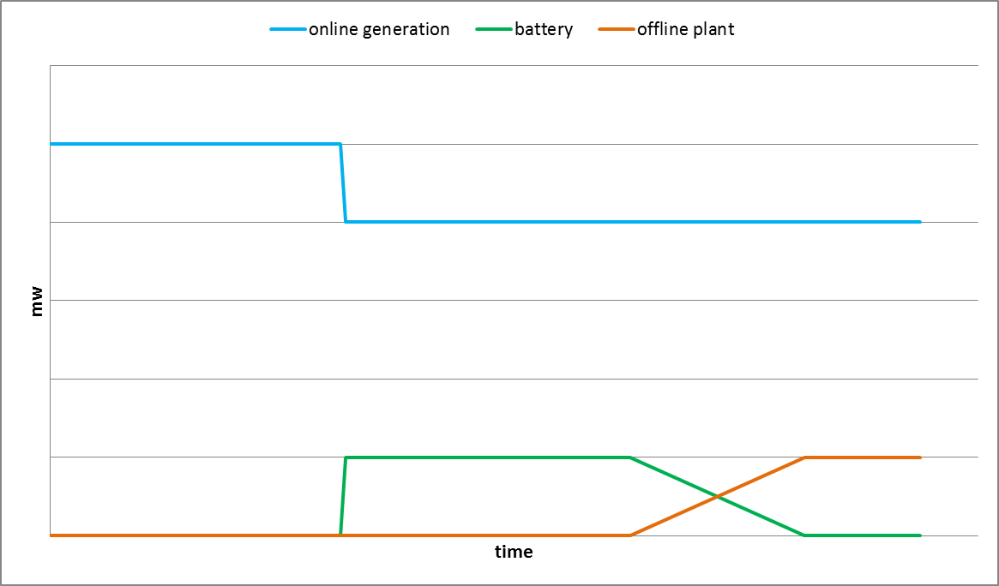
Ancillary service batteries
High power – short duration application
Keep system going while reserve Diesels are started

Slide 16
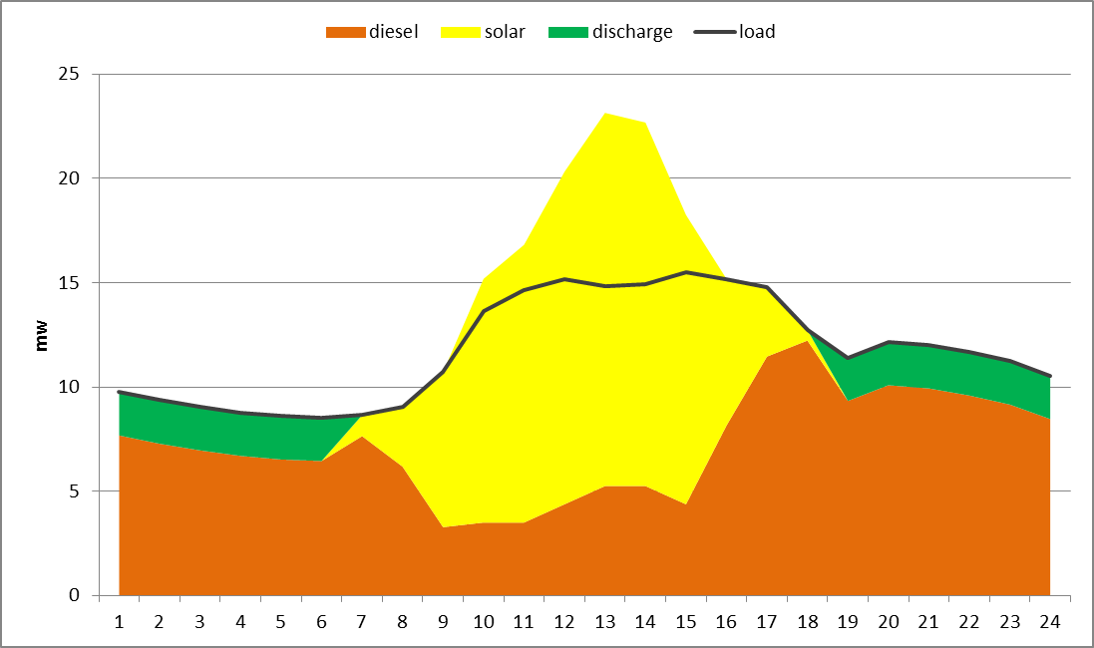
Energy-shifting batteries
Shift energy/capacity from lower-priced periods to higher-priced periods
Capture excess energy and use to displace higher-priced generation (e.g. diesel)
Battery charging when surplus generation
Online diesel to provide reserves for solar fluctuation

Slide 17
Solar – no hydro
Can displace diesel generation:
More on sunny days
Less on cloudy days
None at night
Still need diesel to cover series of dark days
Online diesel, or batteries, required to manage short-term solar fluctuations
But “energy shifting” batteries offer no gains while diesel is on the margin all day:
Only worth considering when solar penetration is so high that excess solar would otherwise “spill”, on sunny days.

Slide 18
Solar – with hydro
Hydro can complement solar in displacing diesel generation:
Increased energy during wet conditions
Increased reserves during dry conditions
Hydro will compete with solar during periods when diesel is completely displaced
Wet and sunny - compete
Wet and cloudy - complement
Dry and sunny - complement
Dry and cloudy - complement
Significant Diesel capacity still required for backup over dry periods with successive cloudy days

Slide 19
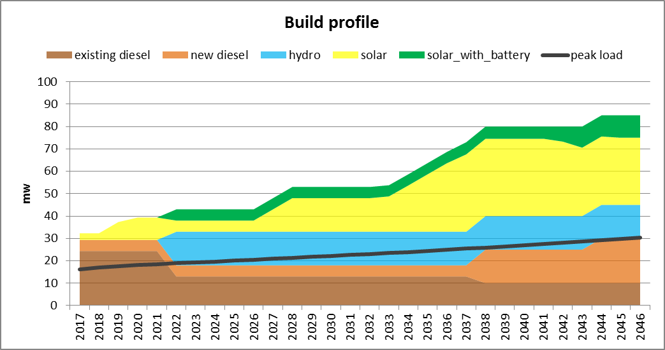
An integrated system development
Energy batteries to capture excess solar
Initially ancillary service batteries to support hydro with reserves
Increasing solar as costs reduce
Hydro build
Diesel to manage dry periods and dark days

Slide 20
Can we go 100% renewable?
System must sustain itself over successive dry cloudy days without backup diesel
Limited hydro energy used for overnight generation
Batteries capture excess solar and complement hydro generation over daily cycle
Significant solar overbuild required, with energy spilled most of the time.
Get up to 8 hours charging time on dry dark days
With discharge of up to 16 hours over peak/night period
Can save money with mix of short/long term batteries,
And sensible design of solar infrastructure

Slide 21
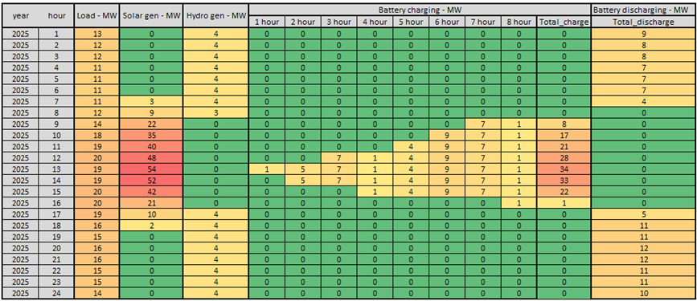
Optimisation for renewable case
Large increase in system costs in doing away with diesel backup generation → increased value of hydro capacity

Slide 22
Conclusion
Small scale makes analysis comparatively more costly
But also arguably more complex
In a small isolated system it becomes critical to capture the salient interactions of:
Energy and ancillary services
Unit loading patterns and contingencies
Short and long term output variability and storage/backup capacity
The interacting characteristics of different technologies can create a complex pattern of competition and complementarity, over time
Diesel capacity seems likely to play an important ongoing backup role
And is btw “100% renewable”, if not actually called upon!

