Slide 1
Security of supply - deriving a winter energy standard using the DOASA model
EPOC Winter Workshop 2018
7 September 2018

Slide 2
What's the economically efficient level of supply to have in the electricity system?

Slide 3
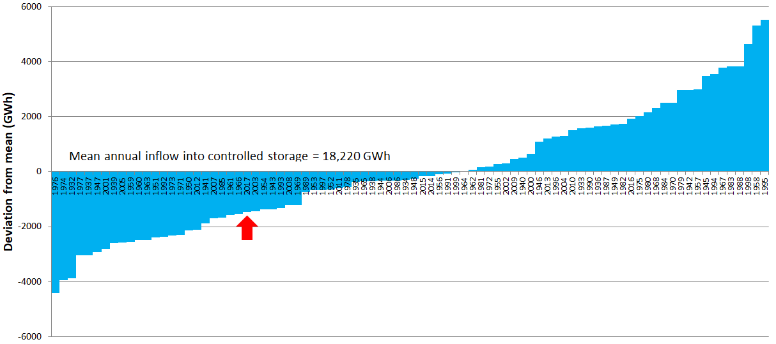
Energy is important in the New Zealand system
What are the winter energy and capacity standards?
International context

Slide 4
Winter energy and capacity standards
Part 7 of the Electricity Industry Participation Code

Slide 5
The winter energy margin

Slide 6
The winter energy standard serves as a reference
Medium-long term security of supply monitoring
The system operator forecasts ability of the power system to meet the standard

Slide 7
What's the economically efficient level of supply to have in the electricity system?
Deriving the winter energy standard
Notes:
Hand over to Conrad

Slide 8
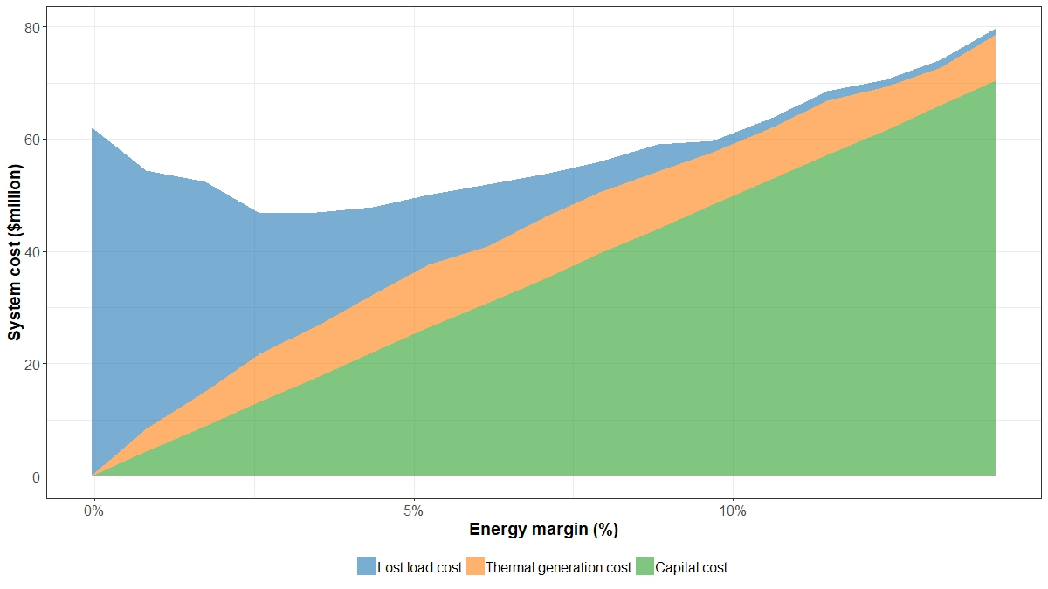
The economic trade-off

Slide 9
Modelling process diagram
For each model run…
Add 50 MW of OCGT generation
Create a new DOASA policy
Run DOASA simulation
Remove thermal
Current fleet
Starting fleet for model
Supply
Fit curve…
Repeat…
Calculate costs (capital, operating and lost load)
$$$

Slide 10
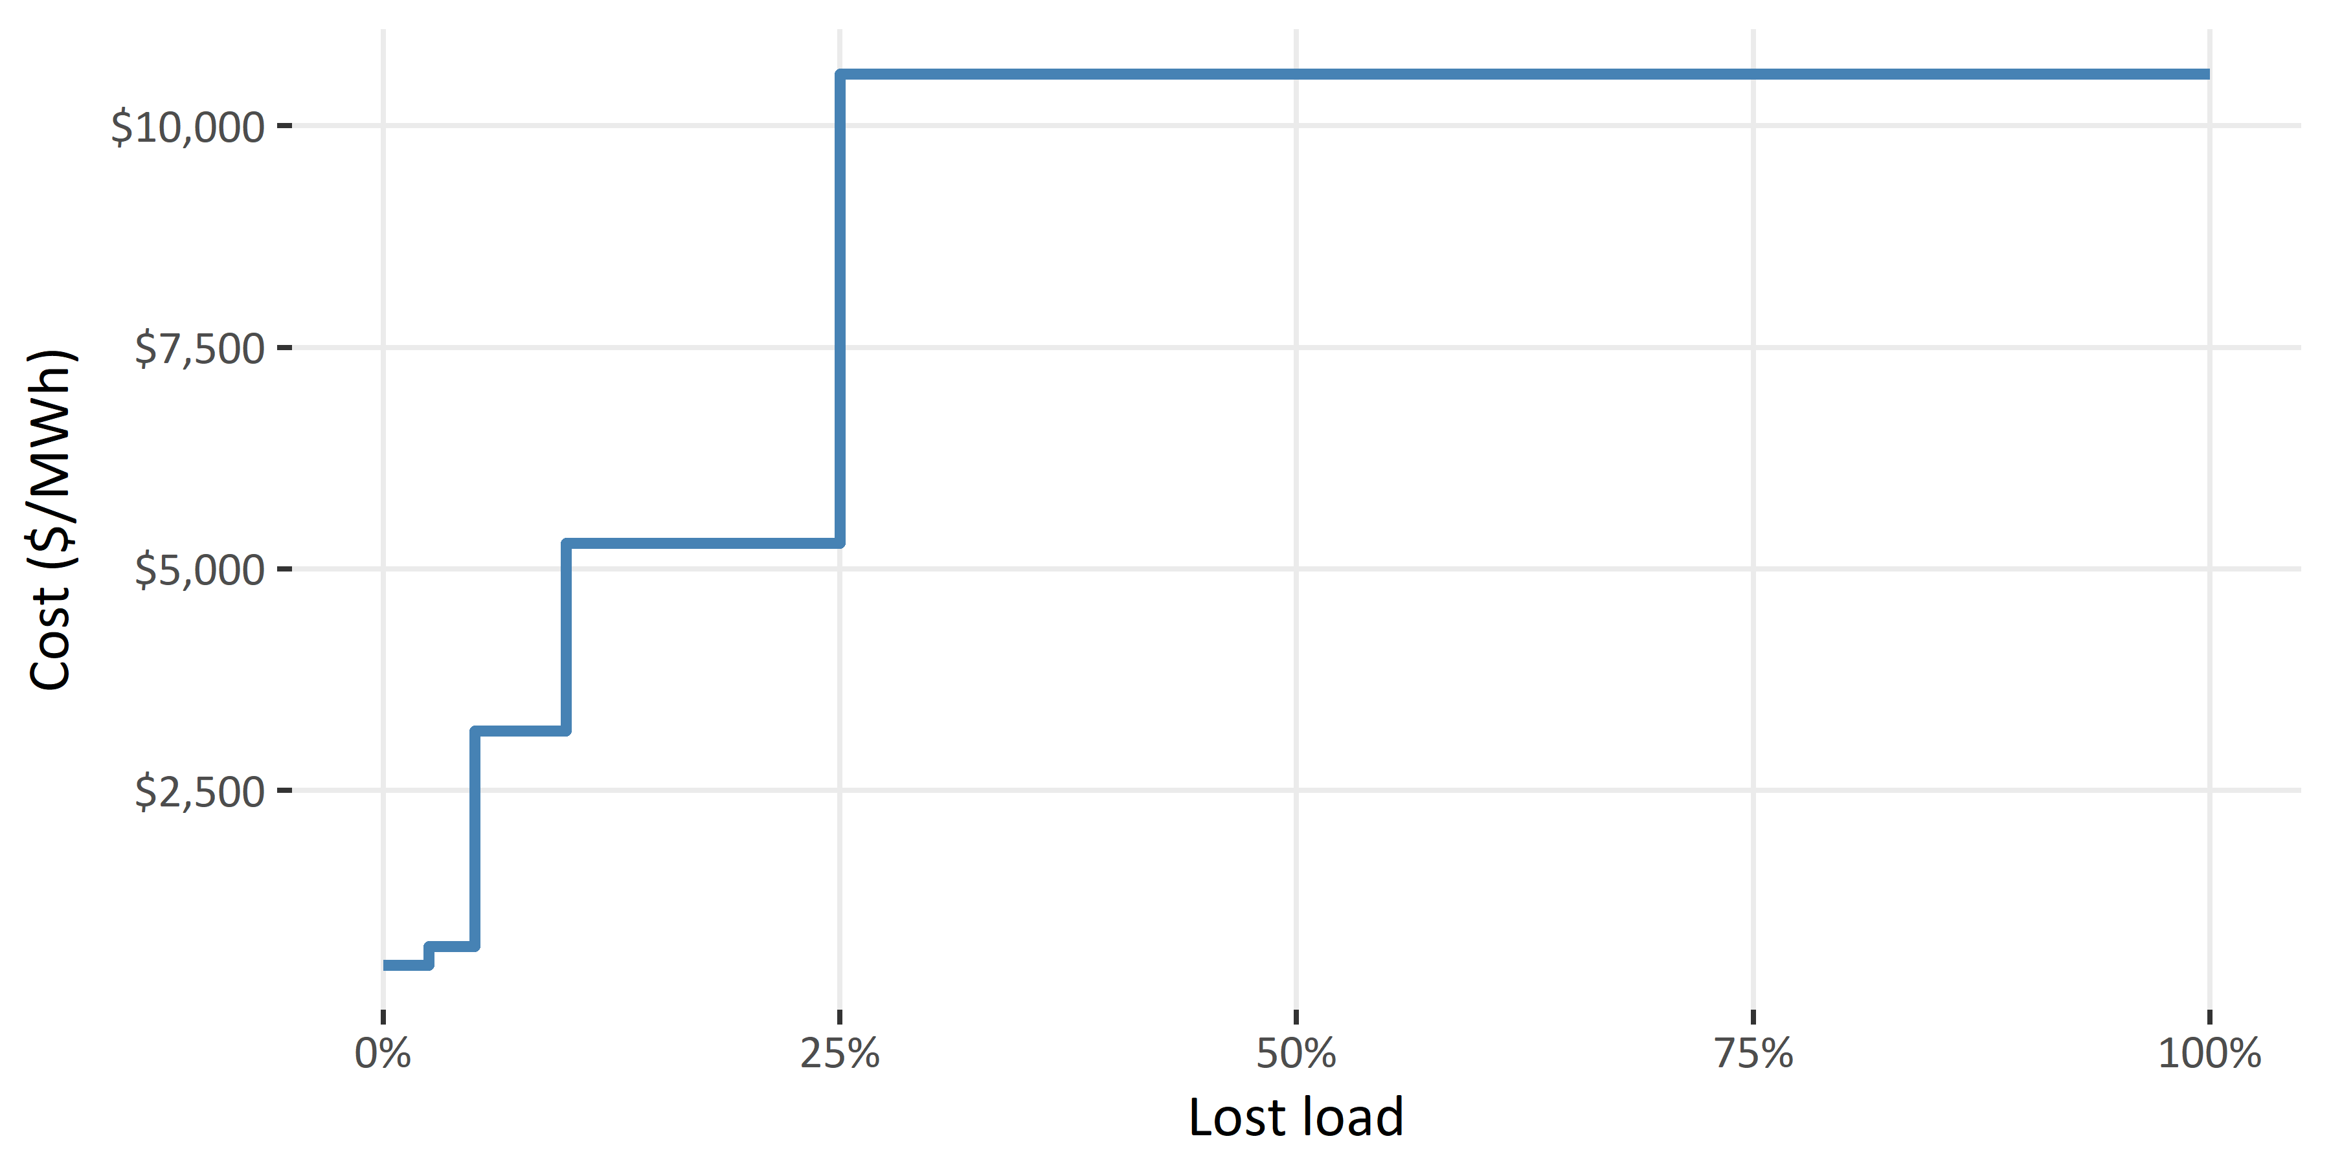
Method – establish a supply/demand basis
Demand
The standard is calculated based on the most recent calendar year (2017).
Reconciled generation, which represents the current fleet, is used as the demand to be supplied.
Shortage costs
Notes:
Given demand growth is slow and the generation fleet undergoes incremental change relative to the total capacity, we assume that calculating the winter energy standard based on the most recent calendar year is appropriate to derive a standard for the medium term.
To represent demand in the model reconciled generation data (from GR010) for 2017 was used. This was the most recent complete year available and forms the base case demand that generation will supply. This is essentially the total ‘demand for generation’.
Transmission losses are included in the demand. Given we have used 2017 reconciled generation for our demand (rather than reconciled demand) in the model this will include the losses from transmission that occurred in 2017. Transmission losses will be different from year to year especially between wet and dry years where substantially different grid flow can occur.
Note that small thermal plant such as co-generation or small embedded plant are treated as fixed stations and have profiled output.
Intermittent includes: wind and small embedded
Inflexible includes: ROR, Co-generation, Geothermal

Slide 11
Method – establish a supply/demand basis
Supply
The supply from inflexible and intermittent generation sources is profiled in order to establish the residual demand to be supplied by the flexible generation in the DOASA model.
Additional generation is modelled as OCGT gas peaker plant with capital cost of $88,000/MW/year and variable generation cost of $113/MWh.
Notes:
Given demand growth is slow and the generation fleet undergoes incremental change relative to the total capacity, we assume that calculating the winter energy standard based on the most recent calendar year is appropriate to derive a standard for the medium term.
To represent demand in the model reconciled generation data (from GR010) for 2017 was used. This was the most recent complete year available and forms the base case demand that generation will supply. This is essentially the total ‘demand for generation’.
Transmission losses are included in the demand. Given we have used 2017 reconciled generation for our demand (rather than reconciled demand) in the model this will include the losses from transmission that occurred in 2017. Transmission losses will be different from year to year especially between wet and dry years where substantially different grid flow can occur.
Note that small thermal plant such as co-generation or small embedded plant are treated as fixed stations and have profiled output.
Intermittent includes: wind and small embedded
Inflexible includes: ROR, Co-generation, Geothermal

Slide 12
Method – establish a set of model runs
Firstly, remove some existing thermal plant from the original fleet in order to establish shortage.
McKee gas OCGT – 100 MW
Whirinaki diesel OCGT – 155 MW
Huntly Units 1 and 2 coal steam turbines – 2 x 240 MW = 480 MW
Stratford gas OCGT – 200 MW
Add generation (modelled as thermal OCGT) to the fleet in increments of 50 MW to establish a set of model runs.
Notes:
Establish a set of model runs with varying supply / demand balances ensuring the balance spans the optimal margin.
For the New Zealand winter energy standard, 935MW of thermal capacity was removed from the existing fleet in order to invoke shortage in the model.
New plant as OCGT rationale:
This assumption is consistent with what is being observed in the current environment, where natural gas appears to be the most likely fuel choice for large-scale (i.e. 50MW+) generation that provides reliable energy, with various resource consents in place to enable them to be built if required.

Slide 13
Method – iterate hydro-thermal modelling
For each model run, use DOASA to establish an optimal hydro release policy based on:
hydro inflows,
the thermal fleet available to the model in the run, and
the demand to be served by load block and week.
Use this release policy to simulate the market dispatch of generation resources for the 84 inflow sequences we have available (1933 to 2016).
Notes:
Hydrological inputs come from the Authority’s hydrological modelling dataset (HMD)

Slide 14
Method – establish an optimal margin
For each model run, calculate:
the capital cost of the additional (thermal) generation,
the expected thermal variable generation cost, and
the expected cost of unserved load.
Fit a combined system cost curve for the set of model runs to establish the minimum system cost which defines an optimal margin.
Notes:
Capital cost: The annualised capital cost of adding or subtracting thermal capacity is calculated using the new plant build cost from the Generation Cost Assumptions in MBIE’s 2016 EDGS report. It is calculated as the capital cost in $/MW multiplied by a capital recovery factor to produce an annualised cost in $/MW/year (where inflation is 2%; WACC is 6%; tax rate is 30%; capital life expectancy is 30 years). Also includes fixed O&M costs - $87,946/MW/year for OCGT gas peakers; $144,498/MW/year for Diesel (recip).
Variable generation cost (SRMC): The short run marginal cost (SRMC) is calculated as the CO² cost-inclusive fuel cost for diesel ($/GJ) multiplied by an adjusted heat rate (GJ/GWh) and divided by 1,000. All inputs are sourced from the cost assumptions for new plant used in MBIE’s 2016 EDGS report – $113.64/MWh for OCGT; $240.62/MWh for Diesel (recip).
Lost load cost (VOLL): stepped VOLL tranches.

Slide 15
Method – establish an appropriate range
Test the sensitivity of the result using a range of different starting assumptions.
Determine the efficient margin and appropriate range after considering the shape of the cost curve, variability in system cost, and the sensitivity analyses.
Notes:
Sensitivities: High demand (+5%); VOLL cost (-50% and +50%); Increased SI demand (+25%/35%/45%) in order to force shortage; Different initial reservoir storage levels (2006 and 2008 – the two lowest in past 20 years and 2011 – the highest in the past 20 years); no contingent storage (for Hawea and Pukaki); thermal fuel cost (-20% and +20%); additional generation modelled as wind only (First, all thermal stations are removed. Next, North Island wind generation is added in proportion to the current wind generation at Haywards and the remainder of the North Island. The current wind generation profile is applied to the new wind capacity.); HVDC limit (800MW and 1,000MW)

Slide 16
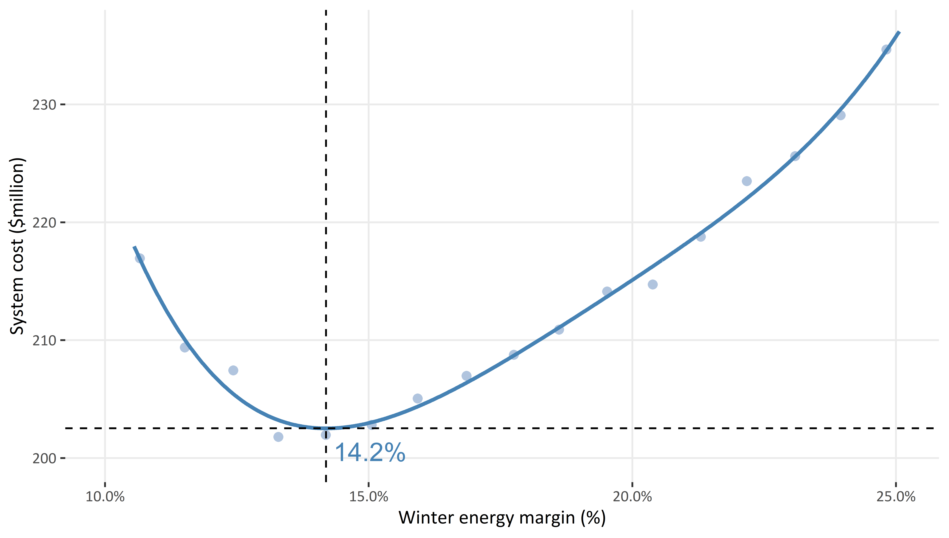
NZ-WEM base case result
Notes:
Talk about noise in the points – time constrained.

Slide 17
Sensitivities

Slide 18
Sensitivities – wind-only
An (extreme) experiment where all additional generation is modelled as wind
Showed materially higher system costs than the base case along with a much lower optimal margin (~11%)

Slide 19
What's the economically efficient level of supply to have in the electricity system?
Concluding remarks and future work
Notes:
Hand over to Conrad

Slide 20
Future modelling enhancements
DOASA enhancements:
Improved modelling of contingent storage
Including transmission losses in the model
More flexibility to represent hydrological constraints and seed data
Method enhancements:
Establishing equilibrium start storage levels for each generating fleet / model run in the analysis

Slide 21
Future challenges – an increasingly dynamic market
More change and more uncertainty
The existing standards and processes may need to evolve too
How might this best be done?

Slide 22
Questions…

Slide 23
The winter energy standard serves as a reference
Medium-long term security of supply monitoring
The system operator forecasts ability of the power system to meet the standard

Slide 24
Appendix – wind generation

