Slide 1
Resilience-constrained economic dispatch via stochastic dual dynamic programming
Leo Yang Liu, Antony Downward, Nirmal Nair
EPOC Winter Workshop 2019

Slide 2
Presentation outline
Climate Change and its impacts on Power system
2016 South Australia Blackout
Stochastic Programming
Resilience-constrained economic dispatch

Slide 3
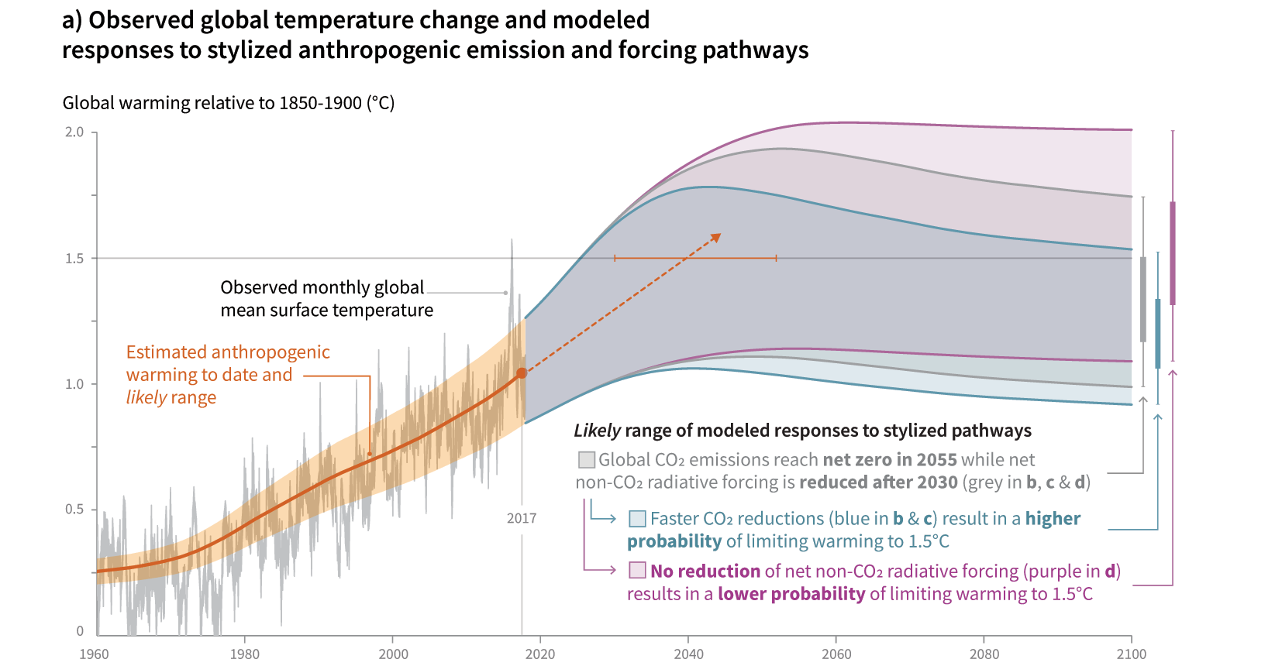
Global Mean Temperatures
International Panel on Climate Change 2019

Slide 4
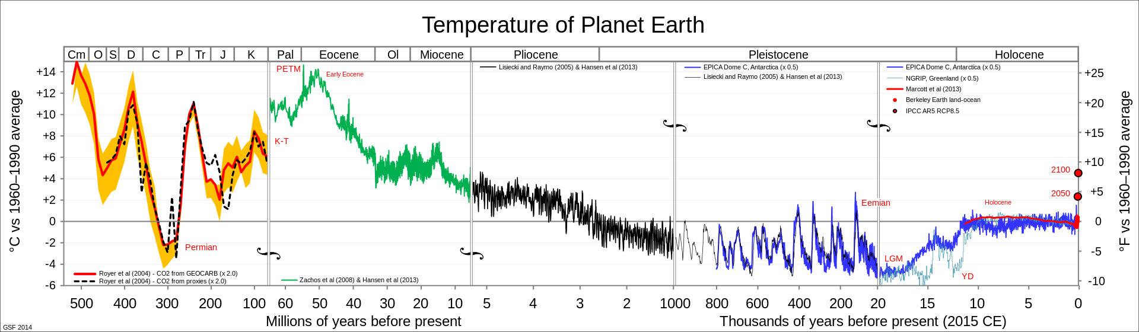
Climate Change

Slide 5
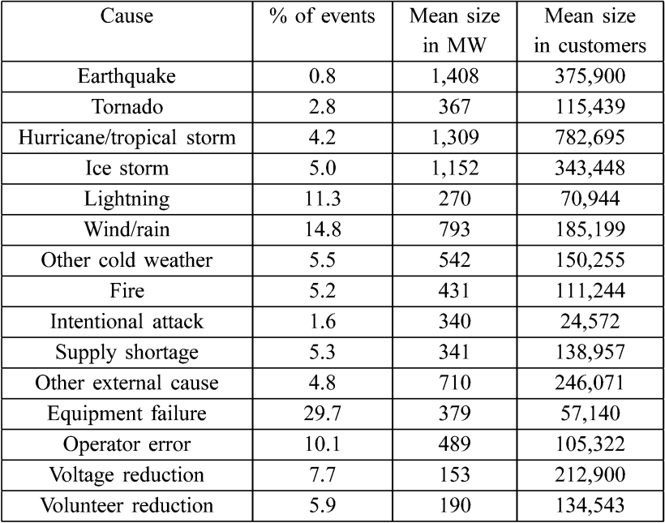
Causes of Power Outages

Slide 6
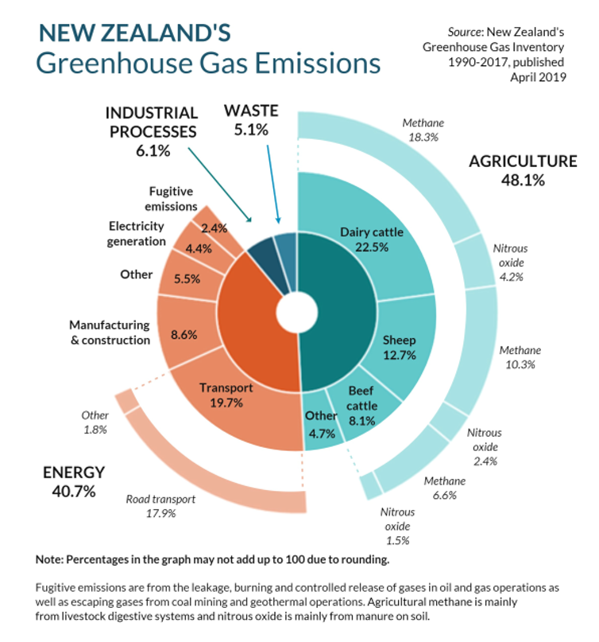
New Zealand’s Energy / Emissions Policy
The New Zealand government has a policy of net-zero CO₂ emissions by 2050.
Part of this is a target of 100% renewable generation* in the electricity sector by 2035.
There has been a lot of discussion about the merits of this target, given the cost of ensuring security of supply.
Nonetheless, it is inevitable that Huntly coal units, and other thermal units will be phased out, and replaced with new renewable generation, particularly wind and geothermal.
* In a normal hydrological year
Ministry for the Environment 2019

Slide 7
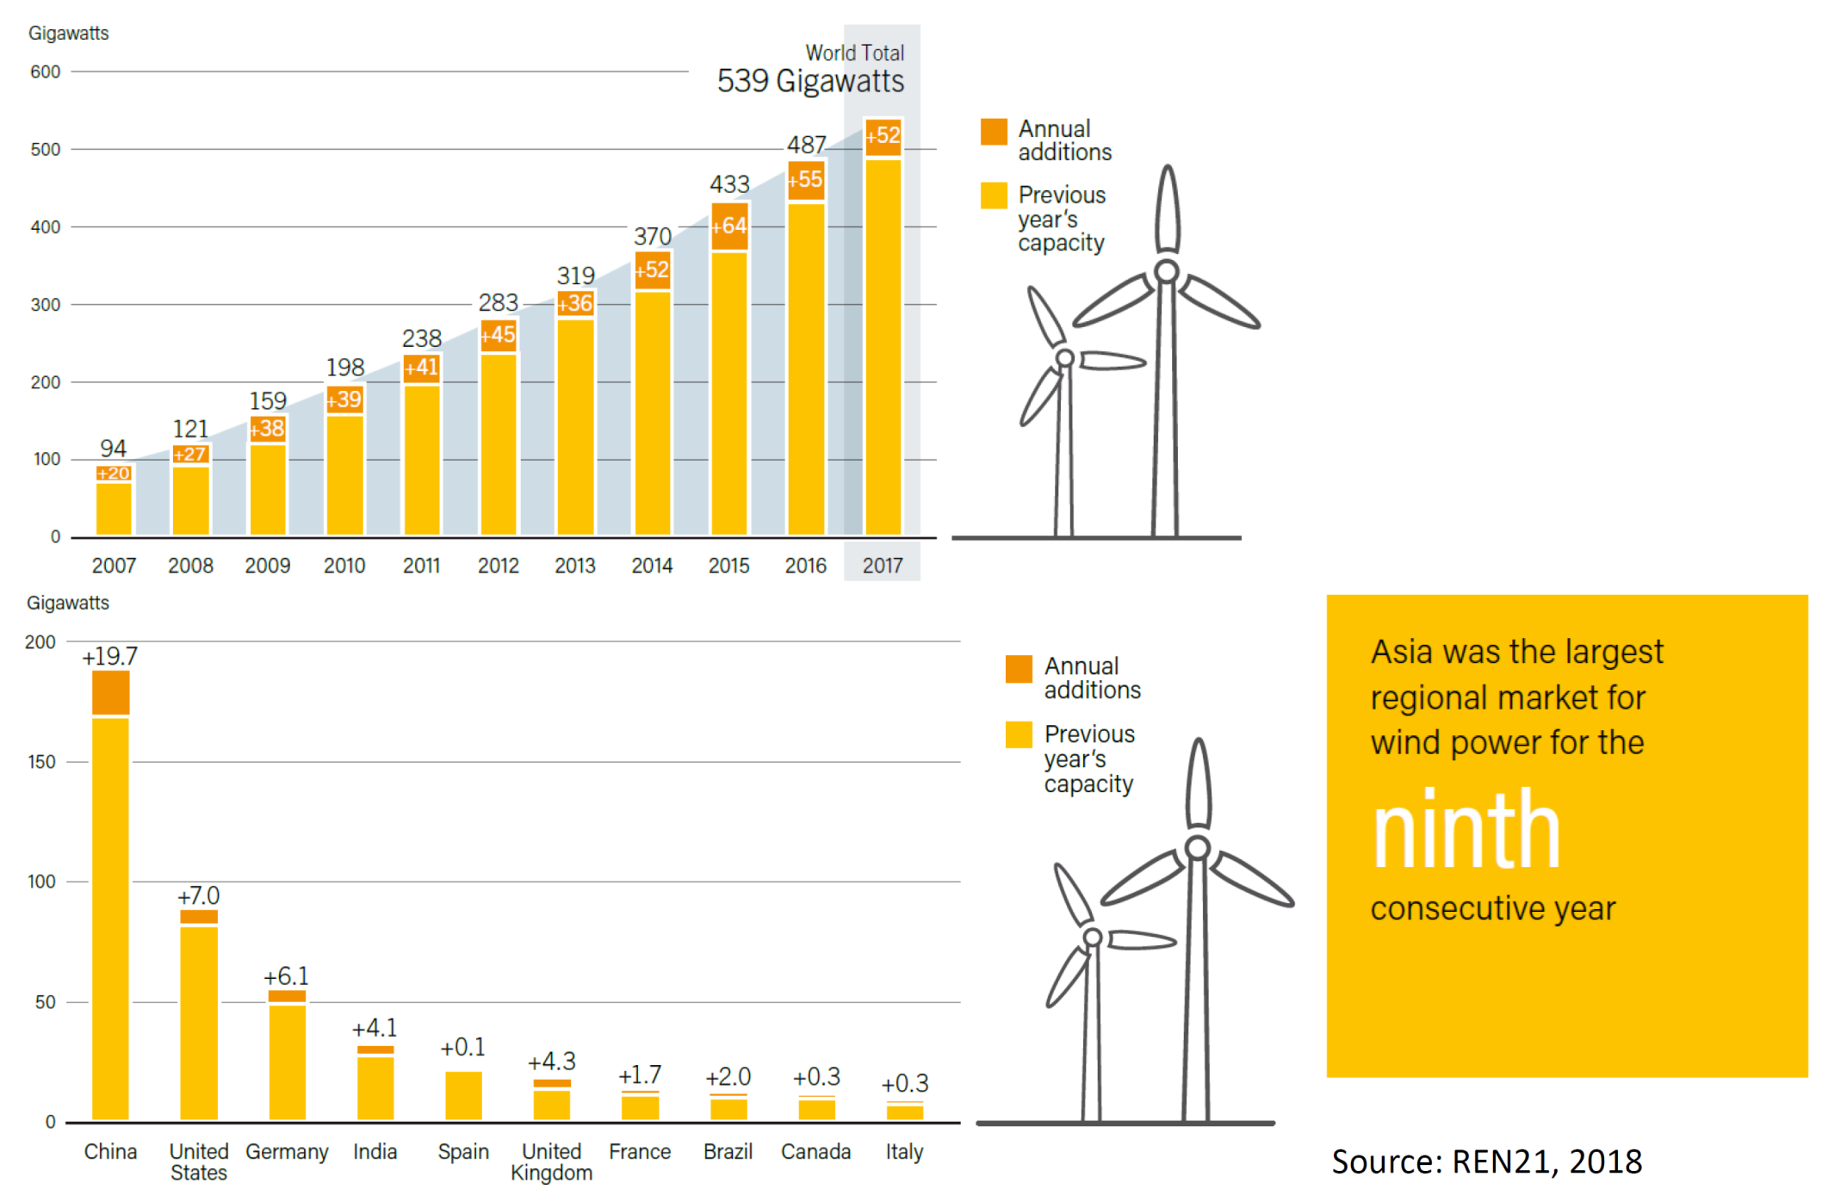
Wind Energy Globally

Slide 8
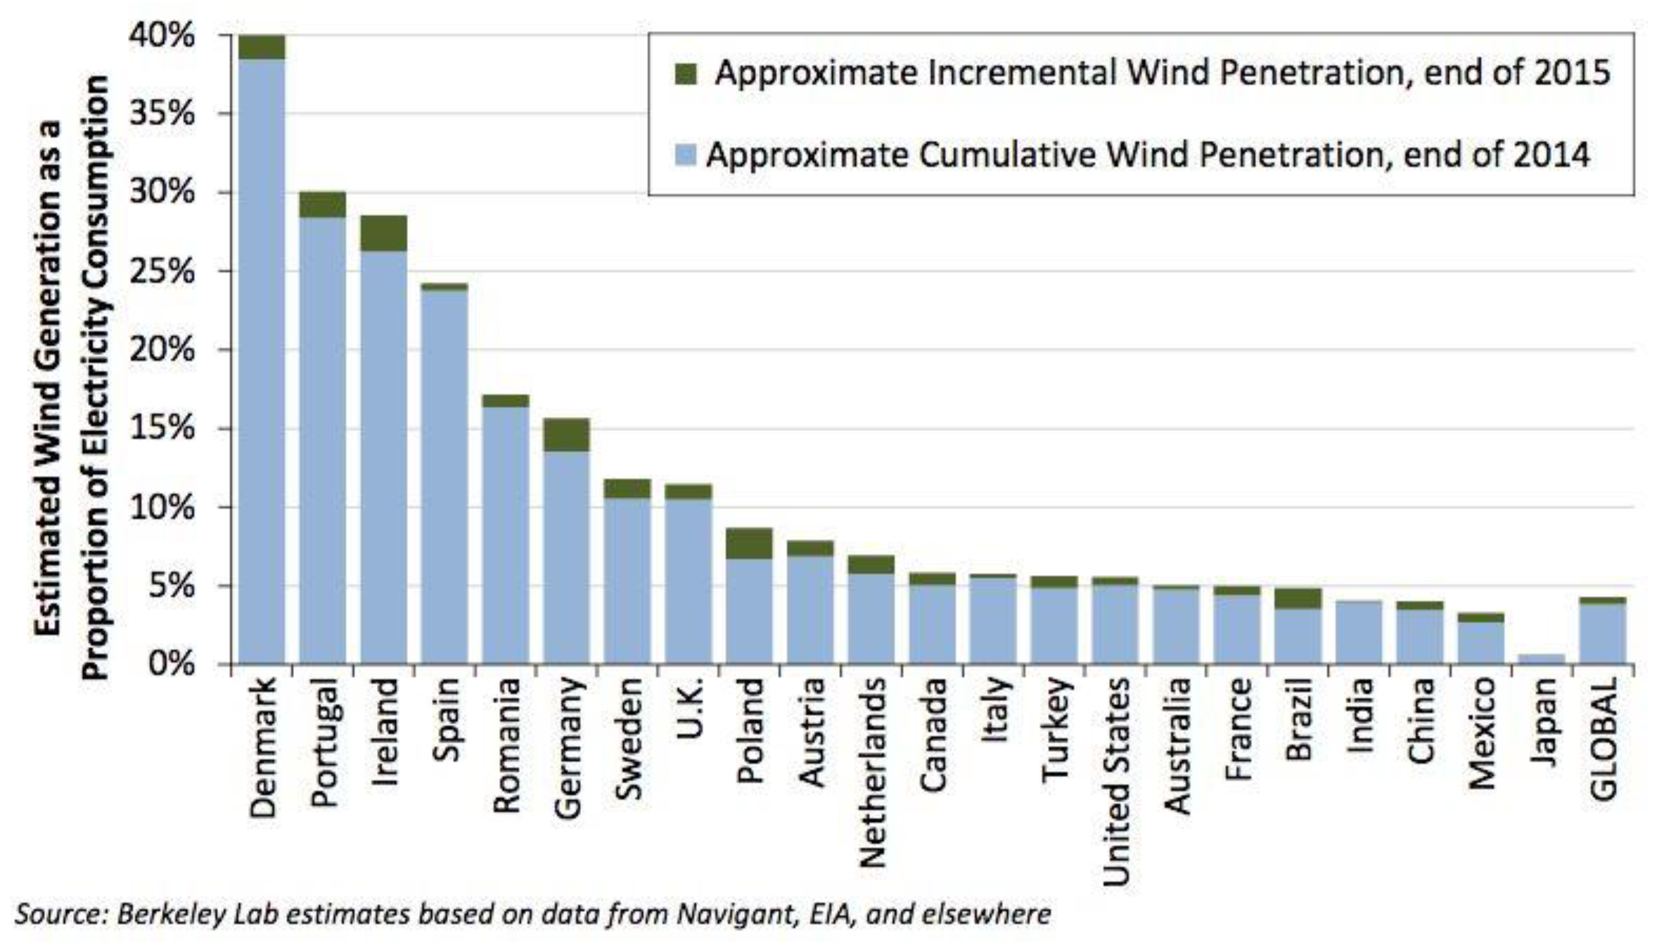
Wind Energy Globally

Slide 9
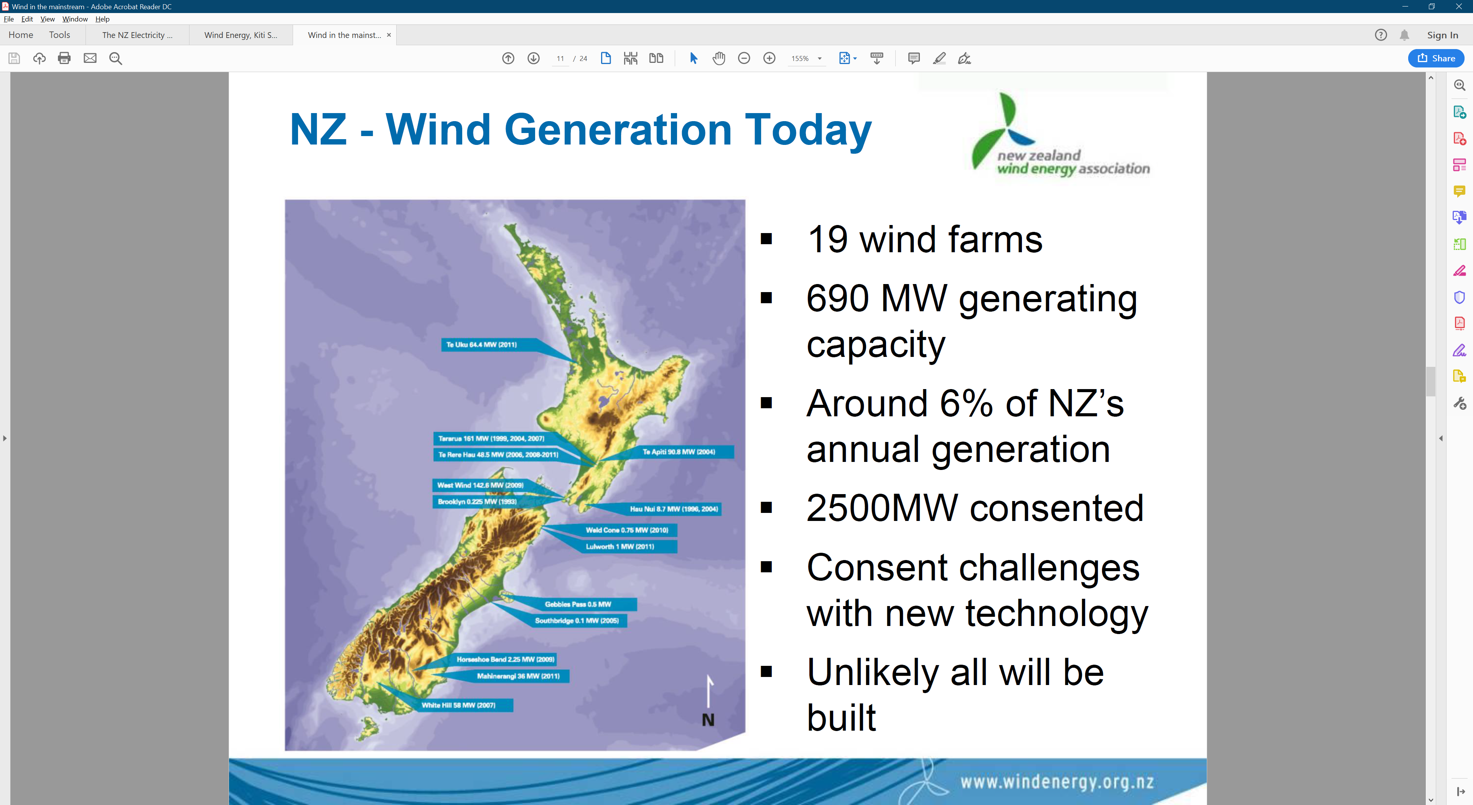
Wind Energy in New Zealand
19 wind farms
690 MW capacity
Approximately 6% of New Zealand’s annual generation
Another 2500 MW consented

Slide 10
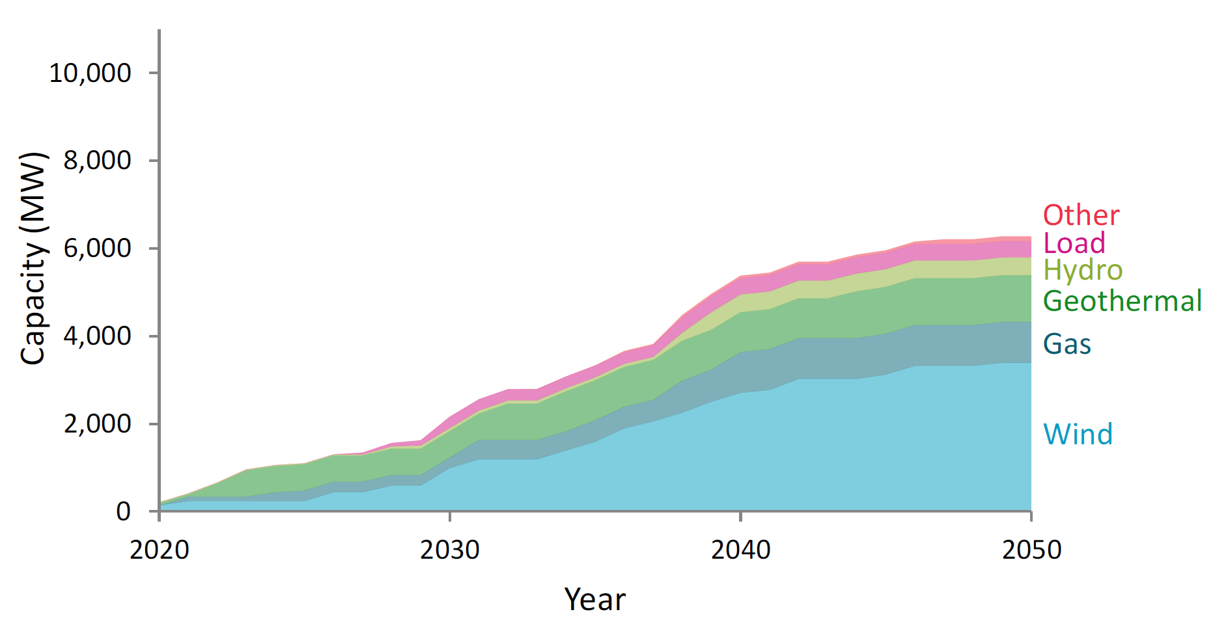
Future Outlook for New Zealand
MBIE Electricity Demand and Generation Scenarios (EDGS) 2019

Slide 11
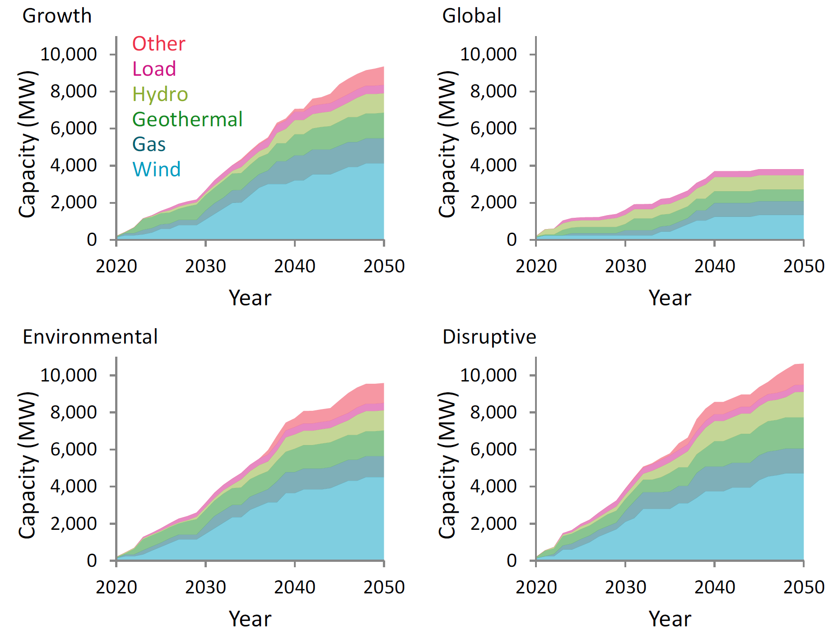
Future Outlook for New Zealand
MBIE Electricity Demand and Generation Scenarios (EDGS) 2019

Slide 12
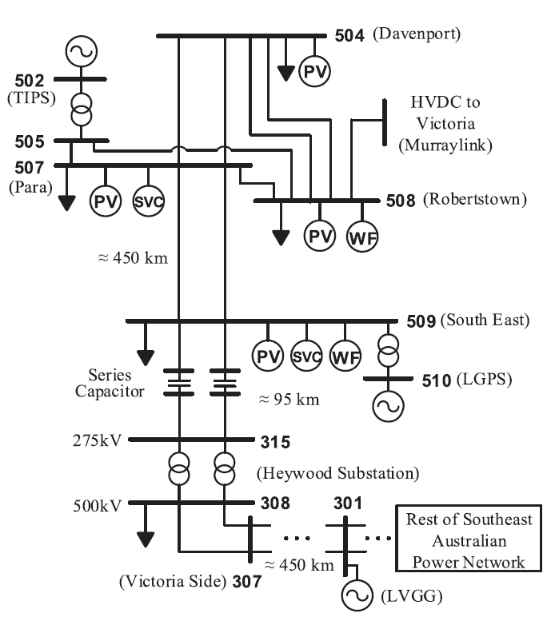
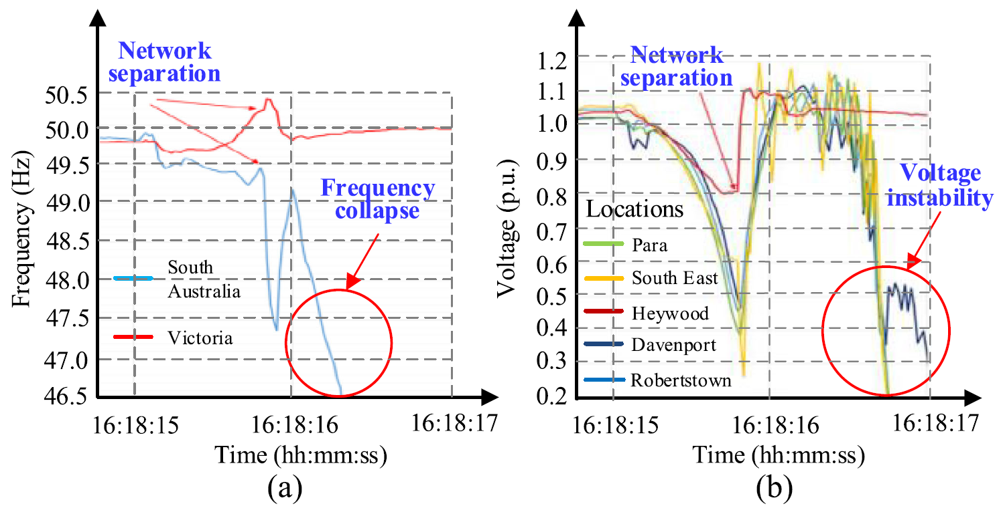
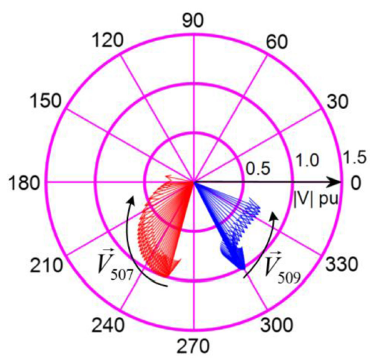
2016 South Australia Blackout
330MW
113MW
883MW
456MW
500MW
R. Yan, N. -Masood, T. Kumar Saha, F. Bai and H. Gu, "The Anatomy of the 2016 South Australia Blackout: A Catastrophic Event in a High Renewable Network," in IEEE Transactions on Power Systems
Notes:
Immediately prior to the event, Supervisory Control and Data Acquisition (SCADA) data showed that the 1,826 MW of electricity demand of SA’s 850,000 electricity customers was being collectively supplied by:
883 MW of SA wind generation.
330 MW of SA gas generation.
613 MW of electricity imports via the two interconnections with Victoria (Heywood and Murraylink).
The total amount of domestic solar photovoltaic (PV) was estimated to be approximately 50 MW.
Extreme weather conditions resulted in five system faults on the SA transmission system in the 87 seconds between 16:16:46 and 16:18:13, with three transmission lines ultimately brought down.
Following these faults, and the resulting six voltage disturbances, there was a sustained reduction of 456 MW of wind generation to the north of Adelaide.
Analysis of high speed monitoring data has shown a further 42 MW of transient wind power reduction. This transient response is the normal expected response of wind farms riding through the voltage disturbances.
Increased flows on the Heywood Interconnector counteracted this loss of local generation by increasing flows from Victoria to SA.
This reduction in generation, and immediate compensating increase of imports on the Heywood Interconnector, resulted in the activation of Heywood Interconnector’s automatic loss of synchronism protection mechanism at South East Substation (SESS), leading to the ‘tripping’ (disconnection) of both of the transmission circuits of the Heywood Interconnector.
As a result, approximately 900 MW of supply from Victoria over the Heywood Interconnector was immediately lost, and the remaining generation in SA was unable to meet the SA demand.
This sudden and large deficit of supply caused the system frequency to collapse more quickly than the SA under frequency load shedding (UFLS) scheme was able to act. Without any significant load shedding, the large mismatch between the remaining generation and connected load led to the system frequency collapse, and consequent Black System.

Slide 13
2016 South Australia Blackout
1.Series compensation between 507 and 509
2. Murray HVDC frequency response
3. Wind emulated inertia
4. Battery storage
5. Operation mode ??
Notes:
1. IGE是指在某次同步频率下，风电机组转子的等效电阻表现为负阻值特性，当转子等效负值电阻大于电网系统(输电线路、变压器等)和发电机定子在此频率下等效电阻之和时，整个风电机组并网系统的等值电阻为负值，形成电气回路的自激，并网次同步电流将持续发散振荡。IGE强调的是一种电气回路的谐振现象。风电机组并网系统的IGE现象通常发生在串补度非常高的情形，并且只涉及电气系统的动态过程，与风电机轴系无关。风电并网系统中暂未发生扭转互作用与暂态扭矩放大作用引起的SSO现象
2.
3.
4.

Slide 14
Resilience-constrained Economic Dispatch
Security-constrained economic dispatch
  “N-1” ,“N-2” ,“N-k” ,“N-1-1”
Resilience-constrained economic dispatch
  Probabilistic
  Sequential Equipment Failure
  Adaptive and Robust

Slide 15
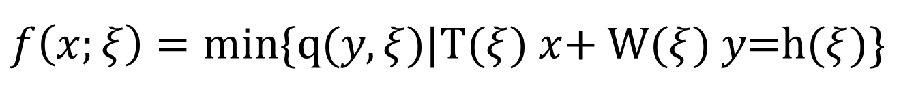
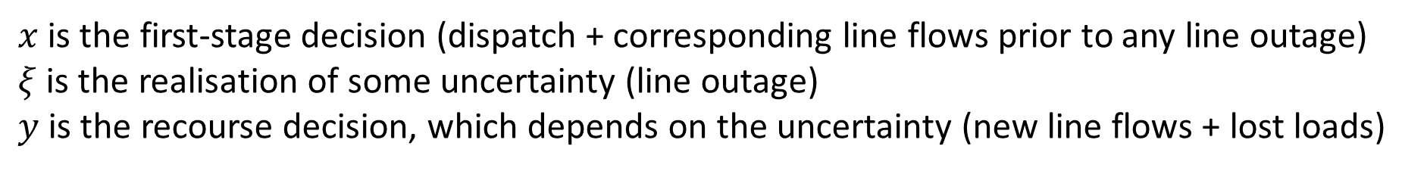
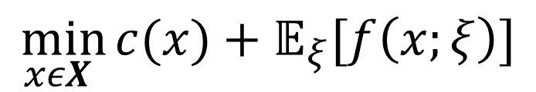
Resilience-constrained Dispatch via Two-stage Stochastic Optimization
$$\min_{xεΧ }{c(x)+𝔼_{ξ}[f\left(x;ξ\right)]}$$
$f\left(x;ξ\right)=min\{q(y,ξ)$|T($ξ$) $x$+ W($ξ$) $y$=h($ξ$)}
$x$ is the first-stage decision (dispatch + corresponding line flows prior to any line outage)
$ξ$ is the realisation of some uncertainty (line outage)
$y$ is the recourse decision, which depends on the uncertainty (new line flows + lost loads)

Slide 16
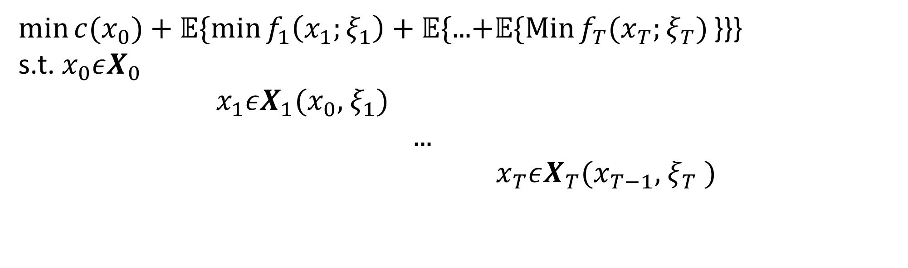
Resilience-constrained Dispatch via Multi-stage Stochastic Optimization
$\min{c(x_{0})}+𝔼\{\min{f_{1}\left(x_{1};ξ_{1}\right)}+𝔼\text{\{...}\text{+}𝔼\{\operatorname{Min}{f_{T}(x_{T};ξ_{T})}\text{\}\}}$}
s.t. $x_{0}εΧ_{0}$
$x_{1}εΧ_{1}(x_{0},$ $ξ_{1})$ $\text{...}$
$x_{T}εΧ_{T}(x_{T−1},$ $ξ_{T}$ $)$

Slide 17
Resilience-constrained Dispatch via Multi-stage Stochastic Optimization
Controls: Active power, load.
Objective: Minimize Cost of dispatch and load shedding.
Constraints: Line capacity, generation capacity, ramp limits, etc.
Locals: Voltage angle, line flow.
States: Active power, equipment status.

Slide 18
Resilience-constrained Dispatch via Multi-stage Stochastic Optimization

Slide 19
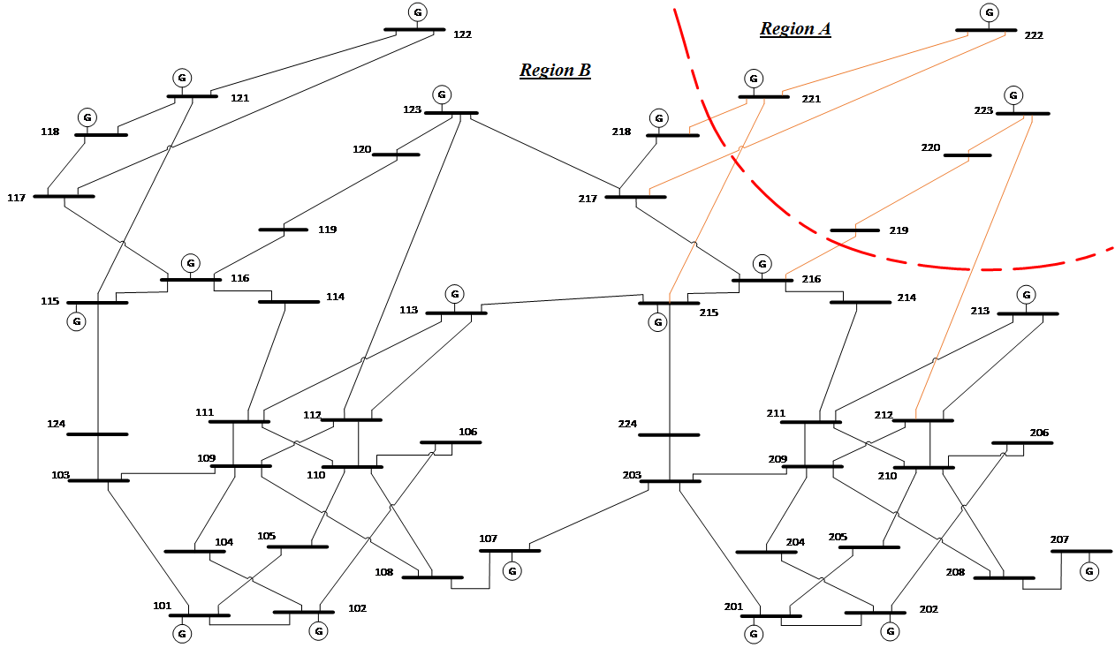
Case Study
Generation: 6810 MW
Load:
5700 MW
Region A Generation:
1360MW

Slide 20
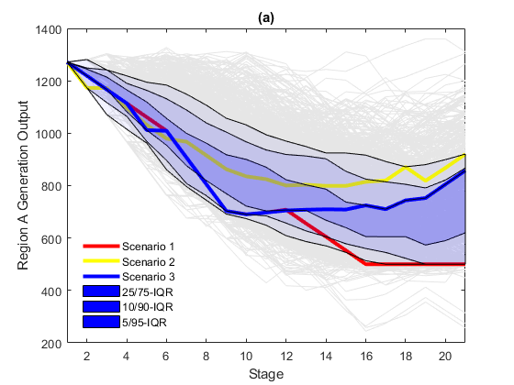
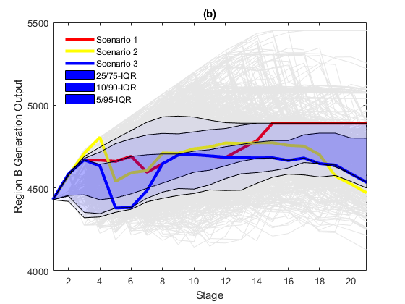
Case Study

Slide 21
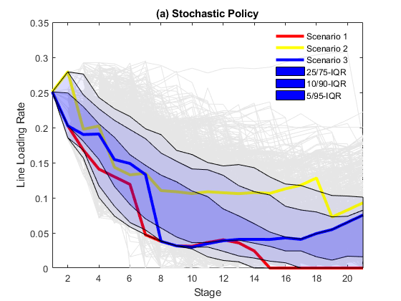
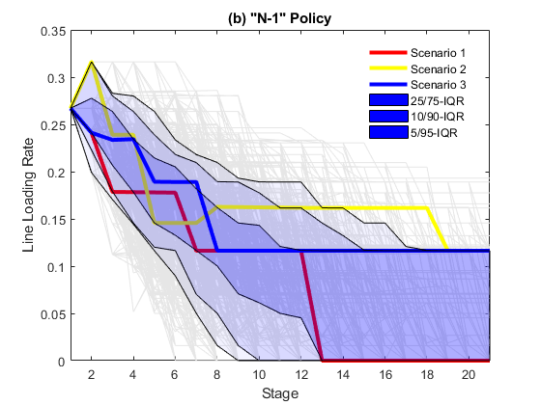
Case Study

Slide 22
Case Study

Slide 23
Case Study

Slide 24
Model limitations and Future work
Probabilistic forecast of equipment failures.
No transient state involved. Policy needs post-optimality dynamic feasibility check.
How to factor in multi-time scale dynamics and hierarchical control in the Multi-stage stochastic optimization framework remains an open question.

Slide 25
Questions?

Slide 26

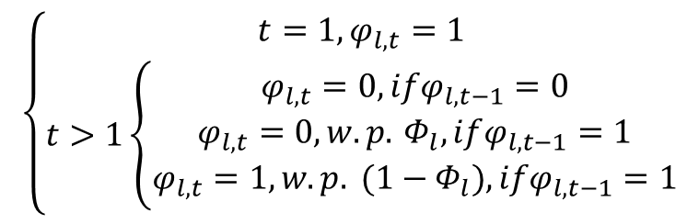

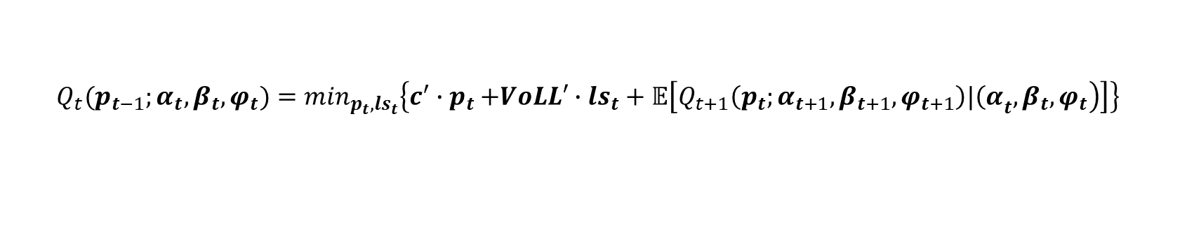


Resilience-constrained Dispatch via Multi-stage Stochastic Optimization
$$Q_{t}(p_{t−1};α_{t},β_{t},φ_{t})=\min_{p_{t},{ls}_{t}}\left\{c^{′}{∙p}_{t}+VoLL′∙{ls}_{t}+𝔼\left[\left.Q_{t+1}\left(p_{t};α_{t+1},β_{t+1},φ_{t+1}\right)|{\left(α\right.}_{t},β_{t},φ_{t}\right)\right]\right\}$$
$$\left\{\begin{matrix}t=1,φ_{l,t}=1 \\ t>1\left\{\begin{matrix}φ_{l,t}=0,ifφ_{l,t−1}=0 \\ φ_{l,t}=0,w.p. Φ_{l},ifφ_{l,t−1}=1 \\ φ_{l,t}=1,w.p. (1−Φ_{l}),ifφ_{l,t−1}=1\end{matrix}\right.\end{matrix}\right.$$
$$0≤{ls}_{i,t}≤{β_{i,t}∙d}_{i,t};∀i∈𝒟,t∈𝒯$$
$$α_{i,t}∙\underline{p_{i}}≤p_{i,t}≤α_{i,t}∙\overline{p_{i}};∀i∈𝒢,t∈𝒯$$
$$0≤{ps}_{i,t}≤p_{i,t};∀i∈𝒢,t∈𝒯$$
$$f_{l,t}=φ_{l,t}∙b_{l}∙\left(θ_{i,t}−θ_{j,t}\right);∀l\left(i,j\right)∈ℒ,t∈𝒯$$
$$−\underline{r_{i}}≤p_{i,t}−p_{i,t−1}≤\overline{r_{i}};∀i∈𝒢,t∈𝒯$$
$$\sum_{i∈𝒢}{p_{i,t}}−\sum_{i∈𝒢}{{ps}_{i,t}}−\sum_{l∈ℒ\left(i,⋅\right)}{f_{l,t}}+\sum_{l∈ℒ\left(⋅,i\right)}{f_{l,t}}=\sum_{i∈𝒟}{{(β_{i,t}∙d}_{i,t}−{ls}_{i,t});∀i∈ℐ,t∈𝒯}$$

