Slide 1
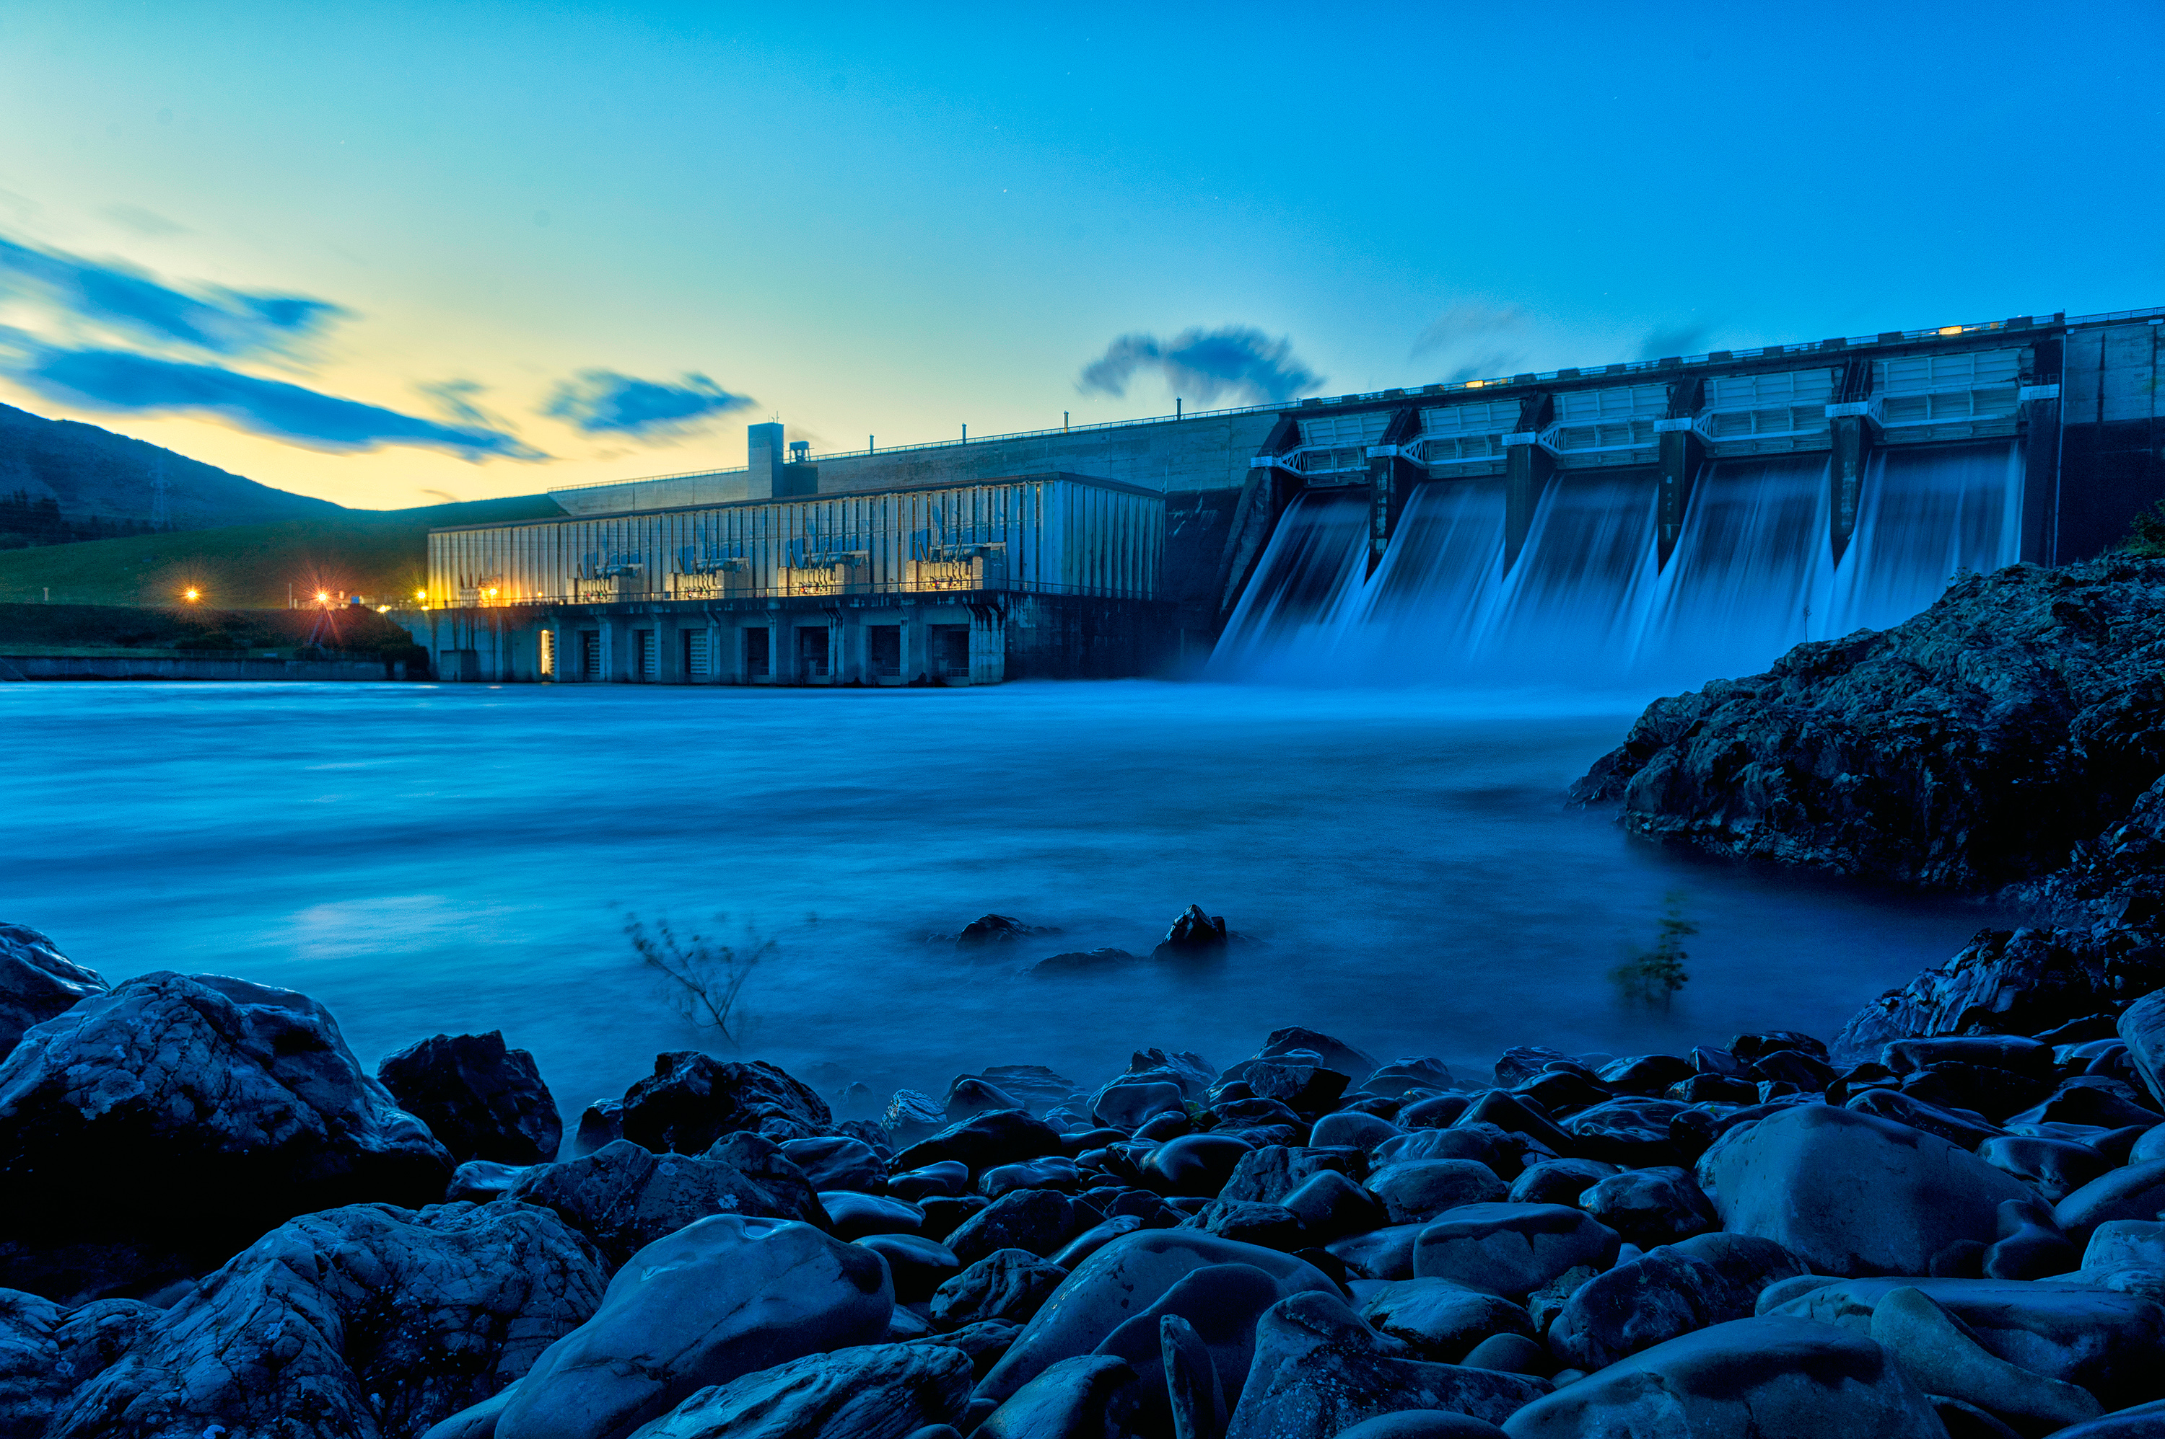

Modelling 100% Renewable Electricity
Greg Sise, Energy Link Ltd
2019
Notes:
Energy Link recently undertook modelling for the Interim Climate Change Committee in relation to a target of 100% renewables in a normal hydrological year. This talk briefly looks at the models used and some of the issues encountered along the way, both in the ICCC and our own modelling of electricity supply with very high penetration of renewables.

Slide 2



I’m talking about…
100% renewables in a normal hydro year
Models deployed in ICCC (and ELL) modelling
Issues of interest

Slide 3
100% Renewables in a Normal Hydro Year
Renewables include geothermal which also emits CO₂
  1.7 Mt CO₂ in 2035 under ICCC’s 100% renewables scenario
Does 100% renewables include forced curtailment of load?
  hopefully not, but it probably requires more active participation by demand than at present
The ICCC was tasked to investigate how to plan for the target of “100% renewables in a normal hydrological year”

Slide 4

What’s a normal hydrological year?
This is an easy one:
Wait until the year is over, and if we got through without a period of significant risk of shortage, then it was a “normal hydrological” year
But looking backwards is difficult to apply operationally!

Slide 5
EMarket
A very detailed electricity market simulation model
Multi-threaded; seems to work best when number of threads = number of physical cores
Can run from day-night down to half hourly time steps
Aggregated grid accurately models power flows, losses on 200+ lines
221 nodes
Market dispatch – our own non-linear optimisation for maximum speed
IR can be turned on, including NMIR (reserves shared across the HVDC link)
Multi-year water values based on own storage time of year, storage in other reservoirs, thermal offers, inter-island transfers, demand, outages, and so on
Longer term storage in Pukaki, Tekapo, Hawea, Manapouri-Te Anau, Taupo, Cobb, Coleridge, and more if desired
River chains – can be optimised if desired (basic operation is actually very good anyway)
Inflows back to 1931, consistent with EA dataset
Run-of-river schemes
Wind and solar farms – renewables.ninja (based on MERRA and SARAH datasets)
Other small generators
Demand elasticity including OCCs
Tiwai triggers at low storage
Contingent storage
Outages
Behind-the-meter solar
EVs
and anything you care to program in the internal ‘Schedule’

Slide 6
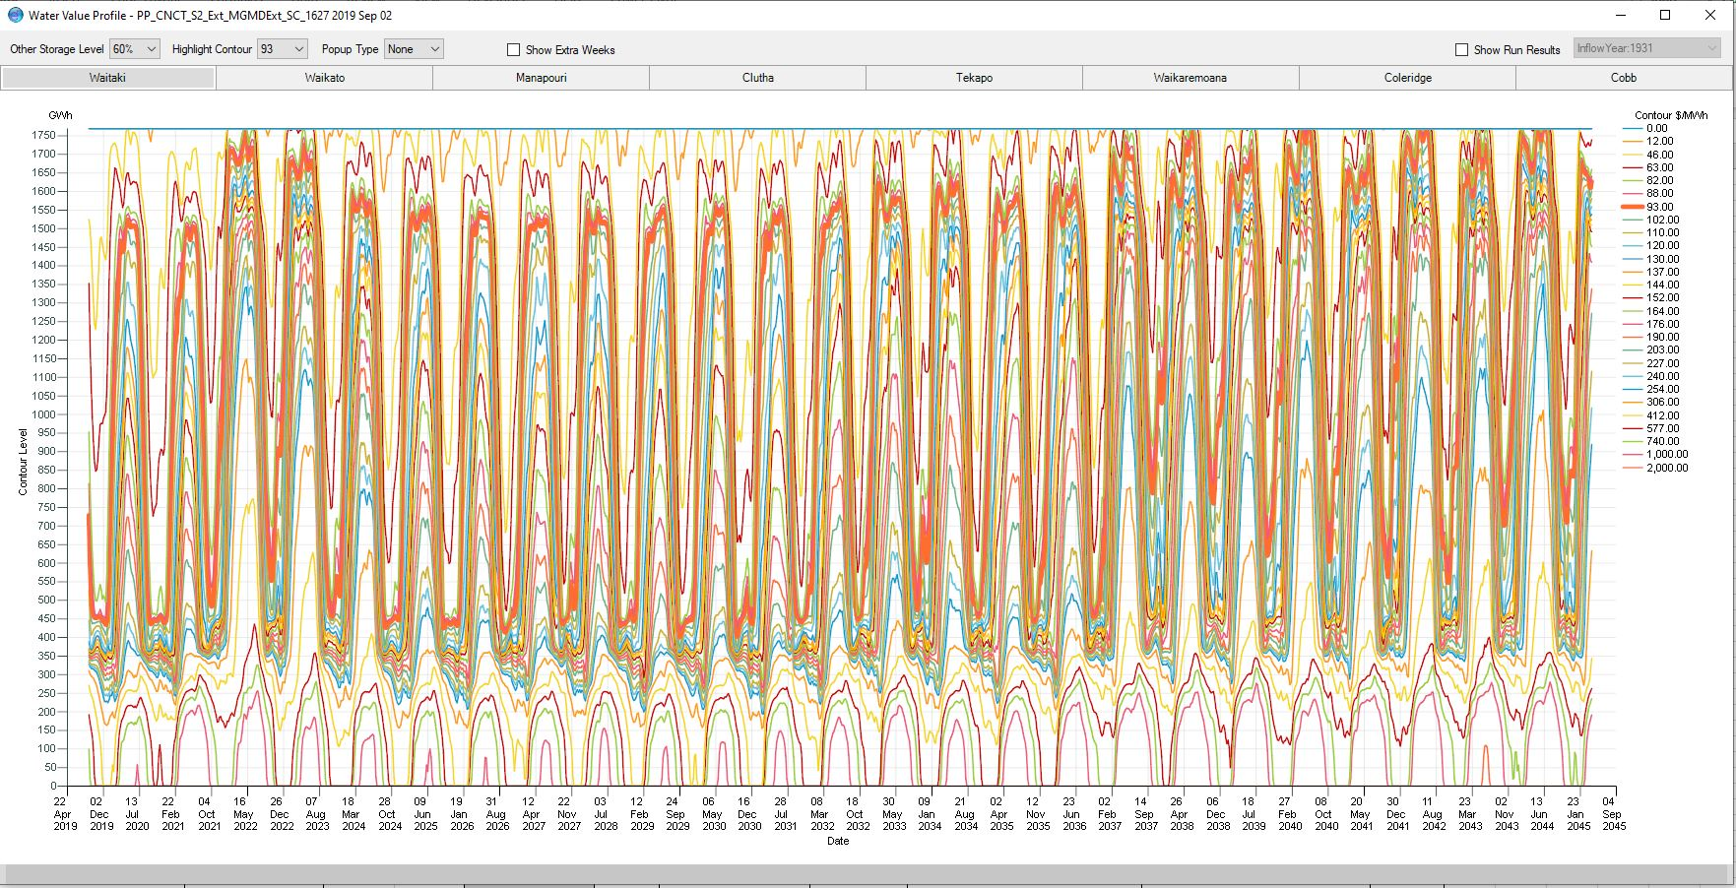
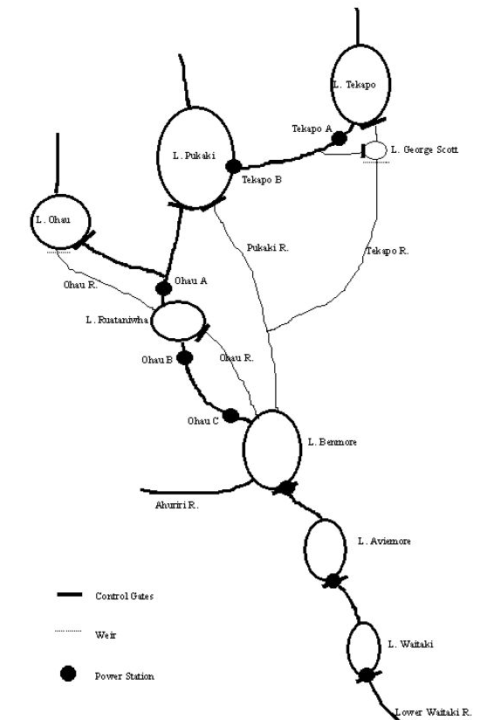
EMarket - Hydro
26 years

Slide 7
I-Gen
Produces build schedules
  currently in Excel, prototype in EMarket
Simulates the process by which market participants decide whether or not to build new plant
LCOEs (previously referred to as LRMCs)
GWAP/TWAP: >1 for peakers; <1 for windfarms; …
Forecast prices and response of price to builds and to demand
Number of years to look-ahead
Location factors
Decision – build if nodal price exceeds LCOE adjusted for GWAP/TWAP

Slide 8
GMarket
Gas market model
1,000 Monte Carlo simulations
Development drilling success rate
Onshore and offshore exploration drilling success rates
Field size distribution
Starting reserves
Reserves to production ratio
Demand and demand elasticity
  Generator assumptions
  Methanex assumptions
LNG import price

Slide 9
Issues
What happens with much more wind connected?
How do water values work with 100% renewables?

Slide 10

Lots of Wind
After approx. 800 MW geothermal built, wind & solar remain
  given current state of knowledge
Wind is over-built to provide adequate backup in dry years
  Capacity factors fall to 30% or less
Calm, cold winter peaks may have little or no wind: non-supply!
  ninja wind data preserved correlations between wind farms down to the hourly level
Solar obviously doesn’t help the winter peak issue
Solutions:
  diversify location of wind farms to reduce correlations between farms
  upgrade HVDC link to support more wind in the South Is
  assumed HVDC charge goes
  add batteries on a large scale
Biomass, pumped storage, hydrogen, …, may be viable in future

Slide 11
Water Values and Spot Pricing
Water values for large hydro lakes are very dependent on the offers of thermal generators
After all thermal is gone, how do the major hydros value water?
Windfarms offer at $12/MWh => wind spilled before water
Calm winter peaks are very short events, priced at $10,000/MWh, but insufficient to raise water values

Slide 12
Water Values and Spot Pricing
Increasing thermal offers
Modelling shows that to maintain prices at close to 99% renewables, remaining peakers have to ramp offers up by a factor of 5
Peakers calm winter peaks AND dry periods

Slide 13
Possible Pricing Alternatives – 2050?
Increase scarcity pricing value many times?
  will have little effect unless they are actually struck: consumers would love that!
Major hydro offers based on LCOE of next plant to be built?
  not directly observable like existing plant offers, differing views on LCOEs
Hedges and retail load provide the revenue?
  persistent low spot prices would incentivise less hedging
New types of hedges?
  Maybe, maybe not: the NZ electricity hedge market moves very slowly
  BUT there is already a swaption between Meridian and Genesis which is effectively a capacity contract
New market structures?
  capacity market, capacity mechanism e.g. enhanced scarcity pricing?

