Slide 1
Long-run Equilibrium Effects of Variable Renewable Energy
The long-run market effects of solar and wind power in a competitive electricity market with free entry and a continuum of thermal technologies.
Pär Holmberg
Research Institute of Industrial Economics (IFN)
Andrew Philpott
University of Auckland
SIAM Conference, Edinburgh

Slide 2

Collaboration with Andy
Two papers on Supply Function Equilibria
Anderson, E. J., Holmberg, P., & Philpott, A. B. (2013). Mixed strategies in discriminatory divisible‐good auctions. The RAND Journal of Economics, 44(1), 1-32.
Holmberg, P., & Philpott, A. B. (2018). On supply-function equilibria in radial transmission networks. European Journal of Operational Research, 271(3), 985-1000.
Application of Market Distribution Function:
Anderson, E. J., & Philpott, A. B. (2002). Optimal offer construction in electricity markets. Mathematics of operations research, 27(1), 82-100.

Slide 3
Summary
VRE (solar and wind) enters
Net demand changes
Thermal fleet adjusts (long run)
Main message
Moderate VRE entry does not lower the long-run price distribution or the loss of load probability.
But it crowds out fuel-efficient baseload and may raise fuel usage and emissions in systems without a domestic carbon cap.
Sufficiently high VRE penetration eventually lowers prices, emissions and fuel dependance.
Renewable targets alone are not a robust substitute for carbon caps, especially not in markets with nuclear power, fossil-based thermal power and negligible energy storage.

Slide 4
Related literature and our contribution
Topic | Representative work | Our contribution
Peak-load pricing / screening curves | Boiteux (1960); Stoft (2002); Zöttl (2010); Chao (2011) | Characterizes long-run effects of VRE entry.
Long-run merit-order effect | Lamont (2008); Antweiler & Muesgens (2021); Newbery (2016) | Full price distribution and its invariance.
Cannibalisation and profile effect | Hirth (2013); Reichenberg et al. (2023) | Driven by correlation between price and demand and VRE output.
Reliability: LOLP and EENS | Chao (1983, 2011); Joskow & Tirole (2007); Holmberg & Ritz (2021) | LOLP invariant to entry and its correlation with demand, but EENS rises.
Fuel use and emissions | Green & Léautier (2015); Holland et al. (2022) | Identify conditions where moderate VRE raises fuel costs and CO2.

Slide 5
Model setting

Slide 6
Model: two-stage competitive equilibrium
Stage 1: investment with free entry. Stage 2: perfectly competitive spot market.
A continuum of thermal technologies, each indexed by its marginal cost c, starting at c = 0.
One VRE technology.
Stage 1: investment
(free entry)
Stage 2: competitive
spot market

Slide 7
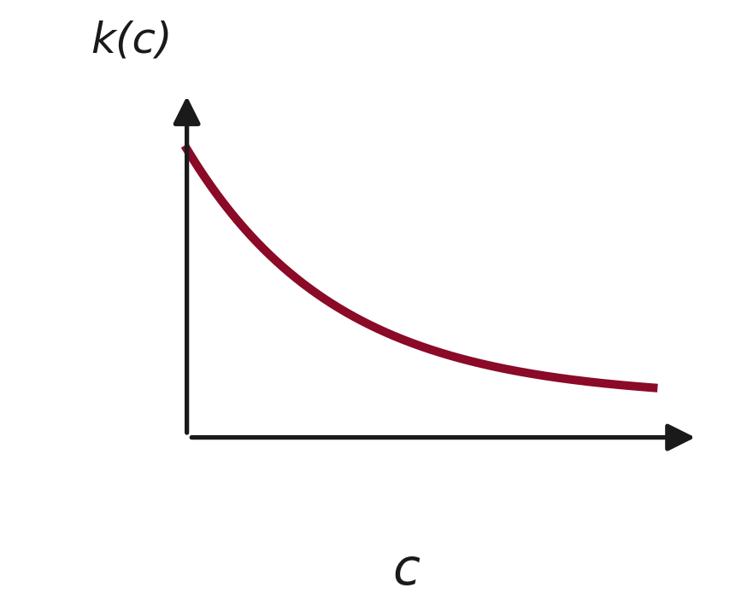
Thermal technologies
Investment cost k(c) is positive, strictly convex and decreasing.
Every technology lies on the efficient frontier; none is dominated.
The c = 0 technology (nuclear, geothermal) has zero emissions; every c > 0 technology has positive emissions.
baseload
peakers

Slide 8
VRE and Demand
Demand d is stochastic and inelastic up to the reservation price (Value of Lost Load) V.
Each VRE unit is a wind-solar mix and a mix across different locations. Each unit is replicable at constant returns to scale.
x is the total VRE capacity.
w is the stochastic VRE availability, which is between 0 and 1.
d and w may be correlated.

Slide 9
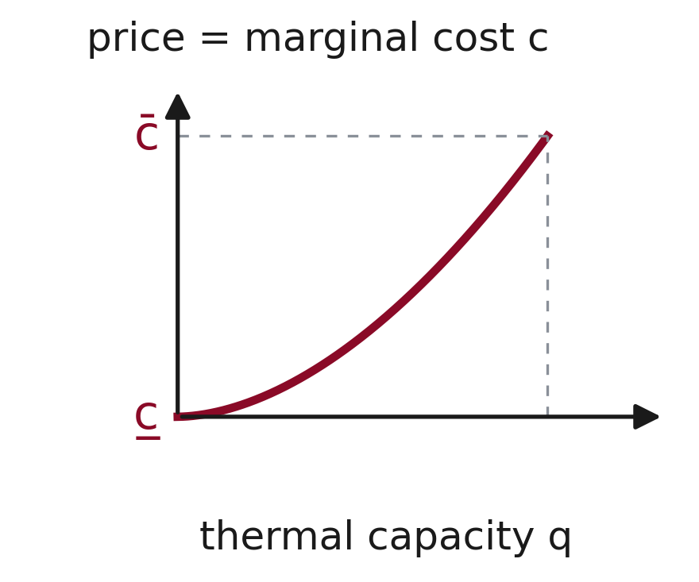
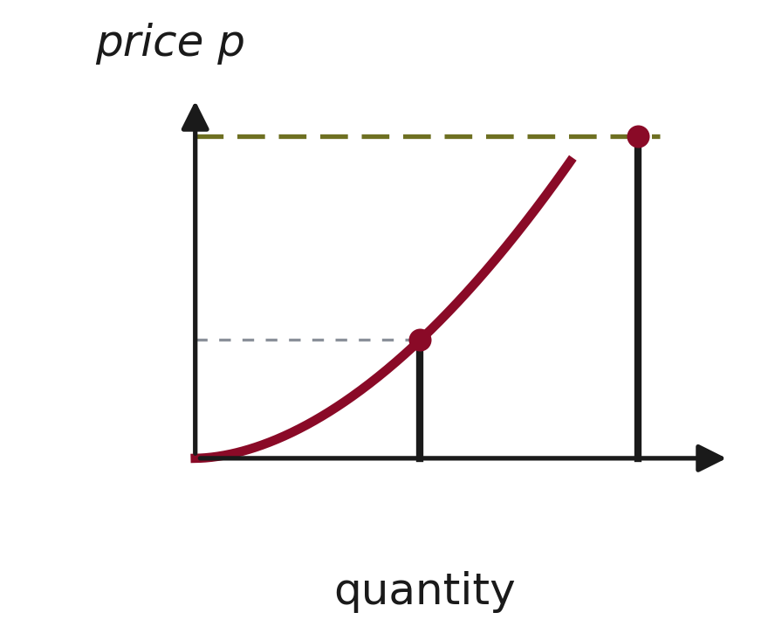
Supply curve, net demand and price
VOLL, V
thermal supply
q(c;x)
Net-demand
Stage 1: investment builds the continuous supply curve q(c;x).
Stage 2: realised net demand d - wx (vertical) sets the price.

Slide 10
Results: long-run equilibrium

Slide 11
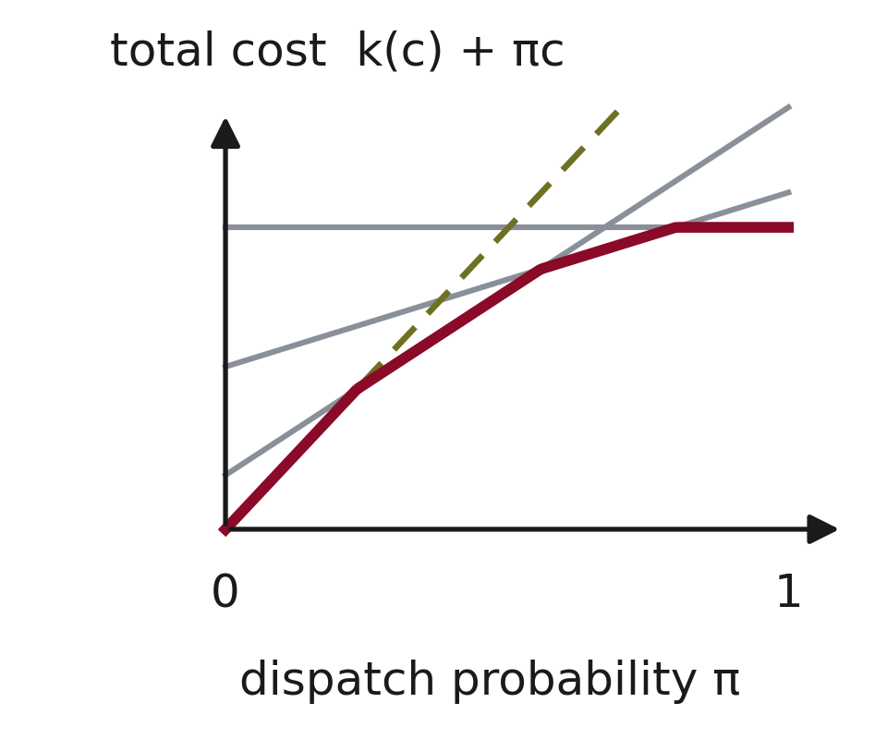


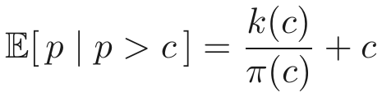
Optimal technology for each dispatch probability
Optimal technology for each dispatch probability =>
peaker
baseload
Can be written as:
Market value equals LCOE for each active technology.
Lower envelope of total cost picks the optimal technology at each dispatch probability.
Special condition for baseload:

Slide 12
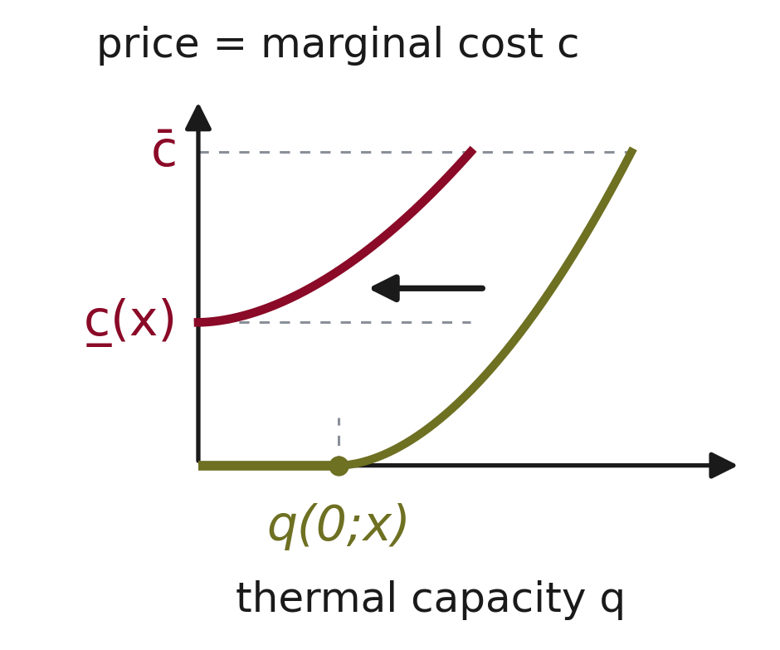
Cutoffs and the effect of more VRE
The upper cutoff is fixed by k(c) and V; it does not move with VRE.
Hence the loss of load probability is invariant to VRE.
The lower cutoff rises at high entry; baseload near c = 0 is crowded out.
VRE shifts thermal supply inwards. Baseload is crowded out for high entry.
Moderate entry: some c = 0 baseload remains.
High entry: all baseload exits (lower cutoff > 0).

Slide 13
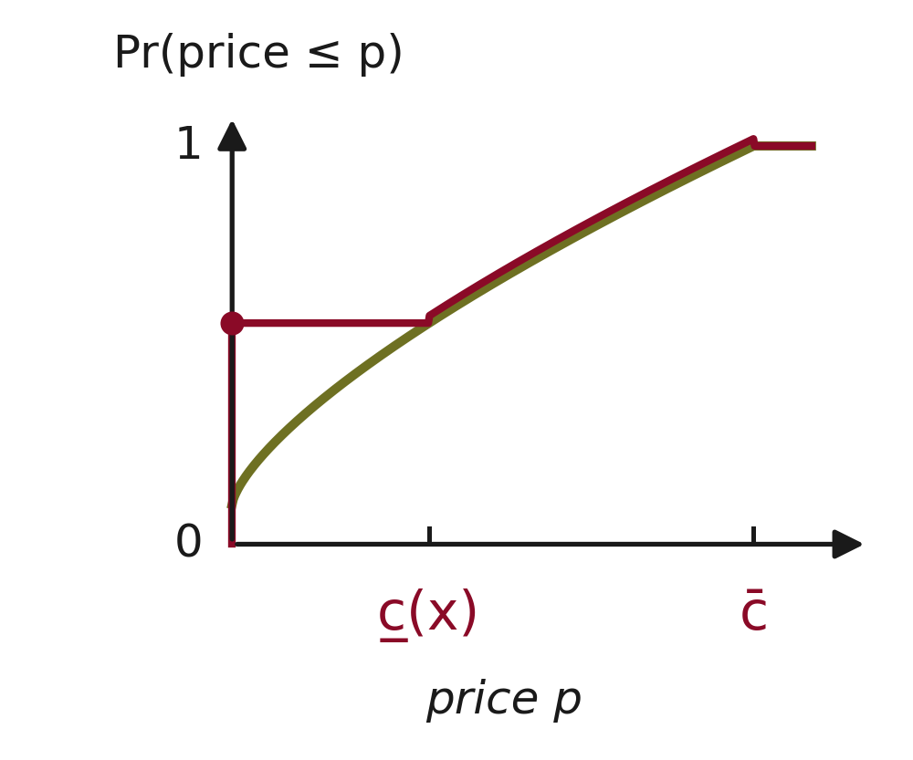
Price distribution and its invariance
Above the lower cutoff, the price distribution is unchanged by VRE.
Below the lower cutoff, all mass collapses to a point at price zero.
Lower-VRE prices first-order stochastically dominate higher-VRE prices.
Moderate entry: cutoff zero, average price unchanged; high entry lowers it.
High VRE entry
Mass at p=0

Slide 14
Consumers: prices and the profile effect
Moderate VRE entry leaves the unweighted average price unchanged.
VRE entry weakens the positive correlation between demand and price, so the demand-weighted price falls.
Consumers with variable demand spend less, even though the price distribution is unchanged.
Flat-demand industry (energy-intensive users) is indifferent at moderate entry.
Such industry strictly prefers high VRE entry, irrespective of its risk preferences.
Variable-demand consumers gain from a weaker price-demand correlation; flat-demand industry needs high entry.

Slide 15
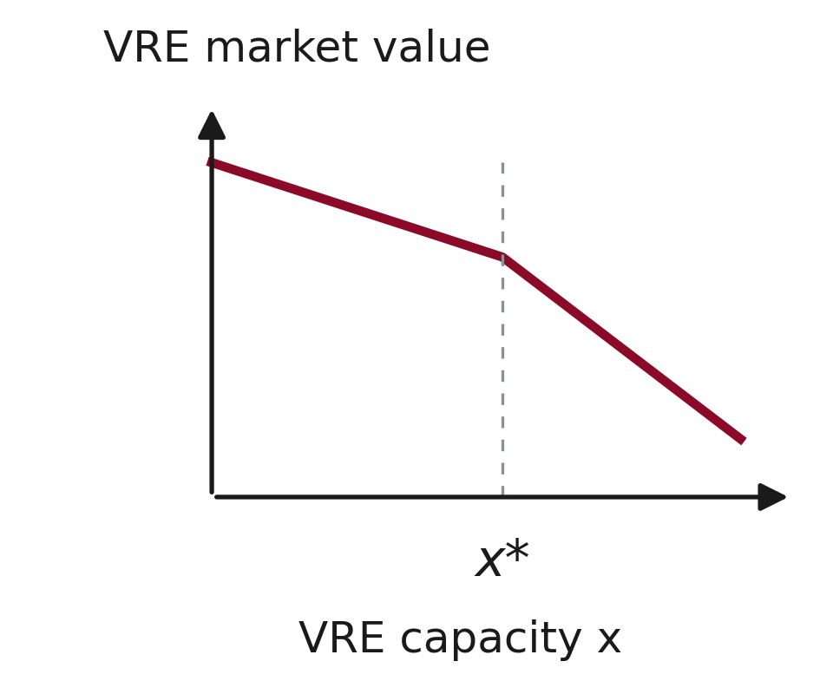
Cannibalisation and market value of VRE
VRE entry weakens the correlation between VRE output and price, so the output-weighted price (VRE market value) falls=> cannibalisation effect.
Cannibalisation strengthens for high VRE entry due to the merit-order effect.
Less correlation between w and p
Less correlation plus merit-order effect.

Slide 16
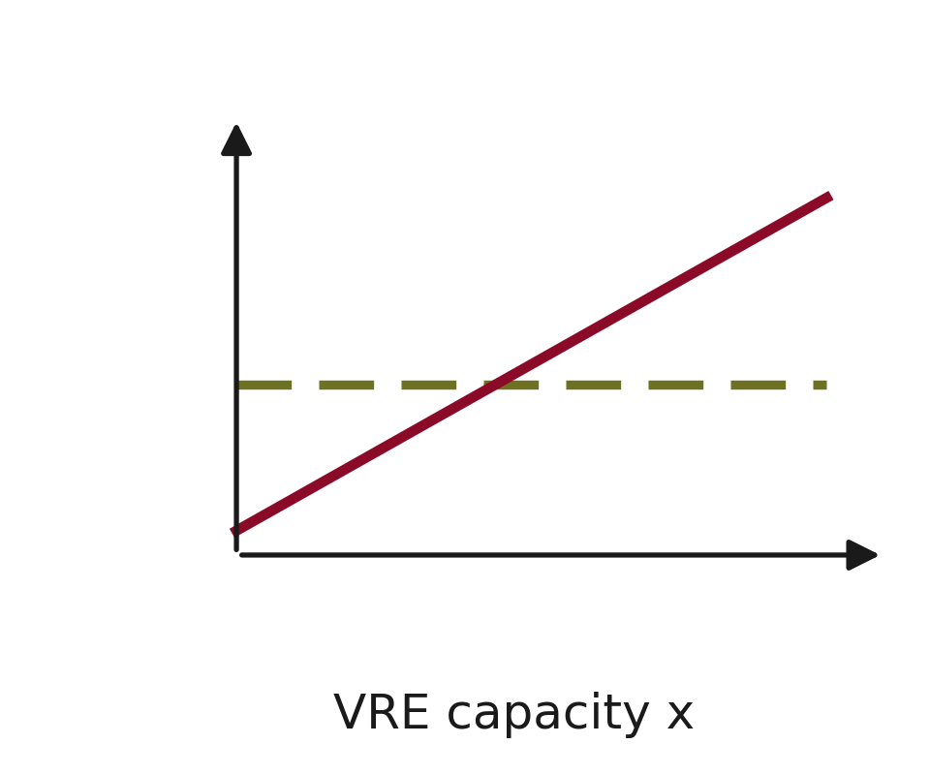
Reliability: LOLP and energy not served
In the long run, LOLP is unchanged by VRE.
But given a shortage, expected energy not served can rise with VRE.
For constant demand, expected rationed energy increases linearly with x.
EENS
LOLP

Slide 17
Short run versus long run
Effect of VRE entry | Short run | Long run
Average price | Falls (merit-order effect) | Unchanged for moderate entry; falls for high entry
Volatility | Rises | Unchanged for moderate entry; rises at high entry (more zero prices)
VRE market value | Falls | Falls, but to a less extent.
Fuel use and emissions | Decrease | Rise with moderate entry under constant demand
The long-run equilibrium mitigates and sometimes overturns short-run results.

Slide 18
Constant demand: fuel costs and emissions

Slide 19
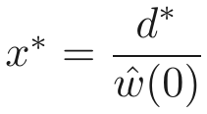


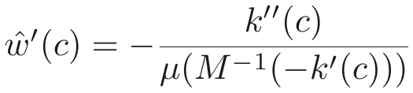
Constant demand: fuel costs and emissions
Baseload is replaced by mid-merit and peakers, which burn fuel.
Operating costs and emissions rise linearly with moderate entry.
Largest effect when k(c) is highly convex for mid-merit and mid-range w is rare.

Slide 20
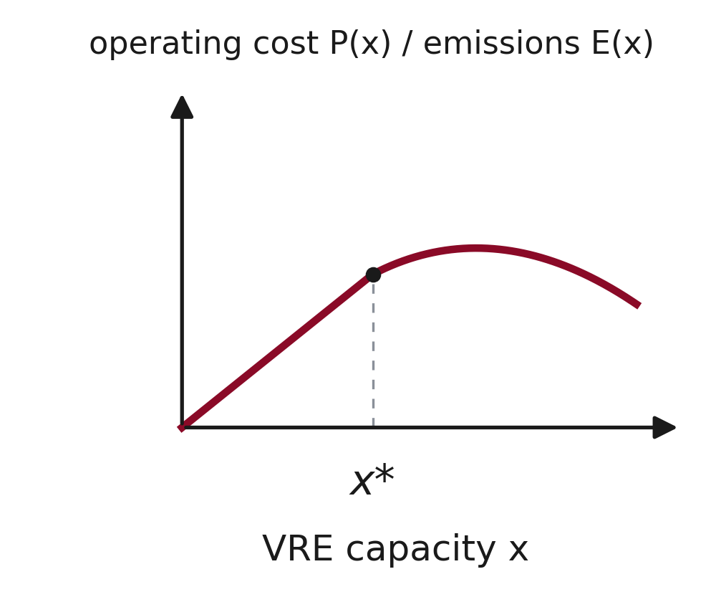
How emissions and costs evolve with VRE
With constant demand, emissions start at zero when x = 0.
They rise linearly up to the high-entry threshold x*.
Beyond x*, baseload has exited; growth continues at a slower rate.
Eventually emissions and fuel costs decline in a non-linear way.
Sufficiently high VRE is needed before they fall.

Slide 21
Where the mechanism matters most
VRE entry has its largest effect on emissions in markets with low demand variability, fuel-efficient baseload (nuclear or geothermal), negligible hydropower, and no domestic carbon cap.
Storage or fossil-free thermal generation soften the effect.
Jurisdictions where VRE entry can have a large effect on domestic emissions
Countries
Belarus, Belgium, Czechia, Hungary, United Arab Emirates
US states
Georgia, Nevada, North Carolina, South Carolina
An EU-wide cap holds the bloc's total emissions, but a small member's emissions may still rise.

