Slide 1
Integrated Modelling of Electricity and Water Markets: A Progress Report From Canterbury S Dye, PR Jackson, R James, I Mahakalanda, A Pinto, JR Raffensperger, EG Read, RA Read & SR Starkey Presented to EPOC 2012 by Grant Read University of Canterbury

Slide 2
Background
Canterbury University intends to eliminate the “Operations Research” component of its Management Science (MSCI) programme, including staff involved in:
The Energy Modelling Research Group (EMRG)
The Water Markets Research Group (WMRG)
But some work on electricity and water market issues is continuing, for now....

Slide 3
Staff: Still involved with supervision
Individual outcomes still uncertain, but...
Shane Dye: Teaching at UC until end of year
Planning to stay in Christchurch
Ross James: Continuing at UC
Fritz Raffensperger: On leave overseas until end of year
Future plans under consideration
Grant Read: Resigned years ago
Planning to stay in Christchurch

Slide 4
More Students
Stephen Starkey: Finishing PhD early 2013 Urban Water Scheduling – Enhancing Allocation with Market Pricing Mechanisms
Indra Mahakalanda: Started PhD late 2011 Analysis of Participant Behaviour in an Integrated Electricity-Water Market
Rosemary Read: Hons Project 2012
Experimental CDDP Re-development for Electricity Authority

Slide 5
Students
Antonio Pinto: Submitting PhD this month Smart markets for Runoff and Sediment Discharge
Peter Jackson: Resuming PhD in September
Generation Investment Incentives in the Public and Private Sectors
Junfu Jiang & Hiroshi Kasai Hons Project 2012 Correlation of wind and inflow for Meridian

Slide 6
Integrated Market Simulation
The last three have been working on a joint electricity/water market simulation suite:
Implemented in Matlab
Simulates market performance
Using Stochastic Constructive Dual DP (like SPECTRA) to clear markets
Assuming differing system parameters, bid forms, period lengths and treatments of uncertainty
Initial results presented to recent CIGRE workshop, and available on website soon

Slide 7
Easy Implementations of Generalised Stochastic CDDP Models for Market Simulation Studies S. Dye, E.G. Read, R.A. Read and S.R. Starkey 4th IEEE/Cigré International Workshop on Hydro Scheduling in Competitive Markets Bergen, Norway, June 2012
SCDDP is ideal tool for market design comparisons because:
It facilitates simulation over all possible outcomes
Accommodates any convex intra-period market clearing module
SCDDP is easily implementable for single reservoir lag-one Markov problems
A simple Excel model provides a good tool for understanding and visualising reservoir optimisation
But higher-dimensional models will require discretisation based on critical dual relationships (as in SPECTRA)

Slide 8
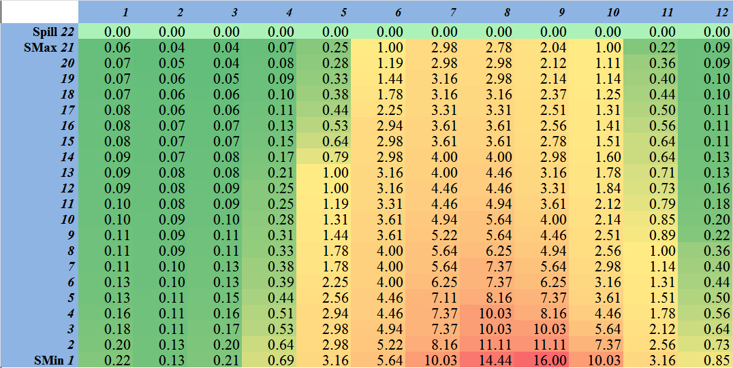
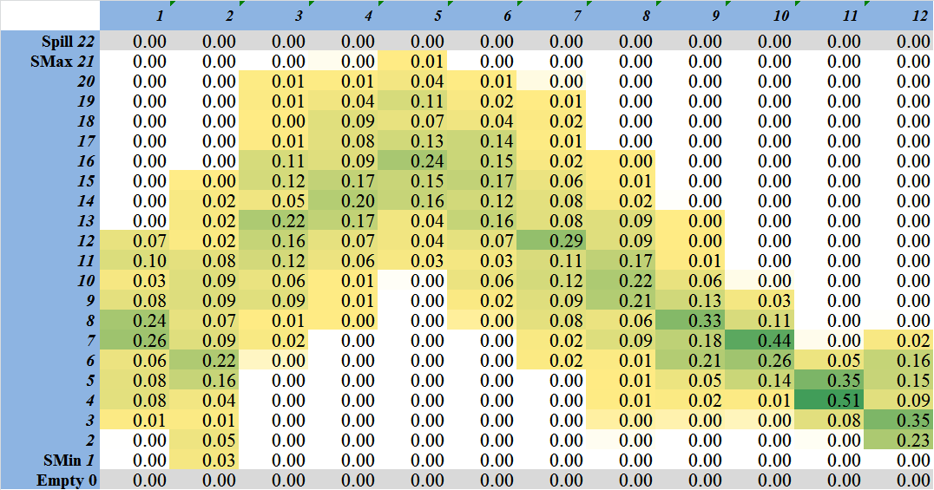
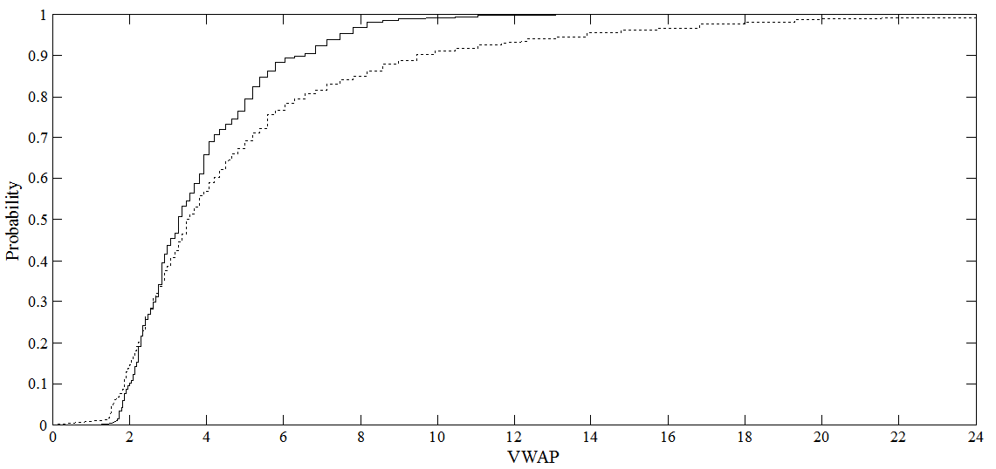
Typical Results (from Excel model)
MWV surface: from CDDP
Simulated “trajectories”
Cumulative distribution of average welfare or (in this case) market price
Stochastic
Deterministic

Slide 9
Stochastic vs Deterministic Water Market Design: Some Experimental Results S.R. Starkey, S. Dye, E.G. Read and R.A. Read 4th IEEE/Cigré International Workshop on Hydro Scheduling in Competitive Markets Bergen, Norway, June 2012
Explores:
Benefit/price impact of alternative market designs (particularly wrt modelling of stochasticity)
How market design performance varies with storage/release capacity, demand curve elasticity etc
Conditions under which simplified market mechanisms could suffice

Slide 10
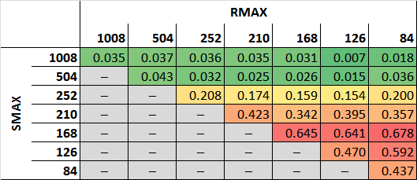
Typical Results
(Value gain from stochastic modelling) /(normal market value)
Using a stochastic model to clear market makes little difference if ratio of storage capacity to inflow variation is:
Very small.. Because we have no control
Very large... Because we can not really go wrong

Slide 11
Developments
Rosemary Read:
(probably) generalising (inter-period) SCDDP
Something like SPECTRA in a more general form
Indra Mahakalanda:
Modelling more realistic agent behaviour
Using a much more detailed intra-period model of integrated catchment operation for both generation and consumptive use

