Slide 1
SPD and Intra-day Uncertainty
PROF. ANDY PHILPOTT, DR. GOLBON ZAKERI, NICHOLAS PORTER

Slide 2
Previous Works
A.B. Philpott and Z. Guan- Models for estimating the performance of electricity markets with hydro-electric reservoir storage (2013)
Approximated New Zealand’s transmission network as an 18 node model.
Compared historical dispatch to a centrally dispatched model with perfect information about demand and inflows.
Fuel costs were 10% lower for the centrally dispatched model, when solved on a daily basis between 2005 and 2009.
These inefficiencies may be due to uncertainty in demand, market power or risk aversion. The exact cause is not clear.

Slide 3
Aim
Develop models for the offering, scheduling, pricing and dispatch of the New Zealand Electricity Market.
Assess the inefficiency caused by uncertainty in demand in the New Zealand Electricity Market.
Quantify the impact on efficiency caused by a day-ahead market.

Slide 4
Introduction
The New Zealand wholesale electricity market operates through a central pool.
Purchaser’s bids and operator’s offers are submitted through 48 half-hour trading periods.
Unlike most overseas market, New Zealand has no day-ahead energy trading.

Slide 5
Introduction
Advantages of a Day-Ahead market
It is more efficient to schedule unit commitment through a common pool over several trading periods.
Generator’s offers do not need to be distorted in order to manage unit commitment.

Slide 6
General Model Assumptions
These models are not strategic: generators offer into the market at fuel cost. The fuel cost for Hydro and Geothermal stations is assumed to be zero.
Unit commitment is neglected, and smooth convex quadratic functions are used for the hydro production functions and the thermal cumulative cost functions.

Slide 7
Clairvoyant Model Formulation
Centrally planned solution, assuming that the demand is known for the day
The objective is to minimize the cost of fuel consumption over the planning horizon (Quadratic).
The network is constrained by upper bounds on transmission line flows, voltage angle constraints, and quadratic thermal losses.
The dispatch is constrained by the generators’ offers, ramping constraints, and demand for the system must be met.
Historical reservoir volumes are used as the starting point and the minimum endpoint for the planning horizon.
Conservation of mass constraints model the quadratic relationship between power generation and flow rate, as well as time delays between reservoirs.
The system is further constrained by limits on reservoir volume, ramping, spill, and generation.
Output:
Dispatch Schedule for the day.
Prices for the day

Slide 8
Comparison
The clairvoyant model produces a competitive equilibrium with perfect information.
In order to assess the effect of uncertainty in demand, we compare the results of the Clairvoyant model to a model that simulates a half-hourly offer and dispatch mechanism with uncertainty in demand.

Slide 9
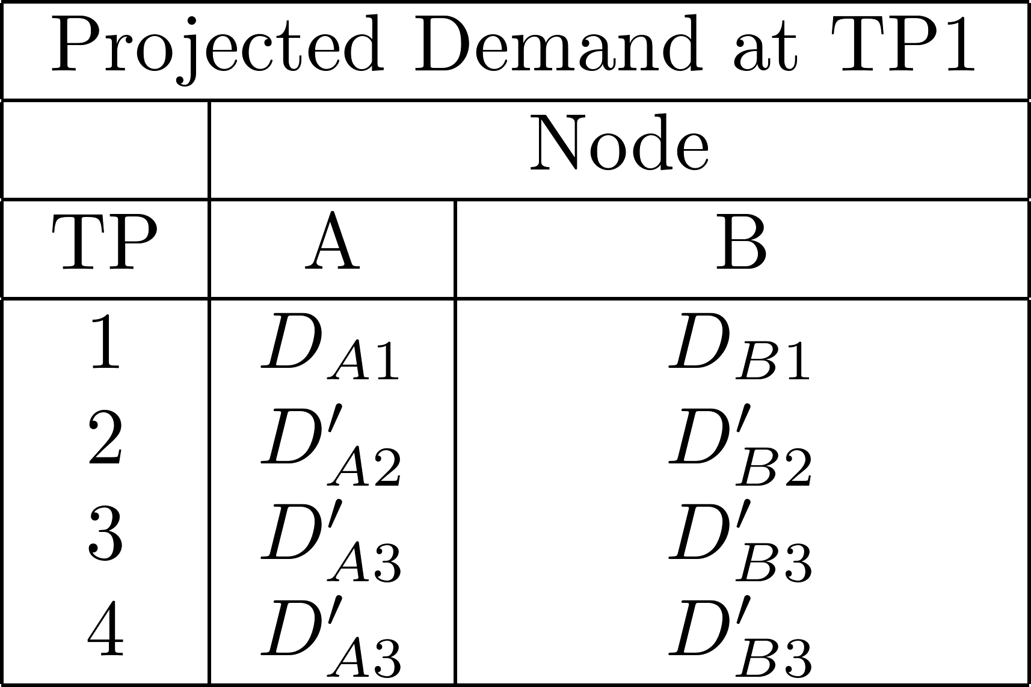
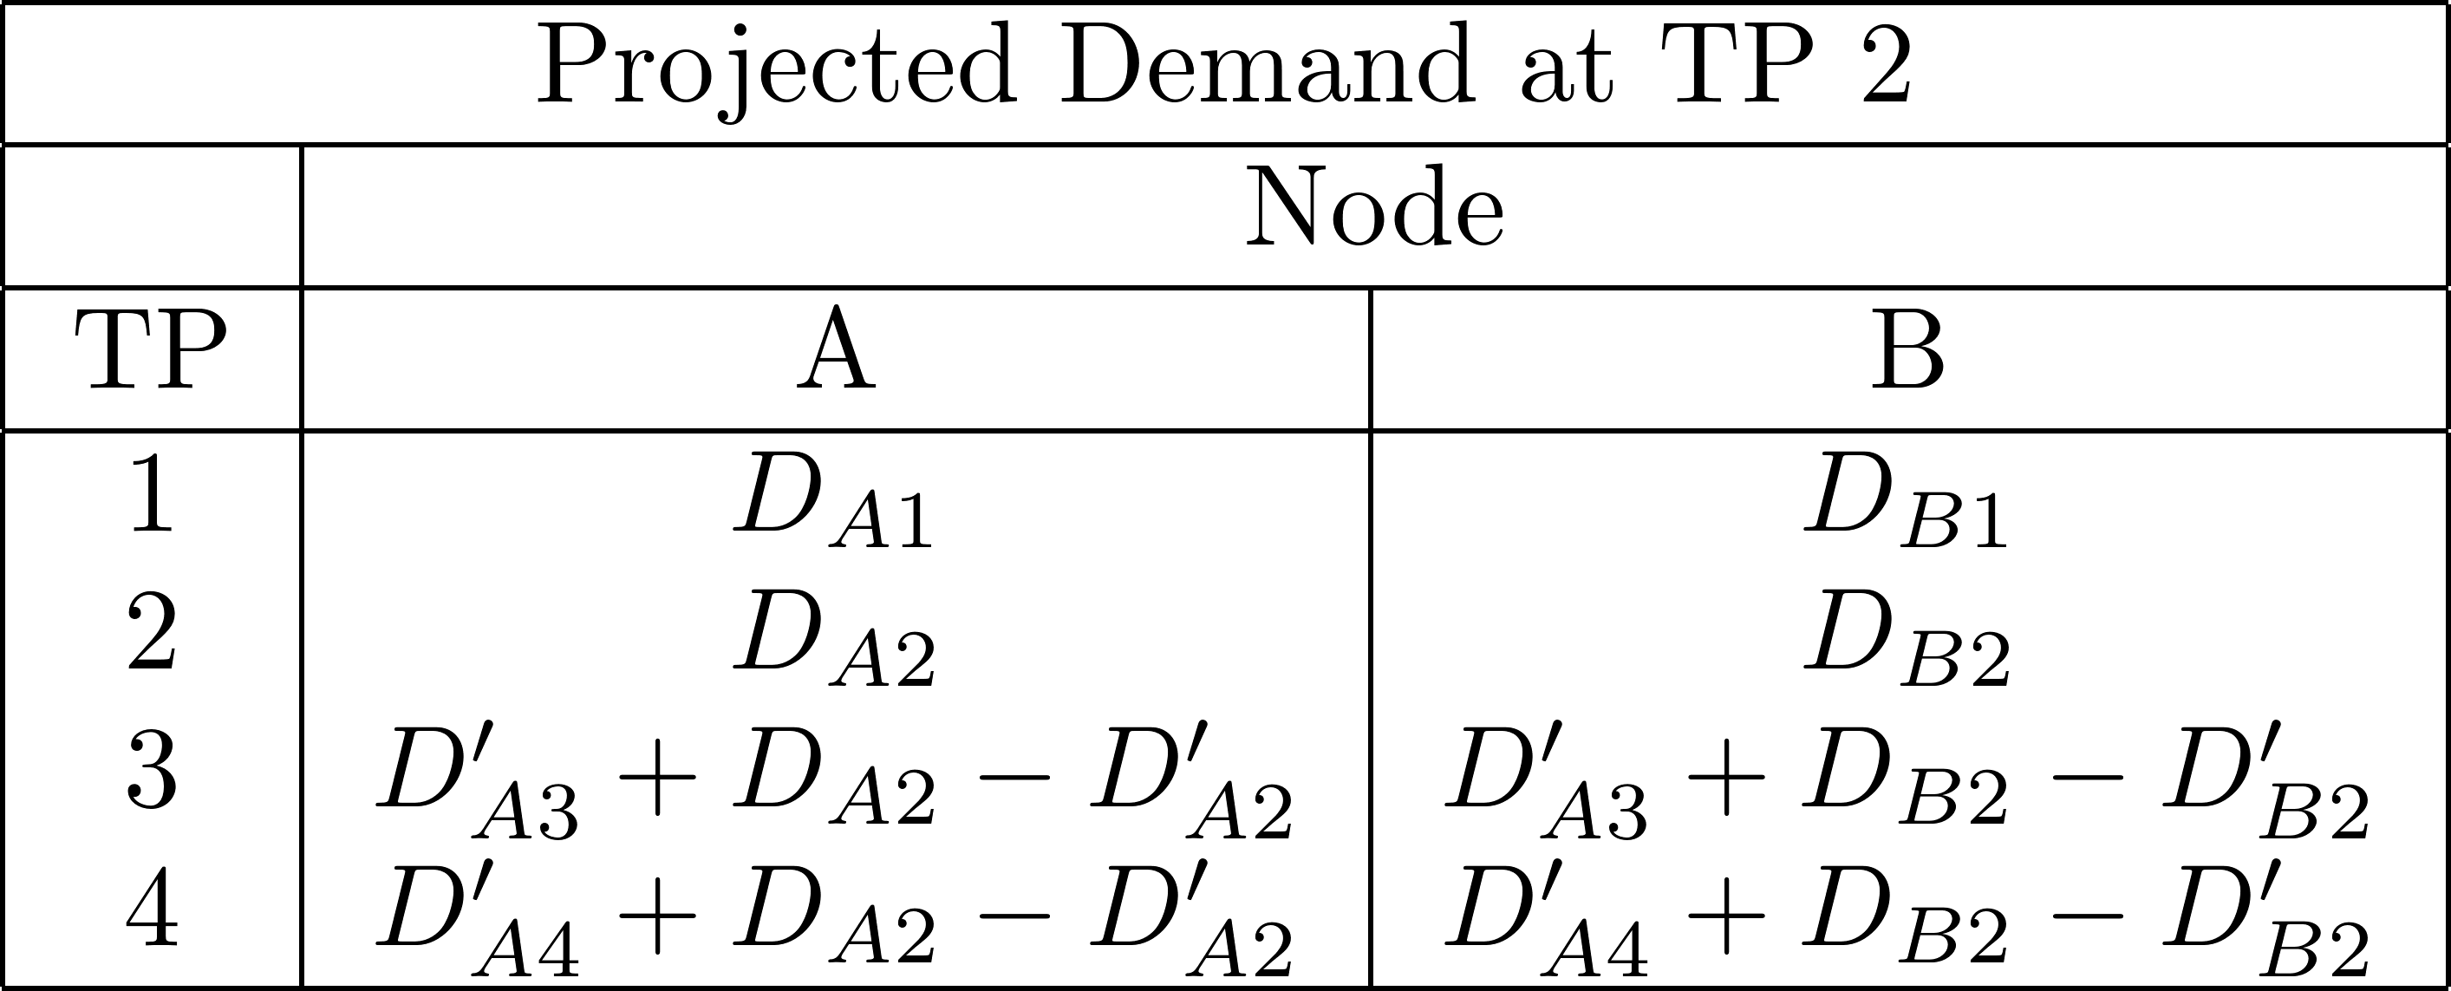
Demand Forecasting
In order to model the intra-day uncertainty, a process of demand forecasting must be developed.
The initial demand estimate comes from averaged historical demands based on season and day of week.
As the true demand for a period becomes known, the demand for all subsequent periods is reforecasted.
Projected demand for all subsequent periods is increased or decreased by the difference between the actual demand and the projected demand for the demand that has just become available.

Slide 10
Half-Hourly Dispatch Model
We have developed a model that simulates a half-hourly offering and dispatch process similar to that in the New Zealand Electricity model.
Unlike the Clairvoyant model, the demand is uncertain.
Within this model, there are a few sub-models:
A river-chain optimisation for each offering hydro generator.
An SPD model

Slide 11
River Chain Formulation
The objective is to maximize the revenue across the planning horizon, given the provisional price vector.
Historical reservoir volumes are used as the starting point and the minimum endpoint for the planning horizon.
Conservation of mass constraints model the quadratic relationship between power generation and flow rate, as well as time delays between reservoirs.
The system is further constrained by limits on reservoir volume, ramping, spill, and generation.
Output:
Offers for SPD

Slide 12
SPD Formulation
The objective is to minimize the cost of fuel over the planning horizon (Quadratic).
The network is constrained by upper bounds on transmission line flows, voltage angle constraints, and quadratic thermal losses.
The dispatch is constrained by the generators’ offers, ramping constraints, and demand for the system must be met.
Outputs
Block Dispatch for the hydro generators.
Thermal Dispatch.
Prices.

Slide 13
Half-Hourly Dispatch Algorithm
The half hourly model is solved 48 times for a single day.
At each trading period the following steps are followed:
Hydro generators calculate offers by solving river chain problem maximising revenue using provisional prices.
Thermal generators offer maximum generation at fuel cost. Hydro generators offer their quantity at zero cost.
Current period’s actual demand becomes known, and demand for remaining periods is reforecasted.
System Operator solves SPD problem minimizing cost of fuel consumption over remaining periods.
Price for current period is set and SPD outputs new price signals.
Thermal Dispatch is fixed for current period
Hydro generation is allowed to be rearranged, provided the sum of rearranged generation is equal to the sum of the dispatch.

Slide 14
Network Assumptions
A subset of 8 nodes in the 18 node New Zealand transmission network is assumed for computational ease.
Reserve, frequency and n-1 security are neglected in this model.
A model with a larger network with more realistic constraints is being developed through vSPD.

Slide 15
Experiment 1
The first experiment involves direct comparison between the clairvoyant model and the half-hourly model.
The two models are compared over 16 winter days across 2008 and 2009.
Historical demand is used as the true demand for both models.
Average demand across sample days is used as the initial projected demand for the half-hourly model.

Slide 16
Experiment 1 Results
From this experiment, we see the total cost of fuel consumption is almost twice as high for the half-hourly model than it is for the clairvoyant model.

Slide 17
Experiment 1- Aggregated Hydro Dispatch

Slide 18
Experiment 1- Results
Also of interest is cost to consumer.
We see almost 12% higher cost to the consumer for the clairvoyant model compared to the half-hourly model.

Slide 19
Experiment 1- WKM Half Hour Prices

Slide 20
Illustration of Pricing Phenomenon
Consider a centrally planned clairvoyant dispatch model, run at a single node across two time periods with one thermal generator and one hydro generator. The problem is to manage the hydro and thermal dispatch over the planning horizon.
Assumptions:
Two time periods and one node.
is the thermal generation at period
Demand for period 1 is 2 MW and demand for period 2 is 2MW
Hydro Generation = 2.2 MW and thermal generation makes up the remaining 1.8MW
Cumulative Fuel Cost for thermal generator at period is given as
Cost of hydro generation is zero. Therefore, we assume that, if , then the market price,
If then

Slide 21
Illustration of Pricing Phenomenon
Consider a case where the total cost of fuel consumption across both periods is being minimized:
Setting
Differentiating this and setting to zero we get:
and
This solution produces prices and the total consumer cost is
The total cost of fuel consumption is

Slide 22
Illustration of Pricing Phenomenon
Consider a case where and
This produces and
The total cost to the consumer is and the cost of fuel consumption is
This solution has a fuel cost that is 8.2% higher than the solution on the previous slide. However, the cost to the consumer is 55% lower for this solution.
This shows that minimizing the cost to consumers across the two trading periods does not necessarily produce an efficient dispatch.

Slide 23
Illustration of Pricing Phenomenon
A=2.36
A=2.36
A=0.981
A=0.981
A=2.124
A=2.72

Slide 24
Experiment 2
In order to smooth this dispatch, and allow for more consistent prices, we consider two approaches.
The first of these approaches is to tighten the ramping constraint on the hydro generators
For the same 16 days from experiment 1, the model is rerun with a ramping limit of 20% of maximum generation per hour.

Slide 25
Experiment 2 Results
By restricting the ramp rates, we see the fuel consumption cost is 23.5% higher for the half-hourly model than it is for the clairvoyant model.

Slide 26
Experiment 2- Aggregated Hydro Dispatch

Slide 27
Experiment 2- Results
Restricting the ramp rate made the cost to the consumer 9.1% higher for the half-hourly model than compared to the clairvoyant model.

Slide 28
Experiment 2- WKM Half Hour Prices

Slide 29
Experiment 3
The second approach to smoothing the results is to model a contract that stipulates the minimum amount each hydro generator must offer at each trade period.
In this experiment, we looked at two particular days and simulated 20 demand scenarios for each.
The days are the same day of the week, and are both winter days, so have the same initial projected demand
In order to find the amount of generation to be contracted, a central plan is solved using an average historical demand.
The contracted hydro generation for each generator is then set to 80% of the generator’s total hydro generation from the central plan.
The demand scenarios come from a normal distribution based on historical data.
Compared the clairvoyant and halfhourly models with and without the generation contract.
The averaged historical demand is used as the initial projected demand.

Slide 30
Experiment 3
For the first day, without a generation contract we see a 22.1% higher cost of fuel for the half-hourly model than for the clairvoyant model.
Including a contract drops the difference in consumption to 1.8%
For the second day, without a generation contract, we see a 500% higher cost of fuel for the half-hourly model than for the clairvoyant model.
Instituting a contract drops the difference in consumption to 165%

Slide 31
Experiment 3- Day 2 Results
Why do we such a big difference between the two models on the second day?
Plenty of water for the second day results in very low cost for the clairvoyant solution.

Slide 32
Experiment 3- Day 1 Results
Looking at a single scenario of experiment on Day 1.

Slide 33
Experiment 3- Consumer Cost
For the first day, without a generation contract we see a 19.8% higher cost to the consumer for the clairvoyant model than for the half-hourly model .
Including a contract drops the difference in consumer cost to 1.4%
For the second day, without a generation contract, we see a 10.6% higher cost to the consumer for the clairvoyant model than for the half-hourly model.
Instituting a contract drops the difference in consumer cost to 6.2%

Slide 34
Experiment 3- Day 1 Results

Slide 35
Conclusions
Too early to make conclusions about the effect of inflexibility to demand uncertainty.
Minimizing fuel cost does not necessarily minimize the cost to the consumer.
Tightened ramping and contracted generation provides us with smoother and more intuitive dispatch schedules.
Tightened ramping especially provided more intuitive customer costs

