Slide 1



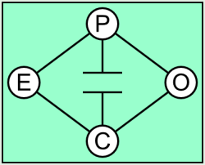
Chilean market design for a single buyer approach
Prof. Rodrigo Palma Behnke
Mrs. Angela Flores
July 9th

Slide 2
The Chilean power system is known for its early adoption of a liberalized market structure. The original set-up revolved around a centralized organization that led to a mandatory pool with cost information and load estimation, using a peak load pricing scheme.
Although it has evolved during its 34 years of operation, it still preserves many of the characteristics of the original framework. The
structure has a separation between free and regulated customers and the mechanisms for final price hedging. It is believed that the
contrast between the Chilean model and the figure of the Single Buyer can be useful, leading to a thorough analysis of differences and similarities, hence contributing to the current discussion in New Zealand about the introduction of a Single Buyer in its market.

Slide 3

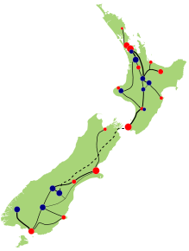
Content
Chilean Energy Challenge
Market Design Comparison
Conclusions

Slide 4
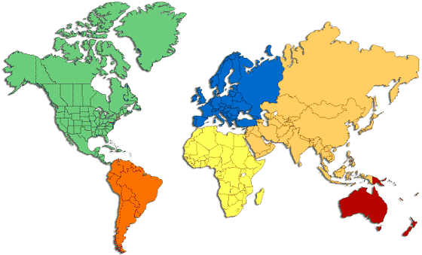
1. Chilean energy challenges Chile in the Region
17 million people vs. 4.5 million
Nearly 4200 km long.
756.626 km² vs. 268.021 km²
GDP per capita US$ 19.000 (2011) vs. US$ 30.000

Slide 5
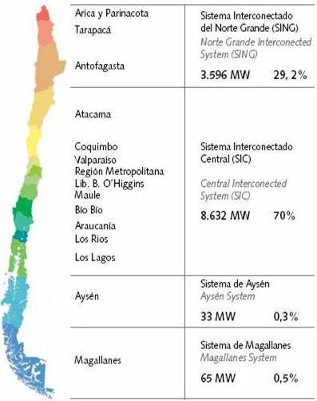
1. Chilean energy challenges Interconnected systems
Installed
capacity
in the country
3,800 MW 23,5 %
15,400 GWh
Chile Today
~ 18.500 MW
4000 km
12,600 MW 75,6 %
47,800 GWh
New Zealand
~ 10.000 MW
50 MW 0,3 %
99 MW 0,6 %
Fuente: http://centralenergia.cl

Slide 6
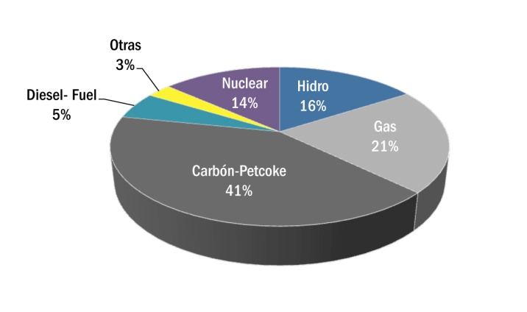
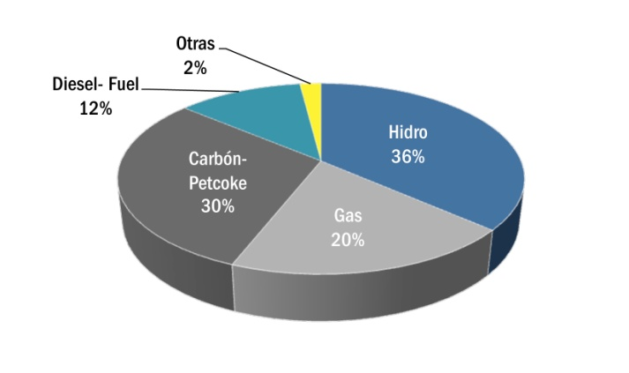
1. Chilean energy challenges Electricity generation matrix
WORLD 2008
Chile 2010
Source: OECD, CNE

Slide 7
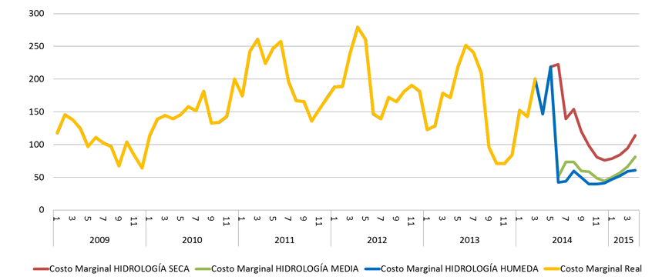
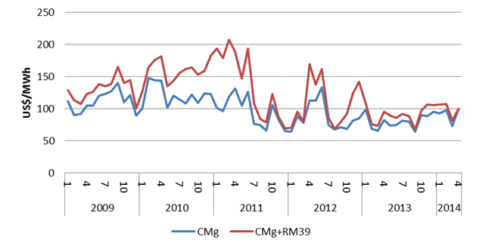
1. Chilean energy challenges Marginal Prices in SIC/SING
SIC
SING
Source:
Systep
CDEC SIC/SING

Slide 8
1. Chilean energy challenges Marginal Prices in SIC
Source:
Systep
CDEC SIC/SING

Slide 9

1. Chilean energy challenges Social opposition
  Fuente: H. Rudnick

Slide 10
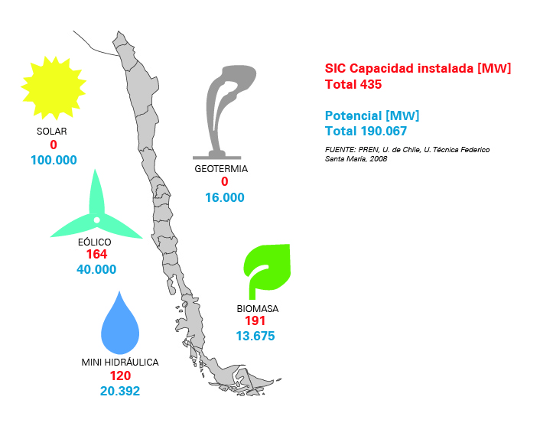
1. Chilean energy challenges Renewable Energy
Potential of renewable energies between 112.000 MW and 191.000 MW
Installed capacity of renewable energies 1236 [MW]
170
200.000
3.000-16.000
302
5.000-40.000
442
2.000-14.000
323
2.000-21.000

Slide 11
1. Chilean energy challenges Renewable Energy Law
20%

Slide 12
1. Chilean energy challenges Pillars of the new Energy Agenda
The government will take a more active role in the energy sector: historic lack of government engagement in planning and overseeing the energy sector has led to an industry in which most of the power and influence is highly concentrated in three powerful companies → territorial planning, strategic expansion, participation of state owned companies.
Stakeholder participation will be incorporated into key processes. → decisions that are trusted, transparent and supported by the public.
New natural gas market structure and management.
Energy efficiency gets the attention it deserves → new energy efficiency law “legal framework to convert [energy efficiency] into a long term State policy” → goal of reducing national energy consumption by 20% by 2025 compared to BAU projections.
Addressing concrete obstacles to renewables. The renewable energy sector is poised to penetrate the Chilean energy market in a huge way, with over 17 GW of projects in the pipeline → energy auctions heavily favors conventional projects. Financing is also more difficult for renewables.
Human capital development and innovation opportunities.

Slide 13
Content
Chilean Energy Challenge
Market Design Comparison
Conclusions

Slide 14
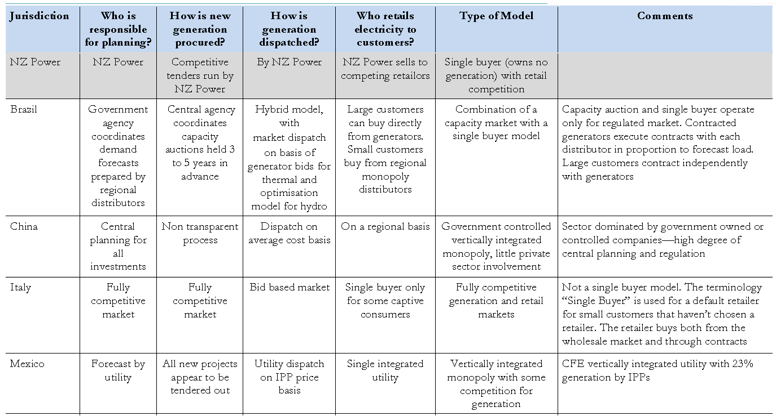
2. Market Design Comparison Comparison
Chile | Fully competitive for generation. Expansion study + Experts Panel for Tx | Fully Competitive | Economic dispatch with cost information and load forecast. | Large customers can buy directly from generators. Small customers buy from regional monopoly distributors | Mandatory pool with actual cost and technical parameters.
http://www.contactenergy.co.nz/web/pdf/general/castalia-review-international-experience-single-buyer-models.pdf

Slide 15
1. Market Design Comparison Market Design Alternatives
Basic Market Structures
Decentralized
Centralized
Physical
Bilateral
Contracts
Power
Exchange
Non- Mandatory
Pool (bid based)
Mandatory
Pool (cost based)
Single
Buyer
Monopoly
Utility
Financial Bilateral contracts

Slide 16
2. Market Design Comparison Market Design Alternatives
Chilean Market Structure
Decentralized
Centralized
Physical
Bilateral
Contracts
Power
Exchange
Non- Mandatory
Pool (bid based)
Mandatory
Pool (cost based)
Single
Buyer
Monopoly
Utility
Financial Bilateral contracts

Slide 17
2. Market Design Comparison Chilean Market model, 1982
Pioneering electricity reform in 1982
Beginning of the electricity market: DFL N 1/1982
  Wholesale market (only generators)
  Development through private investment (generation, transmission,
  distribution)
Regulation by the State at transmission & distribution level
  Tariff regulation for transmission & distribution
  Regulated monopolies, quality of service and supply
  Concession to use public areas and impose right-of-ways
  Indicative planning (generation)

Slide 18
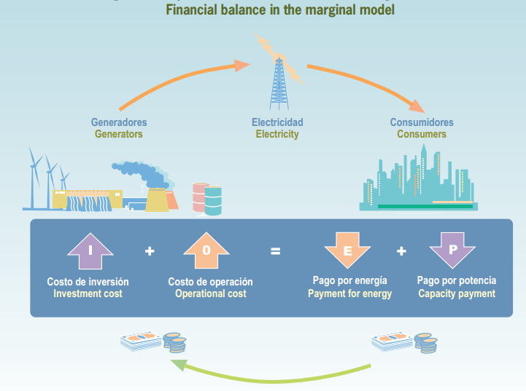
2. Market Design Comparison Chilean Market model, 1982
Basic Market Design:
- Market design is based on a mandatory Pool with audited costs and only
financial bilateral contracts.
Spot Price Calculation:
Based on a minimum operation cost and centralized dispatch
(UC Tools, Plexos, PCP).
Operation planning is carried out using hydro-thermal coordination which determines stored-water opportunity cost (PLP, OSE 2000).
Transmission is a regulated sector. Marginal incomes are transfer to transmission owner reducing transmission charges.

Slide 19

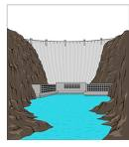


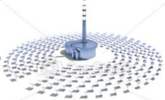


Generation Mix
Comment
Only peak
load units
CP = investment
EP = VC
E. Matrix
1980
CP + EP =
investment + VC
E. Matrix
2000
Natural gas
E. Matrix
2010
Diesel + Coal
E. Matrix
2020

Slide 20





2. Market Design Comparison Pool basic operation
Injection
Generator
Blue
100 MWh
Injection
Generator
green
Injection
Generator
Red
150 US$/MWh
Purchase
Generator
Red
70 MWh
PPA
Between
customer
and
Generator Red
Generator balance
for hour (h) in the
spot market
=
100 X 150 – 70 X 150 = 30 x 150 = 4500 US$

Slide 21
2. Market Design Comparison Market Design Alternatives
New Zealand Market Structure
Decentralized
Centralized
Physical
Bilateral
Contracts
Power
Exchange
Non- Mandatory
Pool (bid based)
Mandatory
Pool (cost based)
Single
Buyer
Monopoly
Utility
Financial Bilateral contracts

Slide 22
2. Market Design Comparison NZ: Observed Problems
  Prices are rising faster than in many of our major competitor countries.
  The way our market works means prices paid are not related to production costs. Instead, all generators are paid the same price, whether they are using the public water resource or expensive gas. Electricity in New Zealand is traded at a wholesale level in a spot market where every half an hour the price is set by the generator who supplies the most expensive electricity. That price is then paid to every generator, no matter how low their actual costs of production are.
  There is a lack of competition in the electricity market. There is considerable evidence that the electricity market is not competitive, especially in the market for residential customers.
  The concentration of retailers in companies owned by major generators. Promoters of the current approach to the electricity sector have always hoped that a vibrant, dynamic market would develop with many buyers and many sellers. This has not occurred.
  No one plans the New Zealand energy sector and ensures it operates for the benefit of all New Zealanders. Some investment decisions (Transpower) are closely monitored, while others (generators) are left completely to the market.
https://www.labour.org.nz/sites/default/files/issues/20130418_NZPower_Policy_Document.pdf

Slide 23
1. Market Design Comparison Market Design Alternatives
NZ proposed Single Buyer
Decentralized
Centralized
Physical
Bilateral
Contracts
Power
Exchange
Non- Mandatory
Pool (bid based)
Mandatory
Pool (cost based)
Single
Buyer
Monopoly
Utility
Financial Bilateral contracts

Slide 24
2. Market Design Comparison Single Buyer NZ: Proposal
  A new Agency will be created: NZ Power.
  It will have for energy sector planning. It will be required to determine future investment needs for generation and seek competitive proposals for the construction of new plant. It will not own generation plants or guarantee their profitability, but it will ensure NZ has the right amount and type of generation.
  NZ Power will act as a single buyer of wholesale electricity. It will have the power to set prices. NZ Power’s goal will be to sell electricity at lower, fairer and more predictable prices.
  The current pricing model will be dumped. Each generator will be paid a fair return for their actual costs, calculated by NZ Power on the basis of their historic capital costs, plus operating costs like fuel, depreciation and maintenance.
  There will be a cost based price pool for wholesale electricity, with generators still offering bids of available electricity supply and the single buyer dispatching the lowest cost bids.
  NZ Power or Transpower will make decisions on what generation should be dispatched at any point in time based not just on the submitted bids by generators, but will seek to optimise short and medium-term issues like fuel supplies. It will have the ability to direct that available capacity be used, even if it has not been bid, thus avoiding the ability of generators to use market power to maximise short-term profits by withholding low-cost generation.
https://www.labour.org.nz/sites/default/files/issues/20130418_NZPower_Policy_Document.pdf

Slide 25
2. Market Design Comparison Single Buyer NZ: Proposal
  NZ Power will sell electricity to retailers on the basis of long-term contracts. Large individual industrial users could contract directly with NZ Power.
  NZ Power will plan for new generation and invite offers to build new plants. New generation can be purchased via long term contract negotiated by the single buyer through competitive tender. The cost of that new generation will be averaged into the retail market.
  One of the advantages of single buyer procurement is that energy efficient alternatives (or move demand to avoid the need for more expensive peak supply) can be considered alongside new generation alternatives. Currently generators, lines companies and retailers are all rewarded for selling or carrying more electricity.
  NZ Power will require the owners of the existing major electricity companies to separate their retail arms into separate, standalone companies with separate boards and management
https://www.labour.org.nz/sites/default/files/issues/20130418_NZPower_Policy_Document.pdf

Slide 26
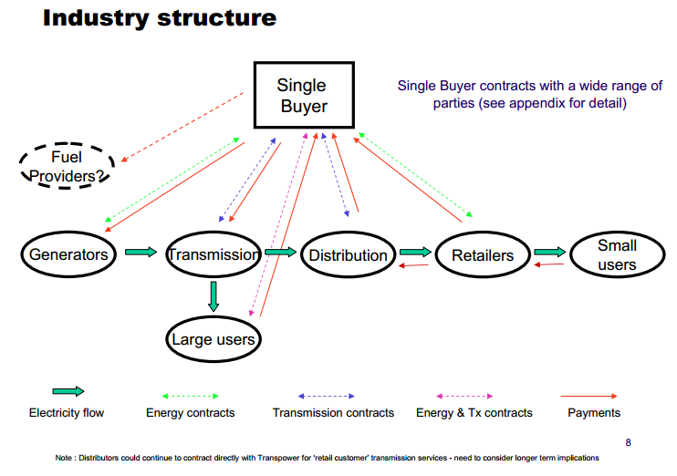
2. Market Design Comparison Single Buyer NZ: Proposal

Slide 27
2. Market Design Comparison Comparison
http://www.contactenergy.co.nz/web/pdf/general/castalia-review-international-experience-single-buyer-models.pdf

Slide 28
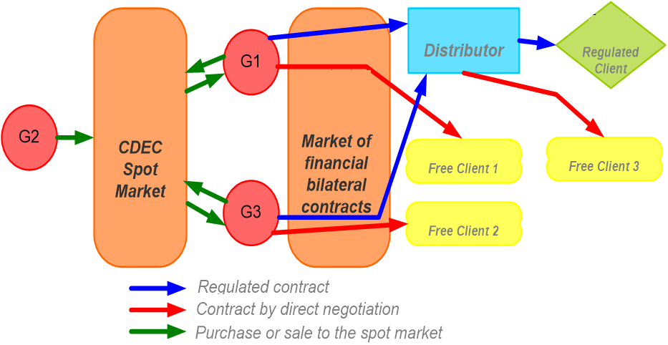
Chilean Electricity Market
General case
2. Market Design Comparison Energy / Cash Flows
(ISO+MO)
Santiago, 10 de Agosto de 2012
CE-FCFM

Slide 29

2. Market Design Comparison Energy / Cash Flows
Chilean Electricity Market
Only spot market sales
(ISO+MO)
Santiago, 10 de Agosto de 2012
CE-FCFM

Slide 30


2. Market Design Comparison Energy / Cash Flows
Chilean Electricity Market
Only spot market sales
(ISO+MO)
Santiago, 10 de Agosto de 2012
CE-FCFM

Slide 31





2. Market Design Comparison Energy / Cash Flows
Chilean Electricity Market
Spot market + Free Customer FBC
(ISO+MO)
Santiago, 10 de Agosto de 2012
CE-FCFM

Slide 32




2. Market Design Comparison Energy / Cash Flows
Chilean Electricity Market
Spot market + Free Customer FBC + Regulated Customer FBC
Santiago, 10 de Agosto de 2012
CE-FCFM

Slide 33

2. Market Design Comparison Energy / Cash Flows
Chilean Electricity Market
Spot market + Free Customer FBC + Regulated Customer FBC
(ISO+MO)
Santiago, 10 de Agosto de 2012
CE-FCFM

Slide 34

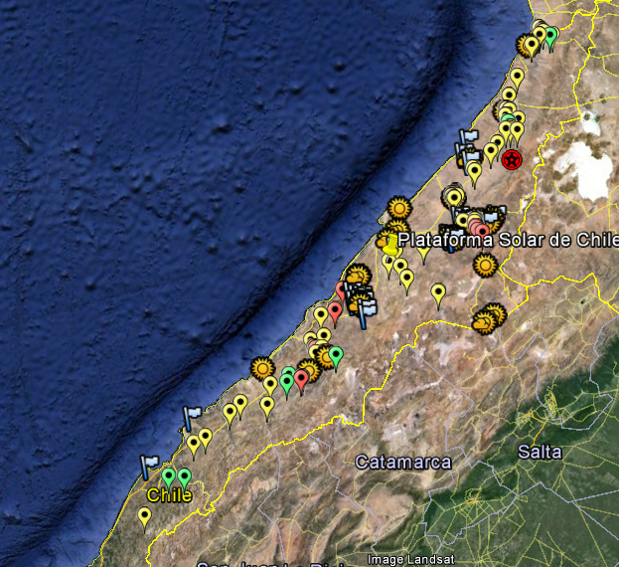
Solar Projects: locations
Notes:
Exceptional conditions: Atacama desert is the region with the highest solar irradiation in the world (2500 kWh/m2). As comparison, the solar potential of Almeria in Spain, one of the best loactions in Europe with XXX kWh, is comparable with the potential in Santiago.
According with our experience the main relationships that must be taken into consideration are:
Solar water treatment (V) and energy storage solutions (IV) are key factors driving new approaches to the incorporation of solar energy in the mining industry (I), the first stemming from the water scarcity/consumption by the production process and the second arising from the need for continuous operation.
Electric power systems with high penetration of solar energy (II) need to find ways of dealing with a variable solar generation source, in which energy storage solutions (IV) can play an important role in compensating the variations in solar energy injections.
Cost-effective solar energy approaches for the industry (I) must be compatible with a bulk power network operation with high penetration of solar energy (II). A careful and synergic design of the system interfaces between the industry and the power network is required.
The solar water treatment research line (V) will incorporate a sub-line for the characterization and measurement of solar radiation in the Atacama region. The research results will be shared with other research lines that can improve their models with the specific radiation pattern.
Solar energy coordination systems for rural and urban communities (III) will provide efficient coordination interfaces with the main interconnected grid (II). Community engagement methodologies in the introduction of solar-based smart microgrids will be studied for new regulatory/social approaches (VI).
In the perspective of a real world impact of the new generated knowledge, research lines I to V will cover a wide range of economic/social/regulatory issues (VI) on overcoming different type of barriers. For example, technical solutions can be compatible with different market/tariff structures.
Weather forecasting and atmospheric models will supply key information to all of the research lines (I to VI).

Slide 35
New operation strategies of the hydrothermal system

Slide 36
Content
Chilean Energy Challenge
Market Design Comparison
Conclusions

Slide 37
Conclusions
  Quick overview about the Chilean electricity market (challenges & structure).
  Who would be facing the risks due to uncertainties in fuel prices, technology developments, failures, etc.?
    Decision making power (errors in decisions) vs Risk
    Decision making power vs Competition
  In the case of a single buyer approach with centralized dispatch based on cost information → gaming → model parameters: Pmin, costs, cycling, maintenance, take or pay, ..)
  Exchanges at marginal costs (Spot prices) seems to be a good allocation scheme among generators → base/reference scenario.
  High penetration of renewable energy and storage devices imposes new challenges in pricing schemes.

Slide 38
Chilean market design for a single buyer approach
Prof. Rodrigo Palma Behnke
Mrs. Angela Flores
July 9th

