Slide 1
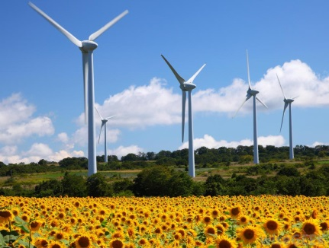

Integrating Renewable Energies in Power Systems
Ruth Domínguez Martín
University of Castilla – La Mancha
Spain

Slide 2
Outline
Spanish electricity market
Operation of renewable-dominated electric energy systems
Conclusions

Slide 3
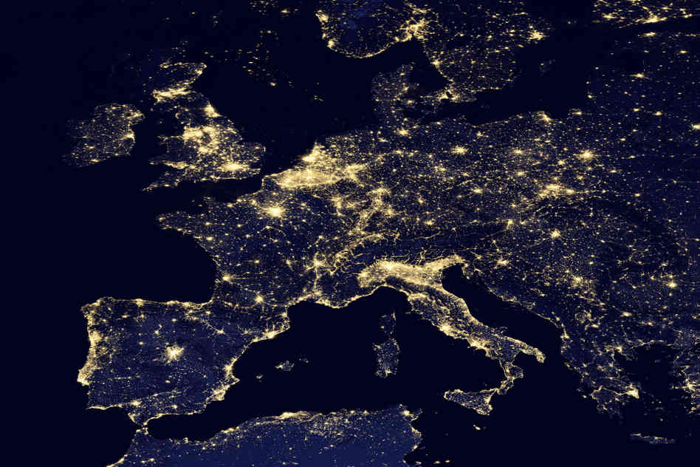
Spanish Electricity Market

Slide 4
Spanish Electricity Sector: Evolution
Until 1988
Oil Crisis 1970’s → reduce oil dependency
Building of coal, hydroelectric and nuclear plants
Marco Legal Estable
1988: oversized generating system
Liberalization of the sector
Law 54/1997: liberalization of the electricity sector
Still a public sector
Two operators: OMEL (PX) and REE (TSO)

Slide 5
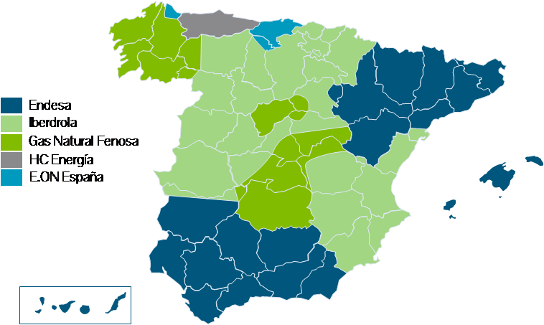
Spanish Electricity Sector: Distribution
Companies
Notes:
Then, under this framework, the government divided the terrotory into a few areas and assigned the distribution service to a few companies.

Slide 6
Spanish Electricity Market: Market Structure
Day-ahead market: the PX (OMIE) receives the bids from producers/consumers, and clears the day-ahead market for the 24 hours of the following day.
The TSO (REE) checks the feasibility of the scheduling in the network, and performs the required resdispatch if necessary.
After that, the TSO manages the reserve (secundary and terciary) markets and deals with the technical constraints of the power system. Only qualified units can participate.
6 intra-day markets are cleared during the day by the PX. Only participants in the day-ahead market are allowed to submit offers.
Notes:
The adjustment markets are now very important for wind producers since a few hours before the delivery time they have a better prediction of the available wind power, and so they can adjust their schedules in the daily market.

Slide 7
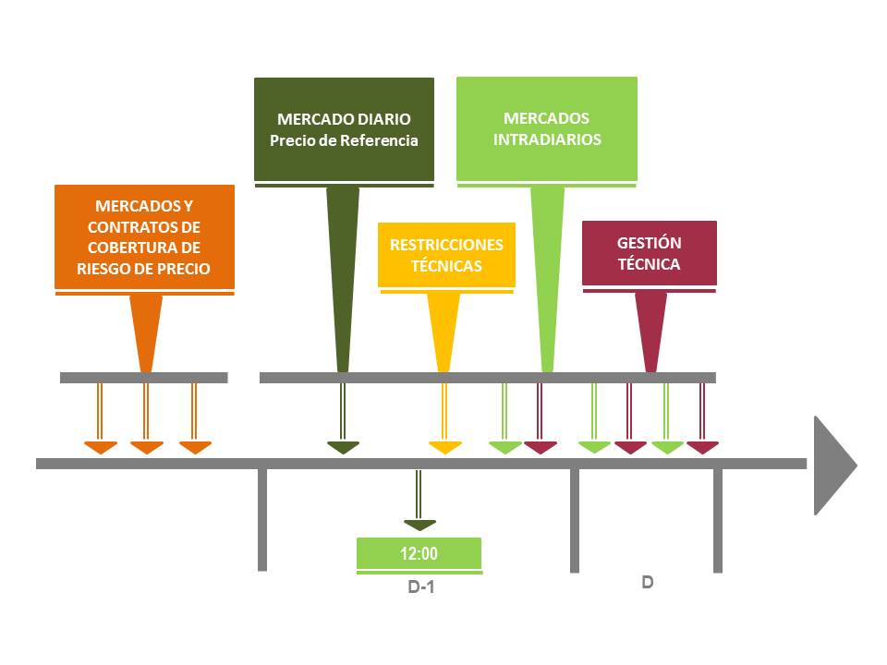

Spanish Electricity Market: Time Framework
Notes:
In this figure, we can see the whole picture of the electricity market
Futures market and bilateral contracts

Slide 8
Spanish Electricity Market: Bids
All available production units that are not bound by physical bilateral contracts are obliged to present bids for the daily market.
Buyers on the electrical power market are reference retailers, resellers and direct consumers.
Bids can comprise between 1 and 25 energy blocks in each hour (€/MW).
Electricity sale bids: simple or complex (indivisibility, load gradients, minimum income, scheduled stop)
Notes:
Electricity sale bids presented by sellers to the market operator may be simple or incorporate complex conditions in terms of their content. Sellers for each hour and production unit present simple bids, indicating a price and an amount of power.

Slide 9
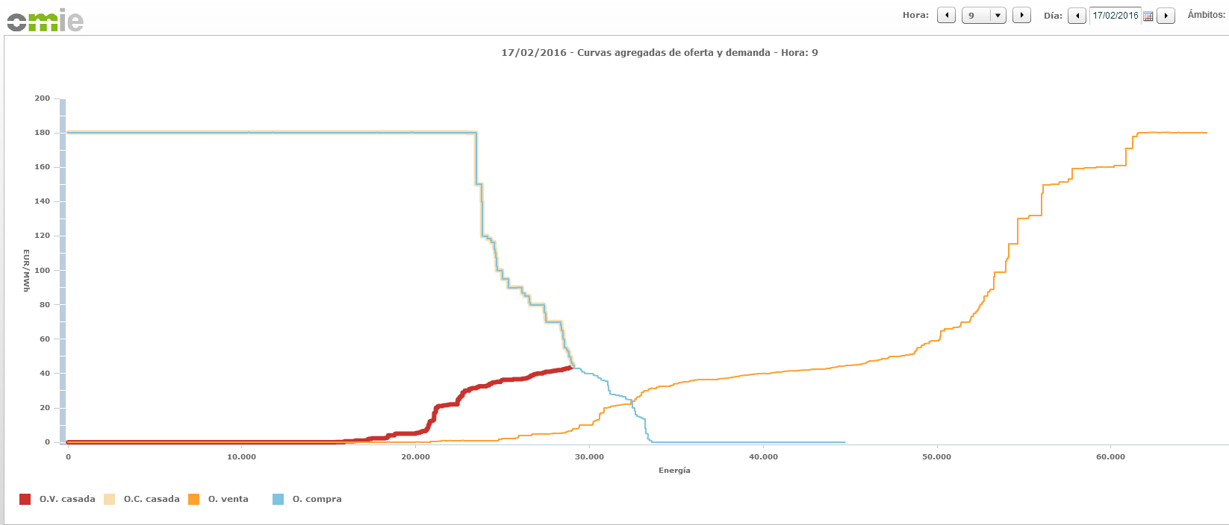
Spanish Electricity Market: Supply/Demand Curves

Slide 10
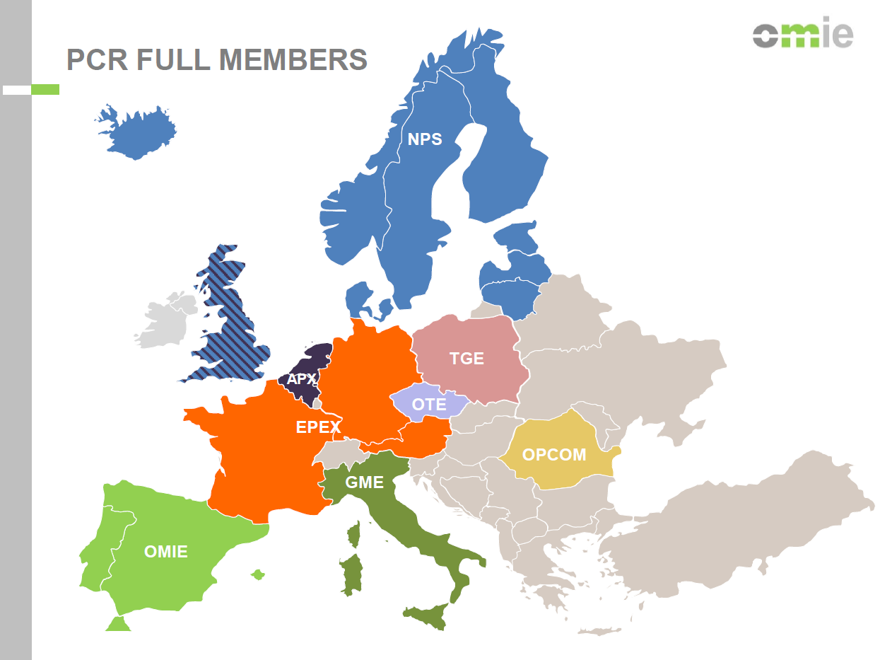
Day-ahead Market: European Coordination
PCR (Price Coupling of Regions): is the project of European Power Exchanges to develop a single price coupling solution to be used to calculate electricity prices across Europe and allocate cross-border capacity on a day-ahead basis
Project is currently being operated by seven
Power Exchanges: EPEX SPOT, GME, Nord
Pool, OMIE, OPCOM, OTE and TGE
Notes:
From a few years ago, the daily market is organized in a coordinated-way with other European PXs.

Slide 11
Day-ahead Market: PCR
PCR is used to couple the following countries: Austria, Belgium, Czech Republic, Denmark, Estonia, Finland, France, Germany, Hungary, Italy, Latvia, Lithuania, Luxembourg, the Netherlands, Norway, Poland, Portugal, Romania, Slovakia, Slovenia, Spain, Sweden and UK.
EUPHEMIA is the algorithm implemented to determine the electricity prices and to allocate cross-border limits among countries. This algorithm optimizes the overall welfare and increases transparency in prices and flows.
Notes:
24 countries
Maximization of the social welfare

Slide 12

EUPHEMIA algorithm
53 bidding areas / 67 lines
Each PX operates several bidding areas
All bidding areas are matched at the
same time
A different price can be obtained for
each bidding area
The price for the bidding area must
respect maximum and minimum price
market boundaries

Slide 13
EUPHEMIA algorithm
Considers a wide range of network restrictions:
  Ramping limit for individual or set of lines between consecutive hours
  Line tariffs
  Line losses
  Hourly and daily net position ramping limits for bidding areas
Output:
  Price per bidding area
  Net position per bidding area
  Flows per interconnection
  Matched energy for each block

Slide 14
European Electricity Market: Next Steps
Load Frequency Control and Reserves: closer cooperation in reserve procurement among European TSOs
Electricity Balancing: to increase the efficiency of trading day-ahead, intra-day and balancing services at cross-border level

Slide 15
Spanish Power System: Volumen of Energy

Slide 16



Spanish Power System: Particularities
Isolated: only connection to France through the Pirineos Mountains
Coal: social issues (subsided to maintain jobs)
Wind and CCGT capacities
Duopoly and a half
Solar PV and self-production/consumption

Slide 17
Spanish Power System: Hydropower
Dry country: low resource availability
Average annual use: 2000 hours (1000 hours in dry years)
Strategic units: fast and flexible, and storage capacity
Use: peak demand (highest electricty prices), and ramping and reserve needs (supply quality)
Largest units:
  Aldeadávila (1962/1986): 1243 MW
  José Mª de Oriol (1970): 957 MW
  La Muela II (enlarged 2015): 1750 MW turbine and 1280 MW pump (largest in Europe)
Notes:
Hydroelectric resources are already exploited

Slide 18
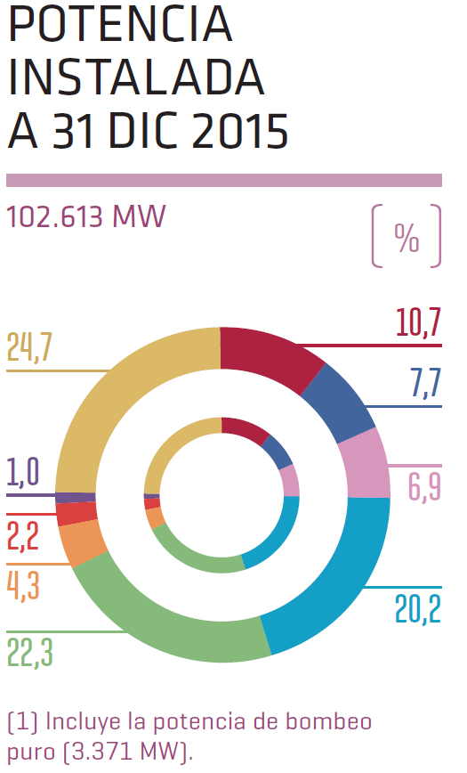
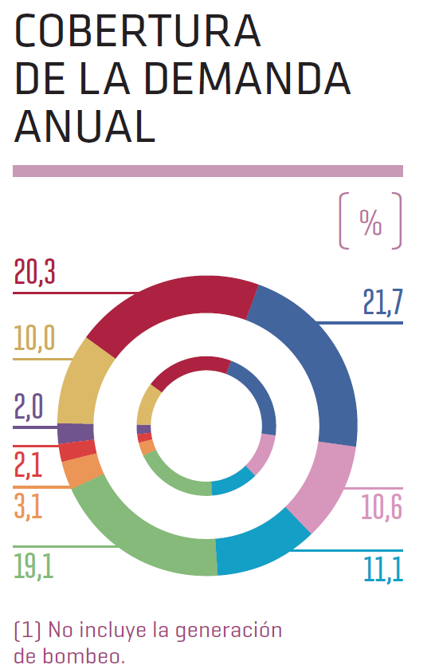

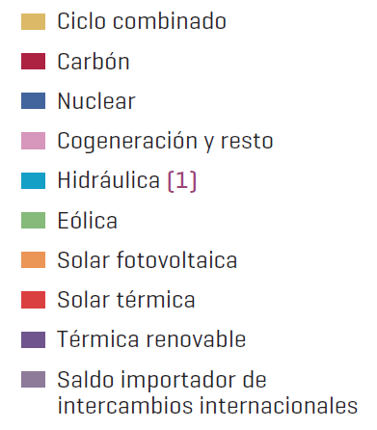
Spanish Power System: 2015
Notes:
Nuclear
Coal
Wind
CCGT
Hydro capacity: 20 GW -> 11% of electricity supply
Demand supply 2013: wind 21%

Slide 19
Spanish Power System: Capacity (MW)
Notes:
2015: 27% reduction in hydro -> increase in non-renewable participation
2015: new hydro-pump unit 878MW (La Muela)

Slide 20
Spanish Power System: Generation (TWh)

Slide 21

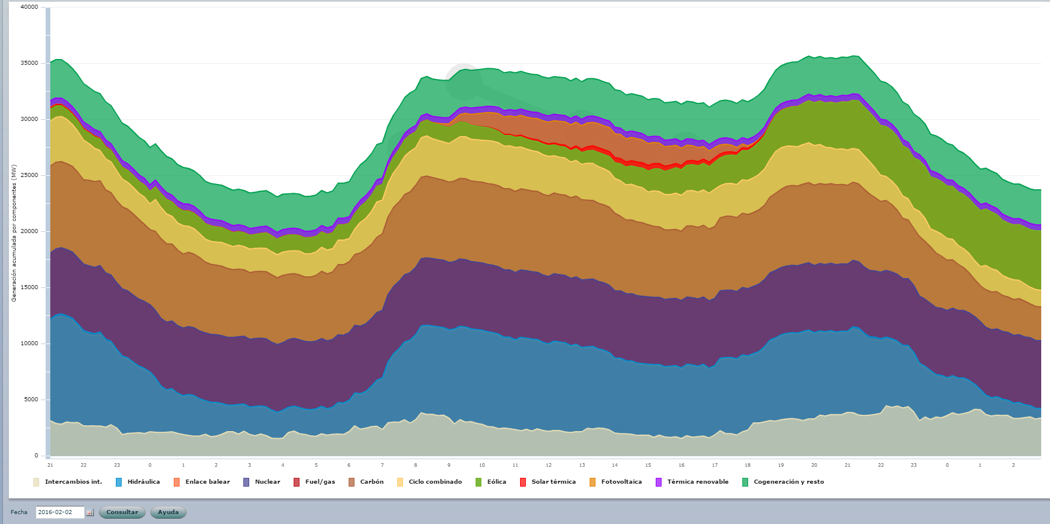
Spanish Power System: Hourly Demand (MW)
Notes:
2nd February

Slide 22
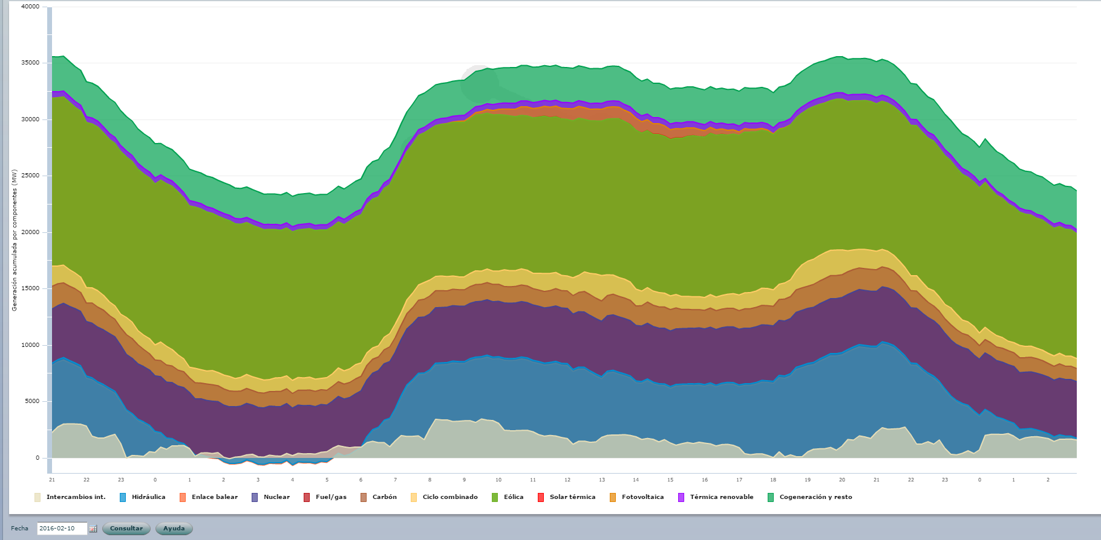
Spanish Power System: Hourly Demand (MW)
Notes:
10th of February

Slide 23
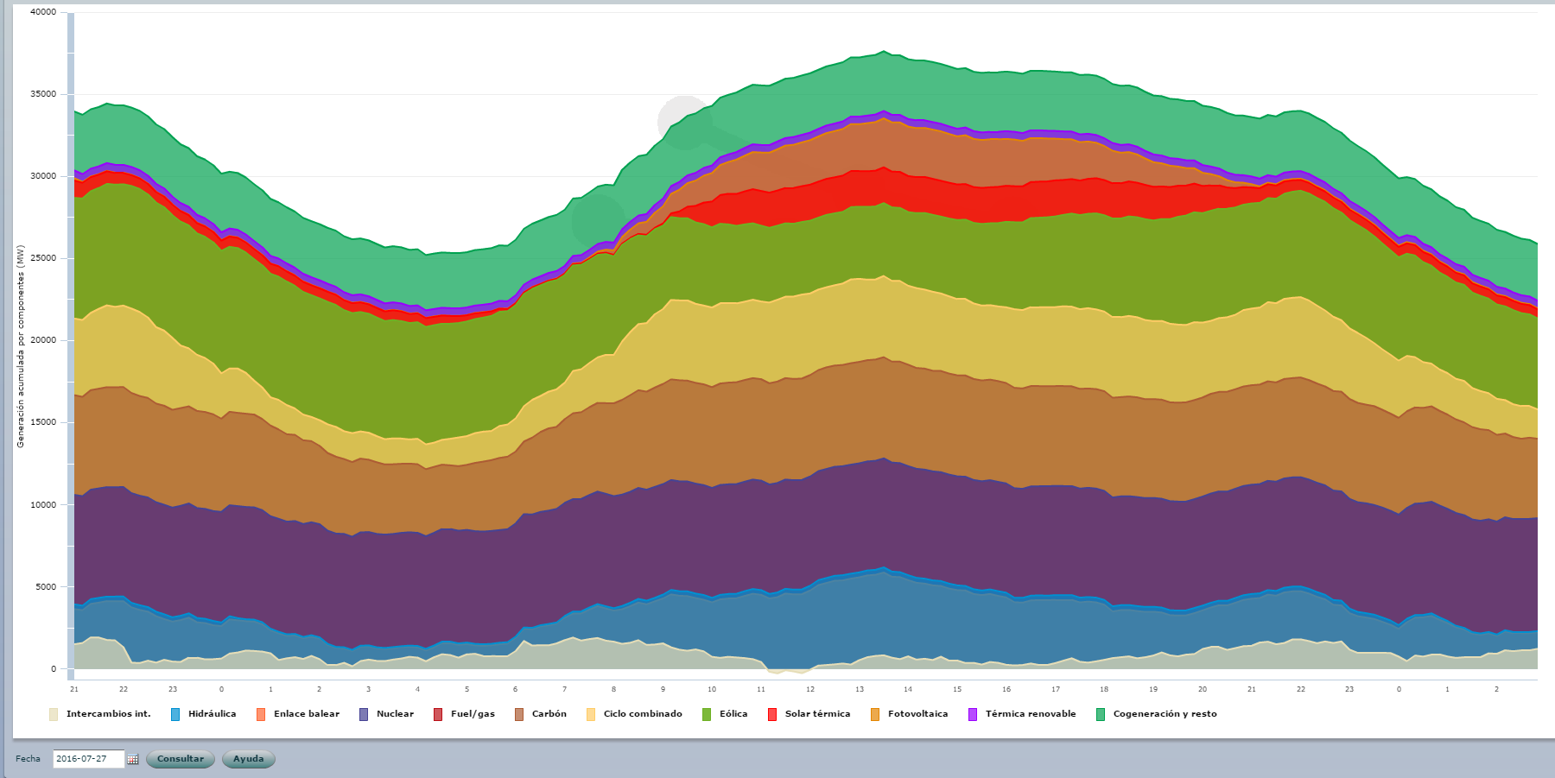
Spanish Power System: Hourly Demand (MW)
Notes:
27th July

Slide 24
Spanish Electricity Market: Prices (annual)
Historic average annual total price (€/MWh)

Slide 25

European Electricity Market: Prices (monthly)
Average monthly price from the day-ahead market in Europe 2015 (€/MWh)

Slide 26
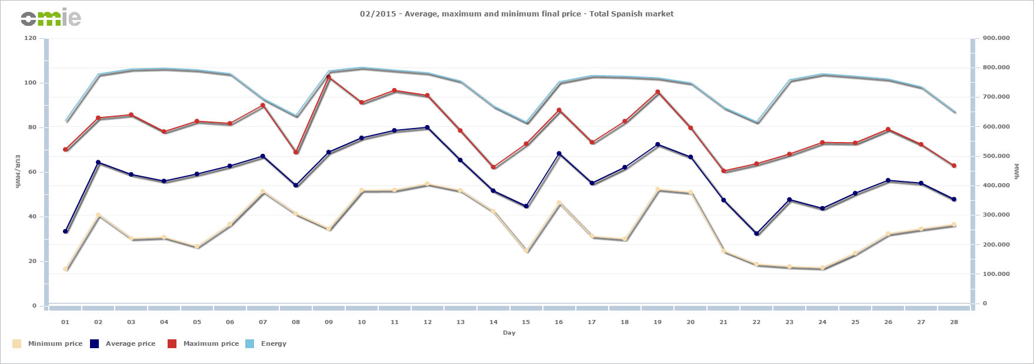
Spanish Electricity Market: Prices (weekly)
Total price: high wind/hydro month (Feb, 2015)
Notes:
In the next figures, we will see the prices over the week in high and low wind months

Slide 27
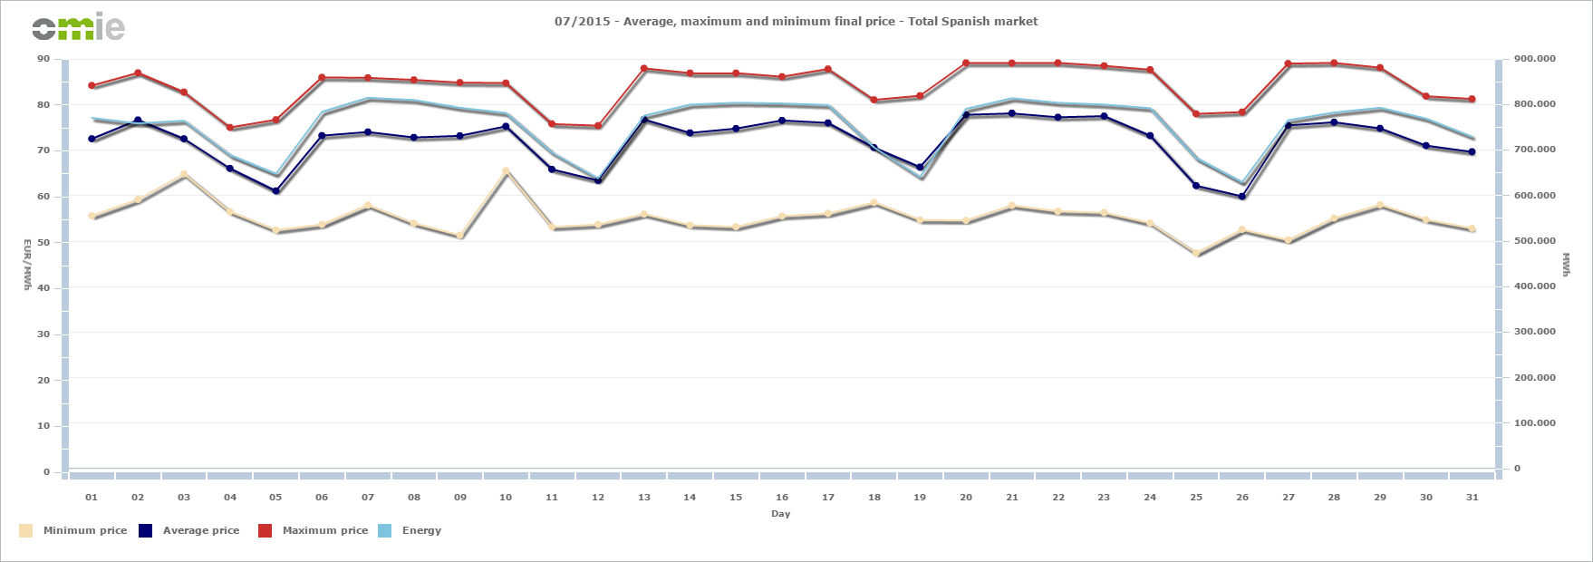
Spanish Electricity Market: Prices (weekly)
Total price: low wind/hydro month (July, 2015)

Slide 28
Spanish Electricity Market: Small Consumers
PVPC (voluntary price for the small consumer): no higher than 10 kW
Two terms:
  Cost of electricity generation, based on day-ahead and intra-day market prices (2015)
  Fixed cost: imposed by the Ministry of Industry (taxes related to mantain the
  reliability of the system)

Slide 29
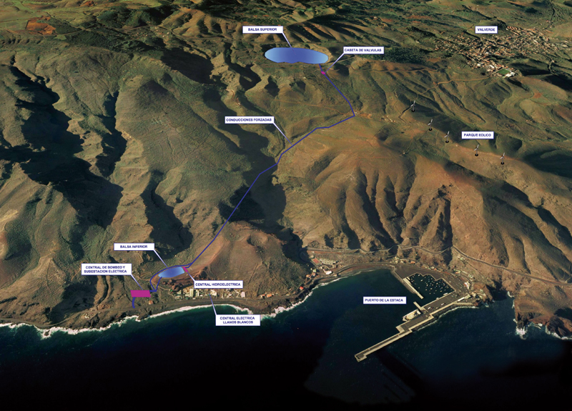
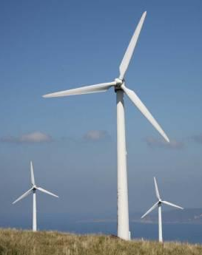
Spanish Power System: HydroWind
An example of sustainable development: El Hierro Island (Canarias)
Wind plant: 11 MW
Turbine capacity: 11 MW
Pumping plant: 6 MW
09/08/2015: 100% renewable
Notes:
The hydro-wind project integrates a wind farm, a pumping seta hydro-electrical plant. The wind farm is able to supply electrical energy directly to the network, while simultaneously feeding a pumping set which dams water in an elevated deposit as an energetic storage system. The hydroelectrical plant uses this stored potential energy, guaranteeing both electrical supply network stability.
The wind farm carries out the capture transformation of wind energy into electrical energy.
When the hydraulic system operates as a pump, it accumulates excess energy; when it operates as a generator, it produces electrical energy regulates the island’s electrical system.
In 2005, the electrical demand was 35 GWh; the electrical power currently installed (Diesel) is 11.36 MW. The current growth rate of the demand for energy has been 8%, although it is expected to stabilise in the short term (3-5 years) at an annual rate of 4%.
The project is aimed at the design, development, construction commissioning of a hydro-wind system able to cover the electrical demand of the island of El Hierro, making this island a territory that is self-supplied in terms of electricity, strictly through renewable energies.
The system will be made up of two water deposits, a wind farm, a hydroelectrical plant, a pumping planta diesel engine plant (existing). The operation’s philosophy is based on supplying the electrical demand of the island with renewable sources, thus guaranteeing the stability of the electrical network; the diesel engine plant will only operate in exceptional/emergency cases, when there is not enough windwater to produce the demanded energy.
With the hydro-wind plant, an intermittent energy source can be transformed into a controlled constant electrical supply, thus optimising the use of wind energy. In this way, the thermal plant operates as a backup by way of reserve, only during periods when there is an absence of wind, minimising the consumption of fossil fuels.
The electrical demand foreseen for the design amounts to 48 GWh/year in the year 2015, based on the energy planning for the Canary Islands, PECAN 2006; nevertheless, the dimensioning of the conduction of waterdeposits will be created based on the demand foreseen for the year 2030, since they are not extendable in a modular way. Likewise, the higher capacity of the deposit will be increased in to meet the water needs required by the island.
2.1.- TECHNICAL CHARACTERISTICS -
The Hydro-wind project is made up, at this time, of the elements listed below:
Top Deposit: Located at the "La Caldera” crater, it will have a maximum capacity of 380,000 m³two drain intakes with PVC-sheet waterproofing; it will be repairable under the water.
Bottom Deposit: Located in the vicinity of T.C. “Llanos Blancos”. It will have a useful capacity of 150,000 m³ made up of a dam built for this purpose, with loose materialsPVC-sheet waterproofing; it will be repairable under the water.
Forced conductions, formed by two aerial pipes with a 530 m stretch under a thistle area in the gallery. 0,8 m diameter, 3015 m discharge conduction, 1 m diameter, 2,350 m turbine capacity conduction 1 m, 188 m aspiration conduction.
Pumping Plant: installed in a newly-constructed building, it will be constituted by 2 1500 kW pump sets6 500 kW pump sets, with a total power of 6 MW. With 1500/500 kW variators.
Turbine Capacity Plant: Constituted by 4 Pelton groups of 2,830 kW of power each, for a total power of 11.32 MW. The maximum flow during generation is 2.0 m³/s, with a gross head of 655 metres.
Wind Farm: Constituted by a set of 5 aerogenerators (Enercon E-70) with 2.3 MW of power each, for a total power of 11.5 MW.
Electrical Sub-station with Interconnection between the hydraulic plant, pumping plant wind farm. It will be located in an area adjacent to the Llanos Blancos Sub-station, with a double bar-system, a double switch, a connection point in the Llanos Blancos Sub-station.

Slide 30
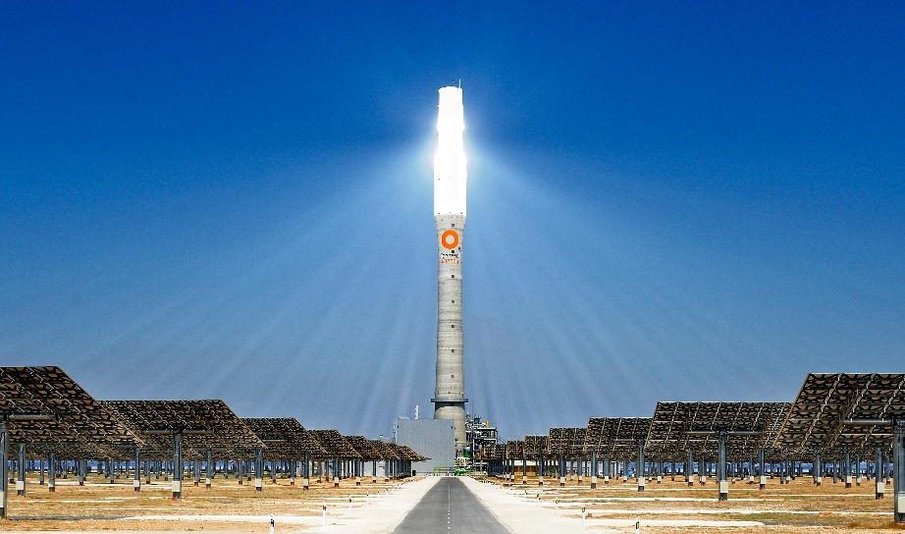
Operation of Renewable-dominated Electric Energy Systems

Slide 31
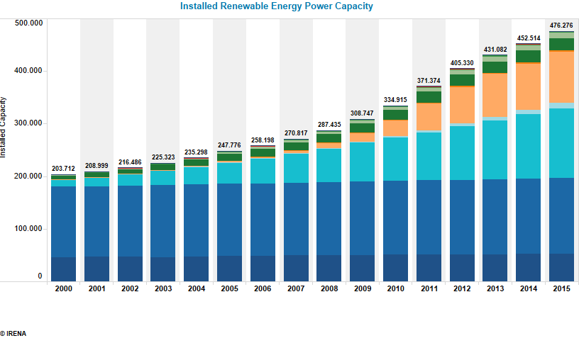
Motivation
Europe (MW)
Hydro-pump
Large hydro
Wind (onshore)
Wind (offshore)
Solar (PV)
Biomass (solid)
Biogas
Geo and others

Slide 32

Motivation
How does an appropriate level of flexibility facilitate the operation of the system?
R. Domínguez (*), A. J. Conejo (**), M. Carrión (*). Operation of
a fully renewable electric energy system with CSP
plants. Applied Energy, vol. 119, pp. 417-430, 2014.
(*) UCLM (Spain); (**) The Ohio State University (Ohio, US)

Slide 33
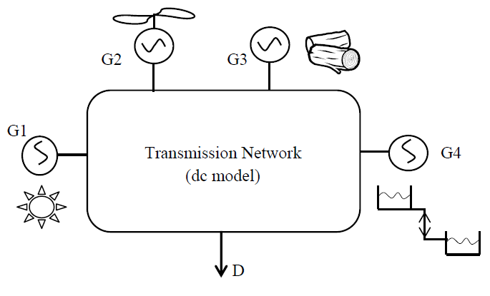
Operating Fully Renewable EES: Objective
To schedule energy and reserves in the day-ahead market, taking into account the uncertainty of the stochastic power production in the real-time operation.

Slide 34
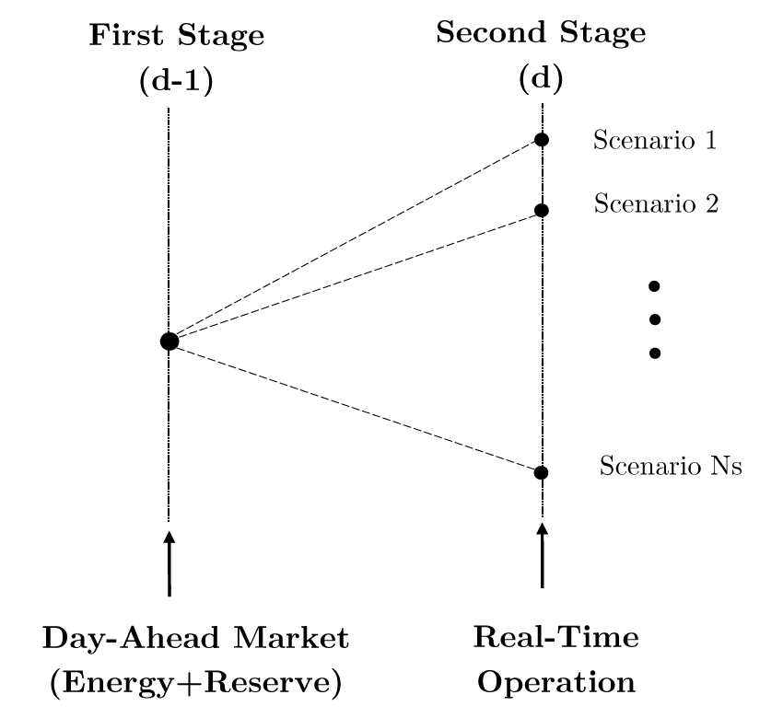
Operating Fully Renewable EES: Decision Process
Two-stage stochastic
programming problem:

Slide 35
Operating Fully Renewable EES: Model Description
Independent System Operator (ISO) perspective
Two types of renewable units:
  Dispatchable units: biomass
  Non-dispatchable units: wind and solar
Storage facilities: pumped-storage units
Biomass units can provide reserve services through scheduled and non-scheduled reserves
Demand side management through reserve services

Slide 36
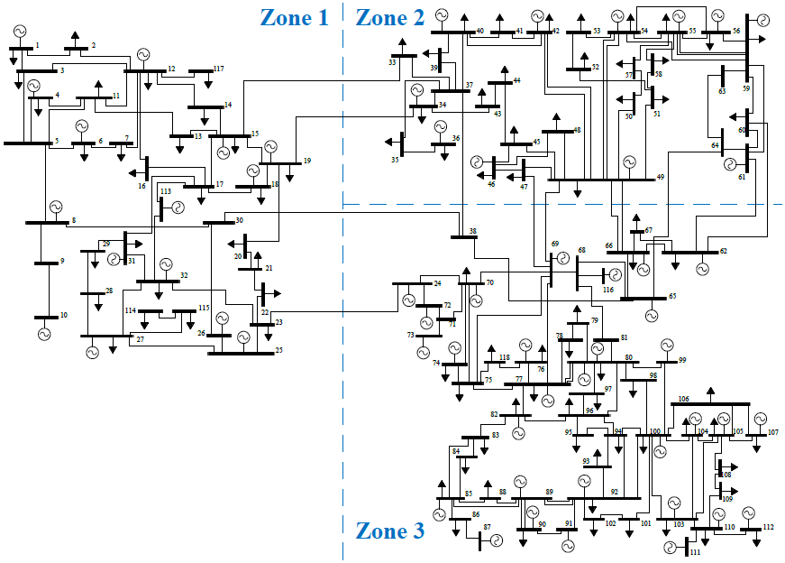
Operating Fully Renewable EES: Case Study
IEEE 118-node system
95 demands
Wind
CSP+TES
Biomass
Pumped-storage

Slide 37
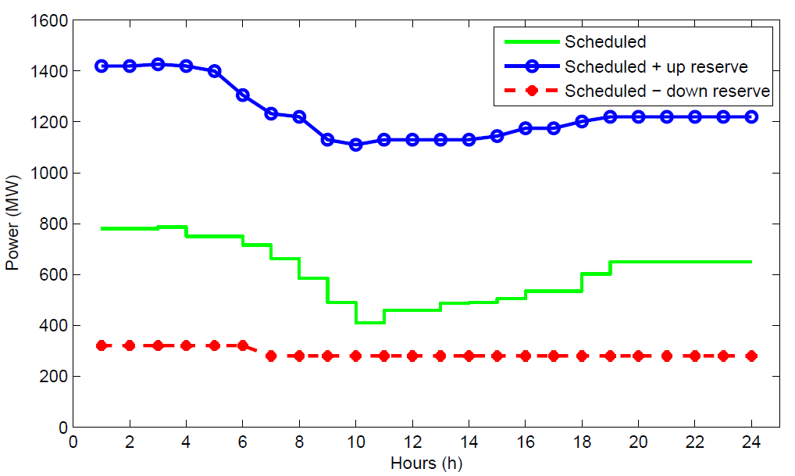
Operating Fully Renewable EES: Results
Power and reserves scheduled by biomass units (day-ahead scheduling)

Slide 38
Operating Fully Renewable EES: Results
Power generated per technology in high/low wind scenarios (real-time operation)

Slide 39
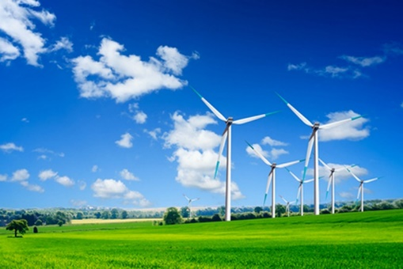
Conclusions
Renewable-dominated power systems represent a more sustainable solution in order to reduce GHG emissions and to avoid nuclear power plants.
However, the stochasticity associated to the renewable resource availability may make difficult to ensure supply quality.
Therefore, back-up technologies are required. A small flexible thermal capacity in the system allows a better integration of renewable production.
If no GHG emissions are allowed, large energy storages need to be built, which may represent a more expensive alternative.

Slide 40
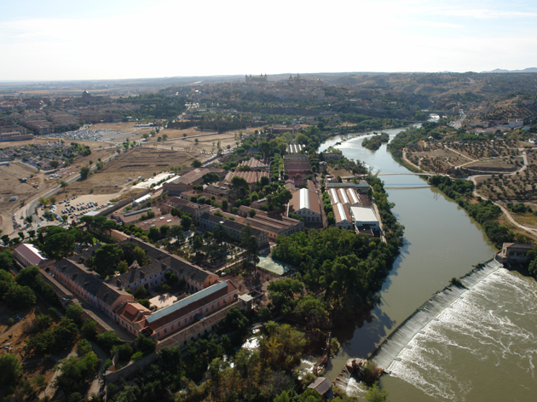


Thanks for your attention!

