Slide 1
MBIE talk for EPOC – Sept 11

Slide 2
Or
How modelling influences policy - or not (?)

Slide 3
A quick bit of history
Pre 1987 - National electricity models – central planning
Central planning – 5 year plan
Least cost stochastic models – Monte, Prism
Objective function simpler – optimal build pattern that minimises cost and least cost dispatch schedule.
Mainframe computers
1987 adds SOEs – WACC becomes important
More sophisticated stochastic dynamic models – Spectra
Unix mini computers
Within company models
1996 Contact split from ECNZ, 1999 ECNZ split
Gaming models, portfolio/risk management
Objective function now more complex, more dimensions to problem
Fast PCs

Slide 4
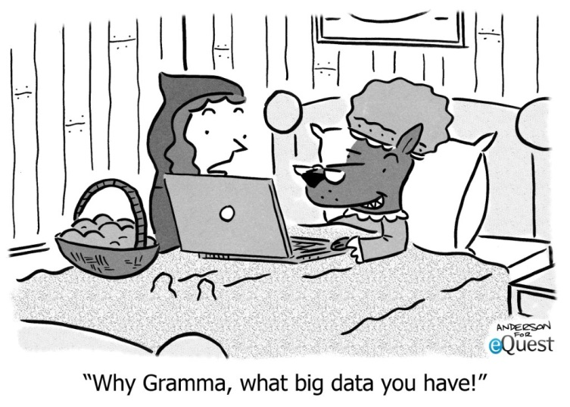
Today’s environment
Competitive electricity market
Companies optimising for profit maximisation
What about national picture?
Quasi equilibrium and equilibrium models, System dynamic models
Very sophisticated models => many dependent assumptions
Scenario modelling
Fundamentally what has changed
Older models simpler – solve least cost problem for best future
Today
We explore different views or scenarios of the future
But new uncertainties about climate and policy settings, technology and competitor behaviour
Assumptions and interpretation become critical

Slide 5
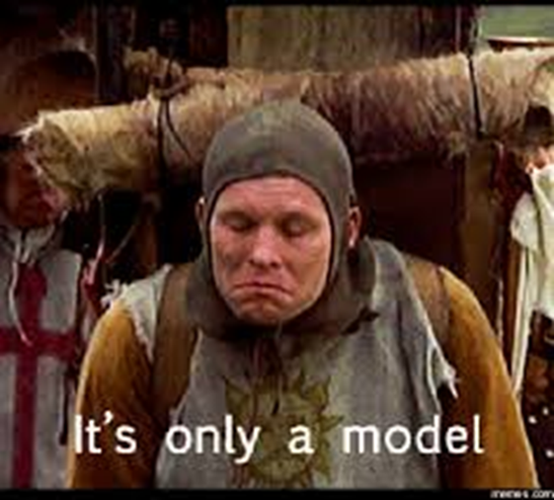
The perils of scenario modelling
Today - a lot of emphasis goes into model development to create highly complex models with thousands of equations and variables.
But the model is only as good as the input.
Typically scenarios are developed to test different hypothesis
One approach is to map scenarios out as the extreme points in some solution space e.g. EDGS
Another is to pick likely future paths and compare. e.g. ICCC
Usually, none have been optimised in the sense of a “best” or preferred plan, as would have been done under central planning.
So care is needed in how you interpret and compare results.

Slide 6
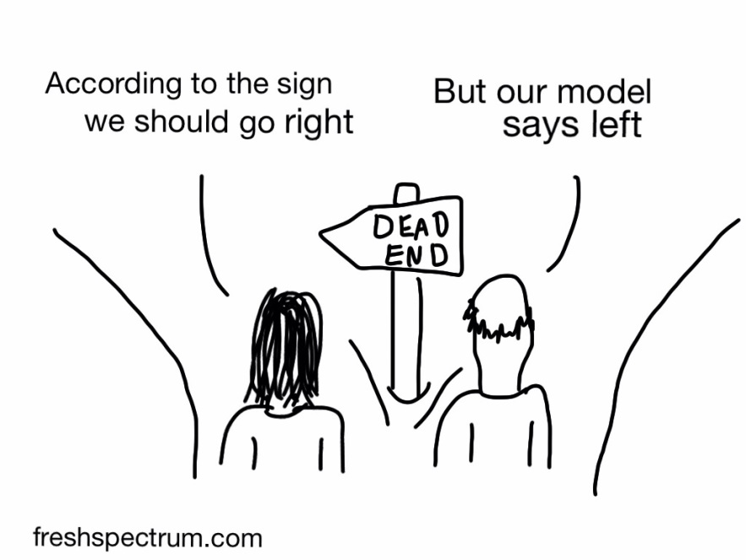
How to get it right
Get buy in on assumptions from stakeholders
Ensure model is appropriate, understood and accepted before you start
Engage with stakeholders, have credible results you can explain
Know the limitations of the model and assumptions

Slide 7
When has it gone right
The ICCC “Accelerated Electrification” report provides a good example of recent success.
Get buy in on assumptions from stakeholders
Had extensive consultation with key stakeholders during process through working group
Ensure model is appropriate, understood and accepted before you start
Largely, used existing accepted models with respected operators
Engage with stakeholders, have credible results you can explain
Engaged with key stakeholders to work through results and gain feedback before public release
Know the limitations of the model and assumptions
Was careful not to go beyond model capabilities

Slide 8
When has it gone wrong
The Wolak Report (2009) and TPM CBA are good examples.
Get buy in on assumptions from stakeholders
Nope
Ensure model is appropriate, understood and accepted before you start
TPM (2019) CBA is a radical change from previous, Wolak model did not have appropriate counter-factual - capped at thermal peaker SRMC
Engage with stakeholders, have credible results you can explain
Both talked, but critics argue they didn’t listen. TPM – 0-$6.4 m range ?
Know the limitations of the model and assumptions
Wolak model did not account for NZ water values, TPM (2016) model had serious flaws. TPM (2019) still being evaluated.

Slide 9
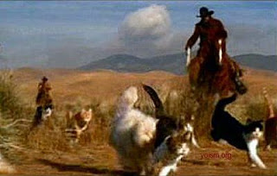
So why does this matter
Many policy decisions rely on analytical support.
Getting the modelling wrong can undermine the policy. This was the case with Wolak’s report and TPM (2016)
And as a result achieving good policy becomes more difficult - like herding cats.

